Slide 1
MBA6262 Entrepreneurship
Stephen Daze
Dom Herrick Entrepreneur in Residence and
Visiting Professor
uOttawa, Telfer School of Management

Slide 2

@sdaze
Pt Prof. Entrepreneurship - 14 years; and, Entrepreneur in Residence, uOttawa Telfer School of Management.
Founder: Agawa Entrepreneurship Development Corporation: & www.coachmystartup.com.
Managing Director Entrepreneurship and Innovation: Ottawa Centre for Research and Innovation - 14 years.
Graduate: 1) uRegina – Business Degree; 2) St FX Adult Education Program; 3) Babson College Entrepreneur Educators Program; and 4) LeanLaunch Pad Educators Program, Stanford.
Previous: - Director: Ottawa Chamber of Commerce
  - Chair: Manning Innovation Awards
  - Queen Elizabeth II Diamond Jubilee Medal Recipient
  - Ottawa Innovation Centre Advisory Panel

Slide 3
Not specific to technology, the course provides students with an opportunity to learn and experience first-hand, the early part of the new venture creation process. Students will work to conceive, validate and create a viable business model for a new venture within the 3 week time frame.

Slide 4
The Course is Not About:
Technology businesses only.
Business plans.
Theoretical research.
Me telling you what is right and you passing the course by telling me what I told you.

Slide 5
The course will:
Emulate a start up experience: a bit chaotic, fast paced, urgent, learning by doing, changing rapidly, etc.
You will have to:
Act fast: i.e. finalize business idea by EOD. (The idea is not as important as you think.)
Talk to customers and key stakeholders.
Iterate and re-iterate, building a viable business model.
Embrace being wrong.
Incorporate feedback freely and report on it.

Slide 6
Session 1 - Content/groups/ideas
Session 2 – Presentations/Lab
Session 3 – Lab/Next Steps
Session 4 - Final Presentations

Slide 7
1. Individual Blog
  Summary of learnings/lessons + application to your project
2. Presentation X2
3. Report (Summary and final)
  Business model
  Description of efforts, learnings and iterations of business model
  Next steps

Slide 8



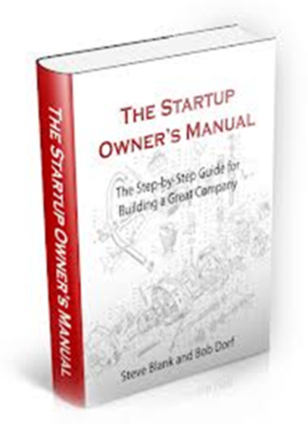
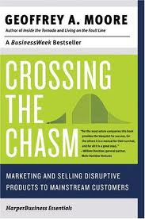
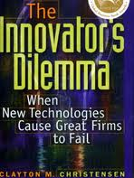
..or others.

Slide 9
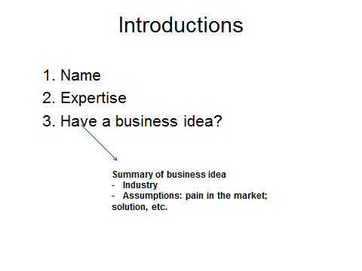

Slide 10
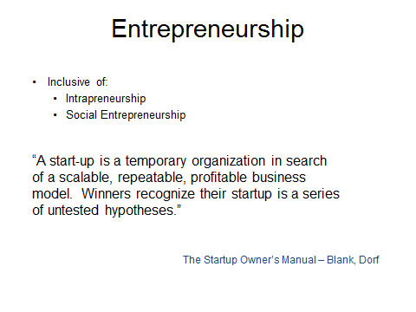

Slide 11
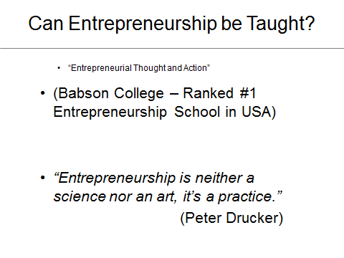

Slide 12
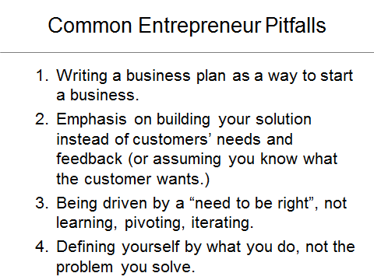

Slide 13
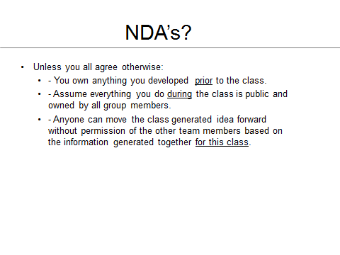

Slide 14
Idea Generation
for Entrepreneurs

Slide 15

Fundamental Premise
“
”
Entrepreneurship is neither a science nor an art.
It’s a practice.
- Peter Drucker
Generating business ideas is nothing more then practice surrounded by some core principles.

Slide 16
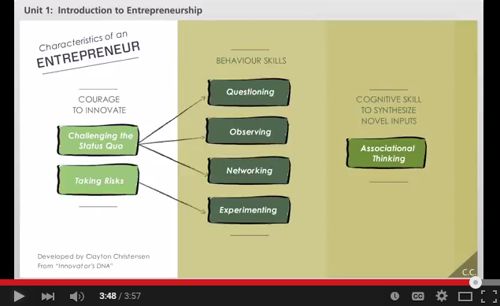

Foundation Elements of Entrepreneurial Idea Seeking
Innovator’s DNA:

Slide 17
Ideas and their Value
Ideas:
  Often not shared enough out of fear.
  Don’t determine success – executing on an idea does.
  Evolve and change, rarely staying the same over time.
  Are infrequently stolen; but could be stolen at any time.

Slide 18
Entrepreneurial Idea Seeking
Job/Hobby/Great Business Idea
Interest:
Excited
Stay awake
Want to learn
Passionate
Personal Assets:
Network
Expertise
Resources
Good idea for someone else!
Great Business Idea!
Opportunity:
Gap/need
Customers
Economics ($)
Hobby
Job

Slide 19
Idea Generation Principles
1

Slide 20
Idea Generation Principles
A
Good Business Ideas Generate Enough Revenue.
They have a value proposition for a critical mass of addressable customers.
Value Proposition
There is enough pain for someone to pay for a solution; and,
Relative to competition.
Critical Mass
Big enough market to matter.
Addressable
I can reach them with my revenues greater than expenses.

Slide 21



Idea Generation Principles
B
Ideas evolve over time or start as mistakes
Evolve over time
(eg. Facebook, Blackberry)
Start as mistakes
(eg. 3M Sticky Notes.)

Slide 22

Idea Generation Principles
IKEA - Ingvar Kamprad founded IKEA in 1943 at his Uncle Ernst’s kitchen table. IKEA was basically an acronym of his name Ingvar Kamprad and Elmtaryd, his family farm and the village Agunnaryd. At first the business was typically mail-order and included only small household goods such as picture frames, wallets, nylon stockings, pens and wallets.

Slide 23

Idea Generation Principles
Nintendo: The Nintendo Corporation’s domination of the gaming industry didn’t start with their first video game console. They have actually established themselves 70 years before the first video game came to life, in the 19th century when they brought back the popularity of card games to Japan. A new card game, Hanafuda, was invented, by Fusajiro Yamauchi (Nintendo founder) which used images instead of numbers, making it difficult for gambling.

Slide 24
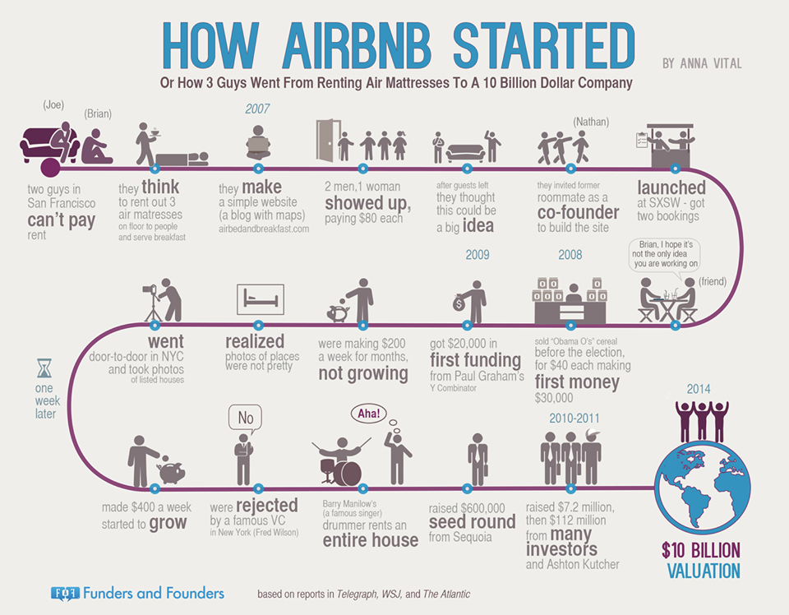

Slide 25

Idea Generation Principles
Netflix : The genesis of Netflix came in 1997 when I got this late fee, about $40, for Apollo 13. I remember the fee because I was embarrassed about it. That was back in the VHS days, and it got me thinking that there's a big market out there.
So I started to investigate the idea of how to create a movie-rental business by mail. I didn't know about DVDs, and then a friend of mine told me they were coming. I ran out to Tower Records in Santa Cruz, Calif., and mailed CDs to myself, just a disc in an envelope. It was a long 24 hours until the mail arrived back at my house, and I ripped them open and they were all in great shape. That was the big excitement point.

Slide 26

Idea Generation Principles
C
Ideas can come from anywhere, most often we see good business ideas starting with one (or more) of the following:
Personal Pain
I have a problem that needs solving.
120,000 customers
80 countries
$2B
valuation

Slide 27

Idea Generation Principles
C
Ideas can come from anywhere, most often we see good business ideas starting with one (or more) of the following:
Market Gap
A critical mass of customers are looking for a solution.

Slide 28

Idea Generation Principles
C
Ideas can come from anywhere, most often we see good business ideas starting with one (or more) of the following:
Interest
I love this so much, I can see myself working on it 24/7.

Slide 29

Idea Generation Principles
C
Ideas can come from anywhere, most often we see good business ideas starting with one (or more) of the following:
Insight
I understand the industry and see where it is going.
~$2B
1998
2015

Slide 30
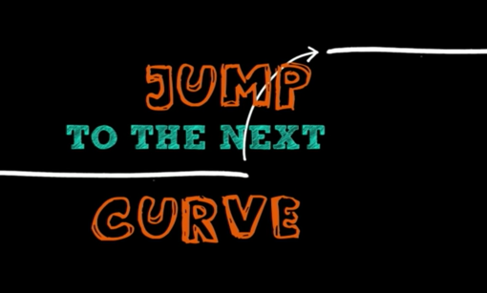

Idea Generation Principles
D
Ideas are truly innovative when you invent brand new solutions and industries rather than make an existing one a bit better.
Guy Kawasaki on Innovation (4:14 – 6:47):

Slide 31
Idea Generation Principles
The best business ideas satisfy most (or all) conditions
  If your current idea doesn’t, look to evolve it sufficiently such that it does.
Good Business Ideas
Necessary conditions:
Can make money (or not loose it): has value (value proposition) to a critical mass of addressable customers.
And
Evolve over time.
Usually start with one or a combination of:
  Personal pain (I have a problem that needs solving.)
  Market gap/need (Others will pay for a solution.)
  Interest (I can see myself doing this 24/7.)
  Insight (I understand the industry and the trends.)
Jump the innovation curve.

Slide 32
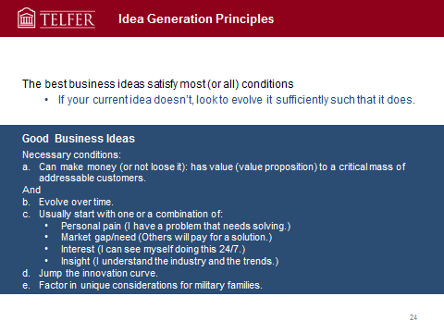
Exercise
1
Generate as many potential business ideas as you can. They don’t have to be good.
2
Look to combine ideas, eliminate and make existing ideas as good as possible.
3
Pick the best business idea.
4
Prepare to discuss why this is the best idea.

Slide 33
Other Considerations
3

Slide 34

Other Considerations
Expanded Thinking: Business Opportunities
What are the businesses associated with coffee?

Slide 35
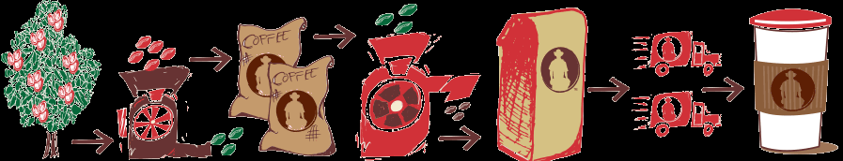
Any more?

Slide 36
Coffee Marketing Chain
Production Initial processing
Smallholder
Medium-sized farmers
Large farms and estates
Collection
Trader
Initial processing
(wet)
Manufacturer
Assembling
Trader/Agent
Curing
(hulling, grading)
Cooperative union
Manufacturer
Intermediation
Auction/Brokers
Shipping
Exporters
Roasting
Domestic roasters
Distribution
Wholesalers and retailers
Consumption
Domestic consumer
Importing consumer

Slide 37
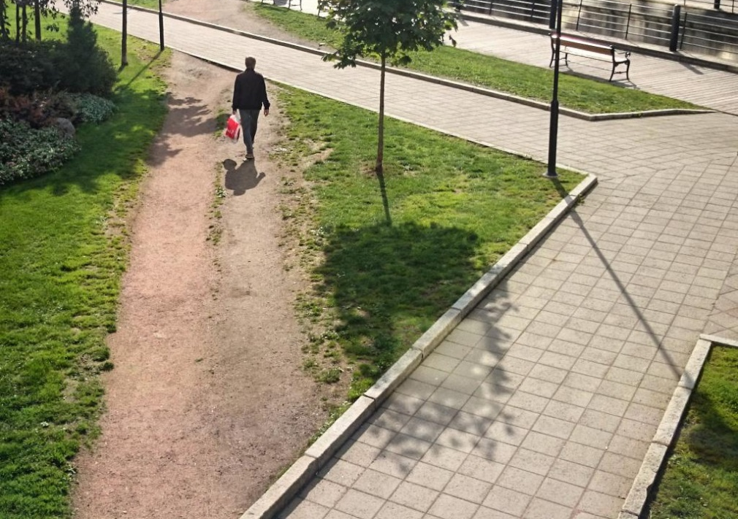
Other Considerations
User-centered Design

Slide 38
Concluding Thoughts?

Slide 39
Business Models

Slide 40
Business Models
A sketch/summary of what the business will do and how it will make money.
Includes strategic components of the business idea and how it operates.
Often established based on trial and error.
Forms the basis for success or failure.

Slide 41
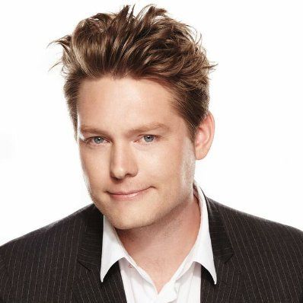
Why are Business Models Important?
Uber, the world’s largest taxi company, owns no vehicles.
Facebook, the world’s most popular media owner, creates no content.
Alibaba, the most valuable retailer, has no inventory.
And Airbnb, the world’s largest accommodation provider, owns no real estate.
Something interesting is happening.
Tom Goodwin,
Sr. Vice President of strategy and innovation at Havas Media

Slide 42
Business Models vs. Business Plans
Business Plans
Assume full knowledge of the market, solution and customers.
Don’t require a lot of external interaction.
Are a useful implementation tool, focusing much on operationalizing strategies.
Usually written too soon; often not written at all.
Business Models
Assumes evolution: discovery and iteration.
Forces “getting out of the building” to talk with clients.
Forms foundation for success or failure.

Slide 43
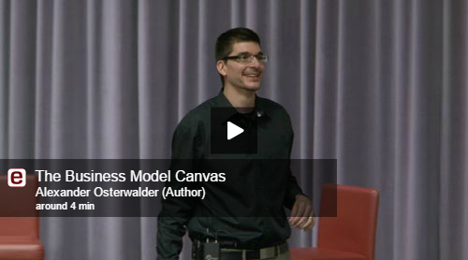
Business Model Canvas

Slide 44
The following slides thanks to Steve Blank and the Lean LaunchPad Educators Program

Slide 45
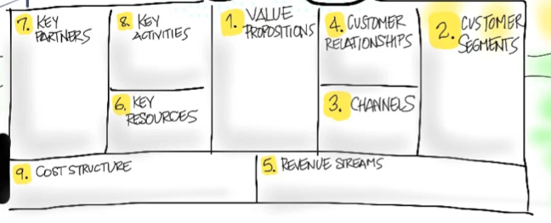
Value Proposition
What Are You Building and For Who?

Slide 46
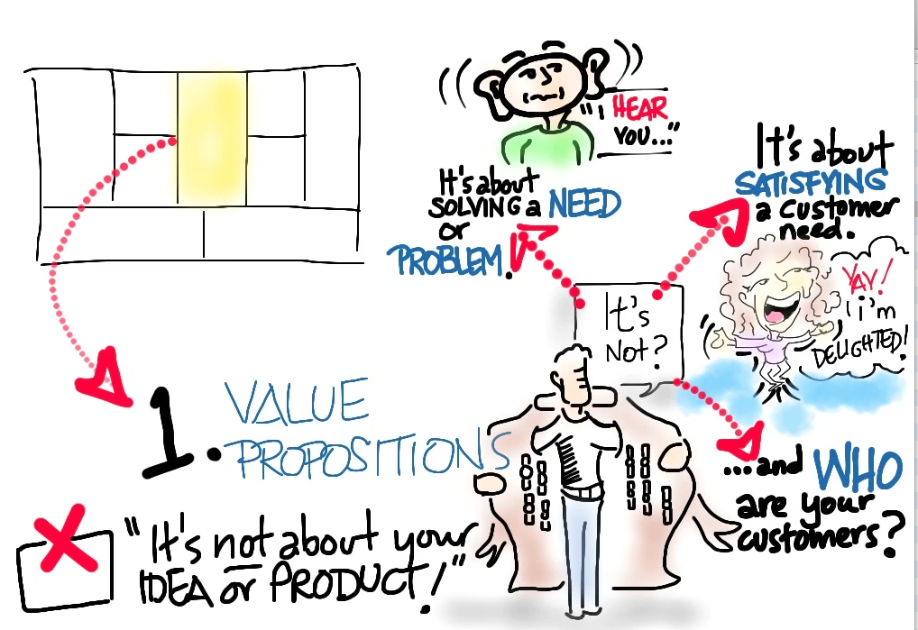

Slide 47
Customer Segments
Who Are They?
Why Would They Buy?

Slide 49
Multiple Customer Segments
Might have multiple segments of users
Might have users and payers
Might have 5 or 6 different customers
  Medical devices have doctors, hospitals, patient, insurance company, FDA, etc.
For every customer segment you need:
  Value proposition
  Revenue model
  And may have unique channels, customer relationships, etc.

Slide 50
Product/Market Fit
Does the Value Proposition MVP Match the Customer Segment Archetype?

Slide 51
Channels
How Does Your Product
Get to Customers?

Slide 53
Customer Relationships
How Do You Get, Keep and Grow Customers?

Slide 55
Revenue Streams
How Do You Make Money?

Slide 57
Key Resources
What Are Your Most Important Assets?

Slide 59
Key Partners
Who Are Your Partners and Suppliers?

Slide 61
Key Activities
What’s Most Important for the Business?

Slide 63
Cost Structure
What Are the Costs and Expenses?

Slide 65
BUT...

Slide 66
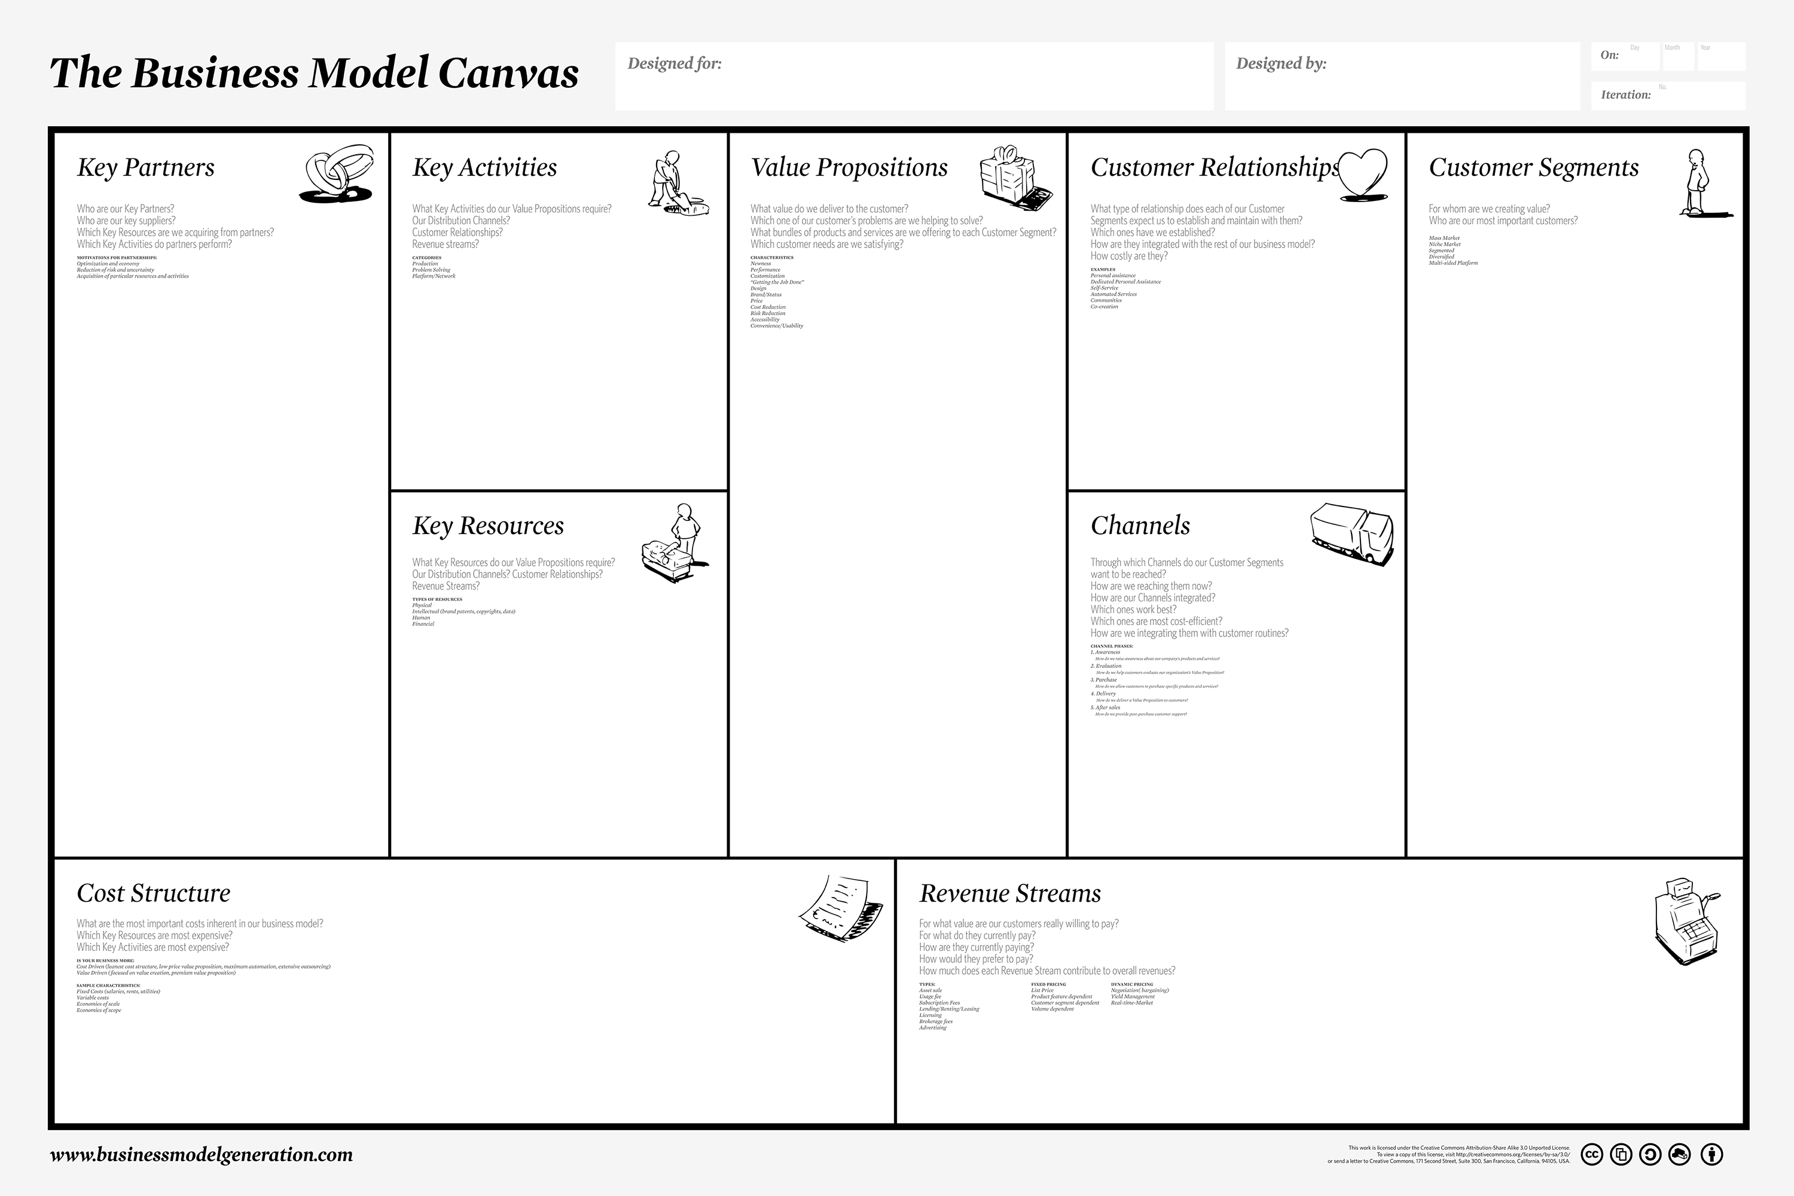
They Are All Guesses
Guess
Guess
Guess
Guess
Guess
Guess
Guess
Guess
Guess

Slide 67
We have to Validate (test) our
Assumptions
Test the Problem, then the solution.

Slide 68

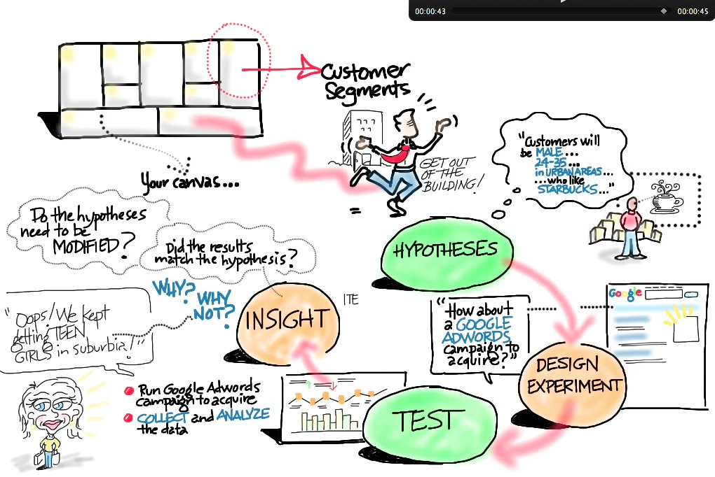

Slide 69
Business Model Examples

Slide 70
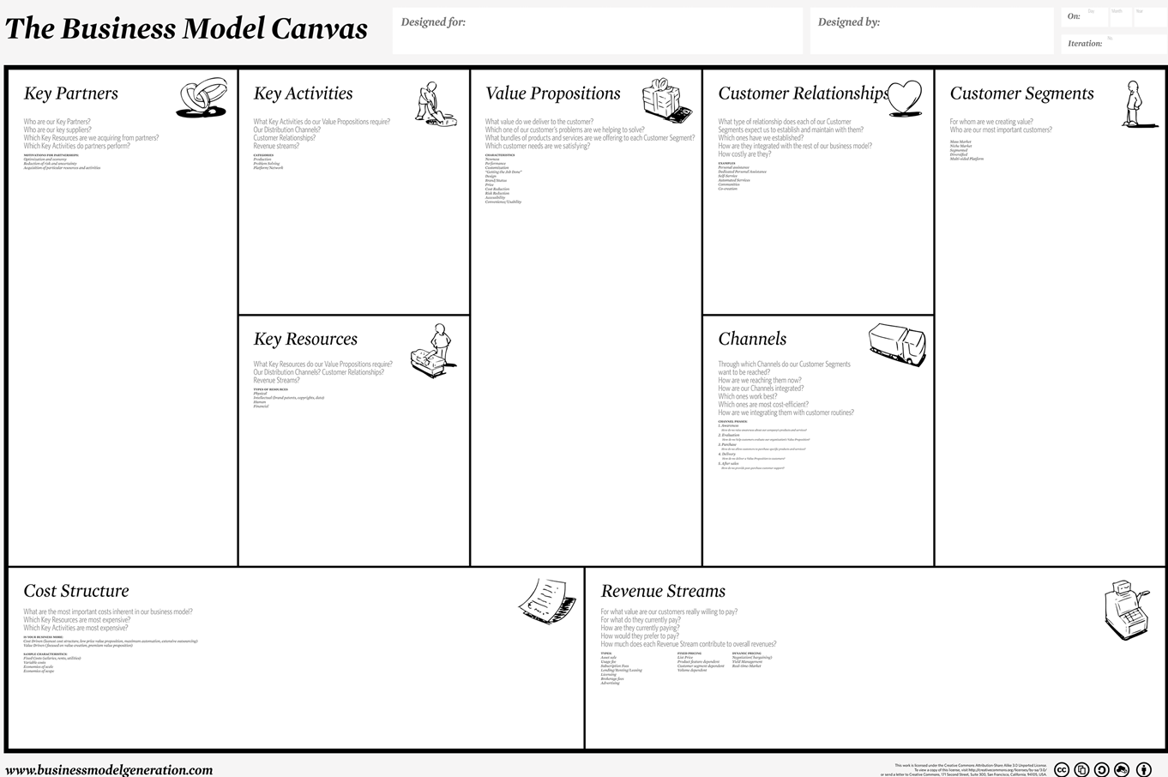
Lemonade Stand in City Park

Slide 71

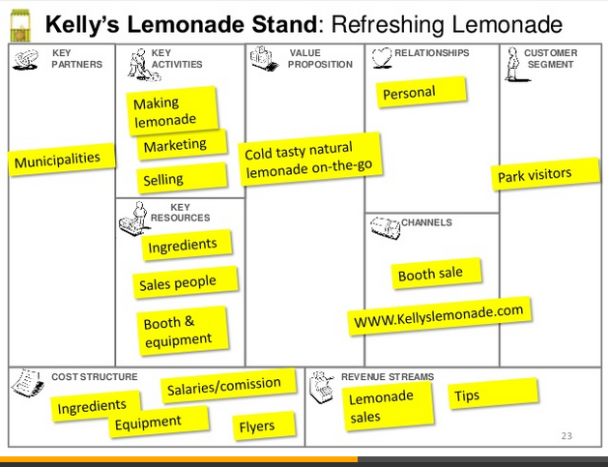
Kelly’s Lemonade Stand: Refreshing Lemonade

Slide 72
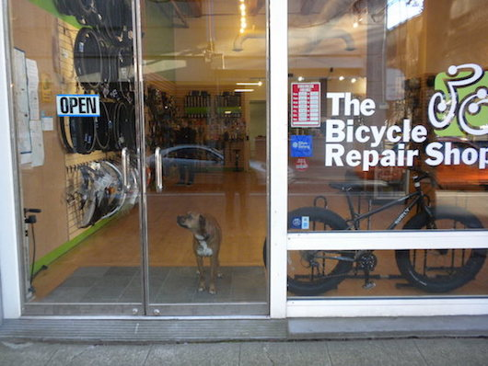

Slide 73
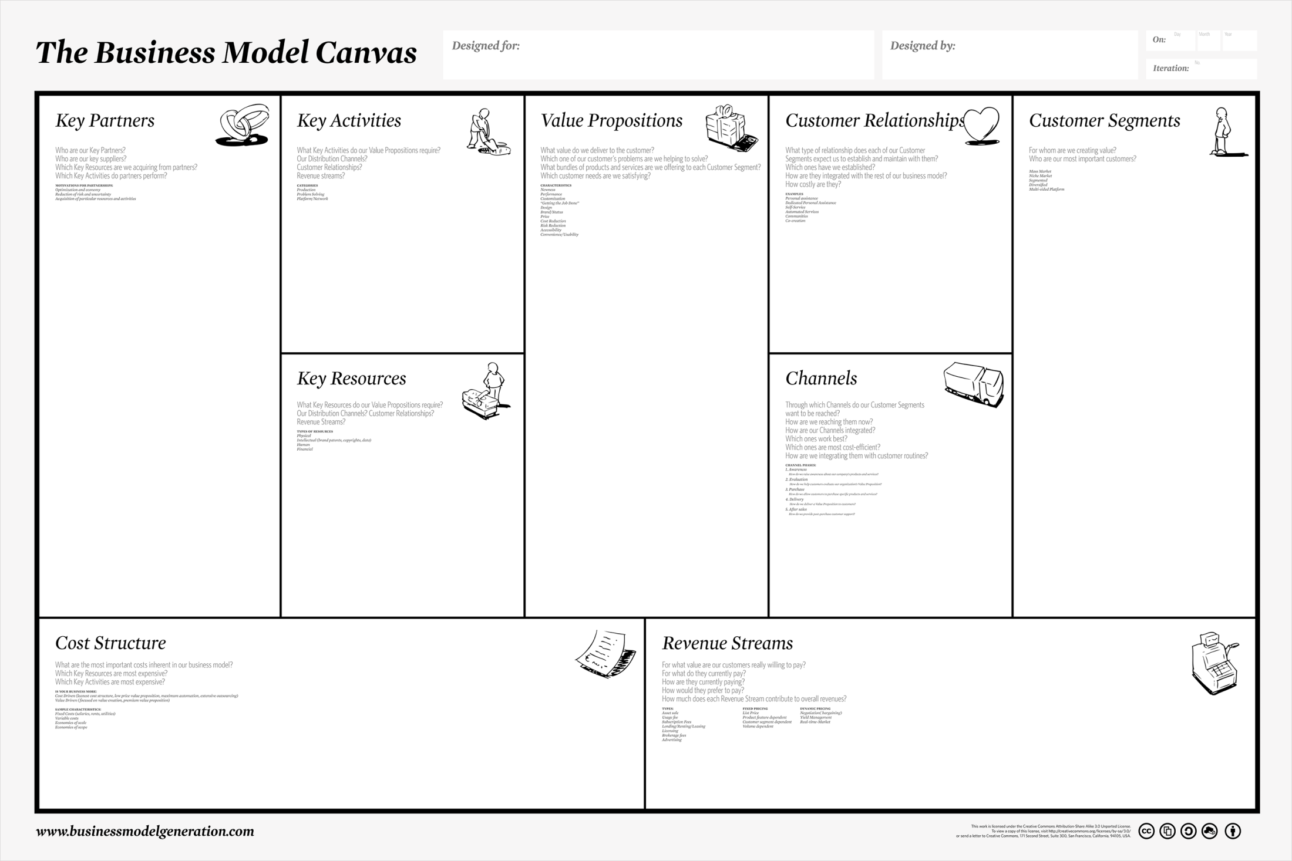

Slide 74
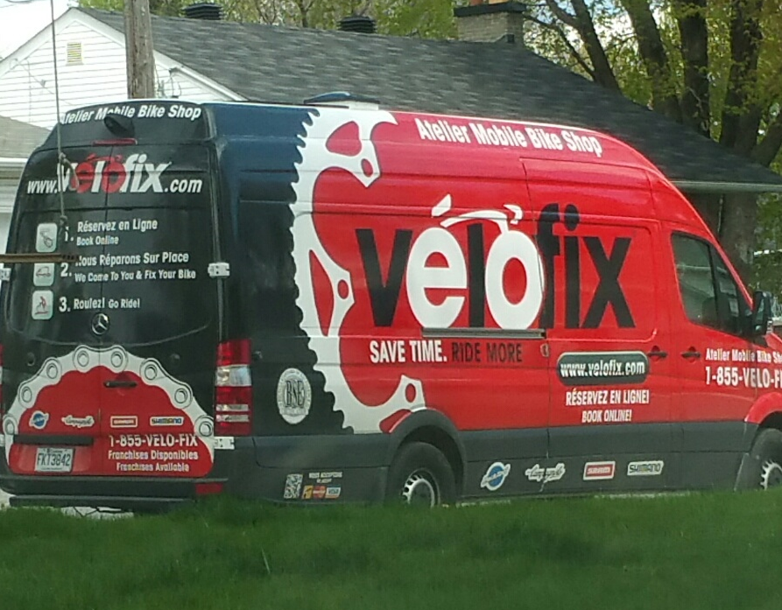

Slide 76

Amazon Business Model Canvas

Slide 77
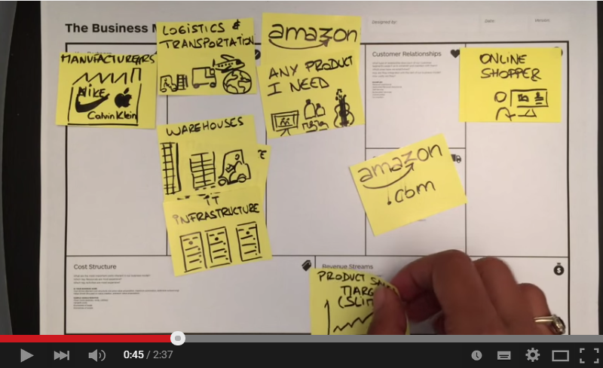
Amazon Business Model Canvas

Slide 79
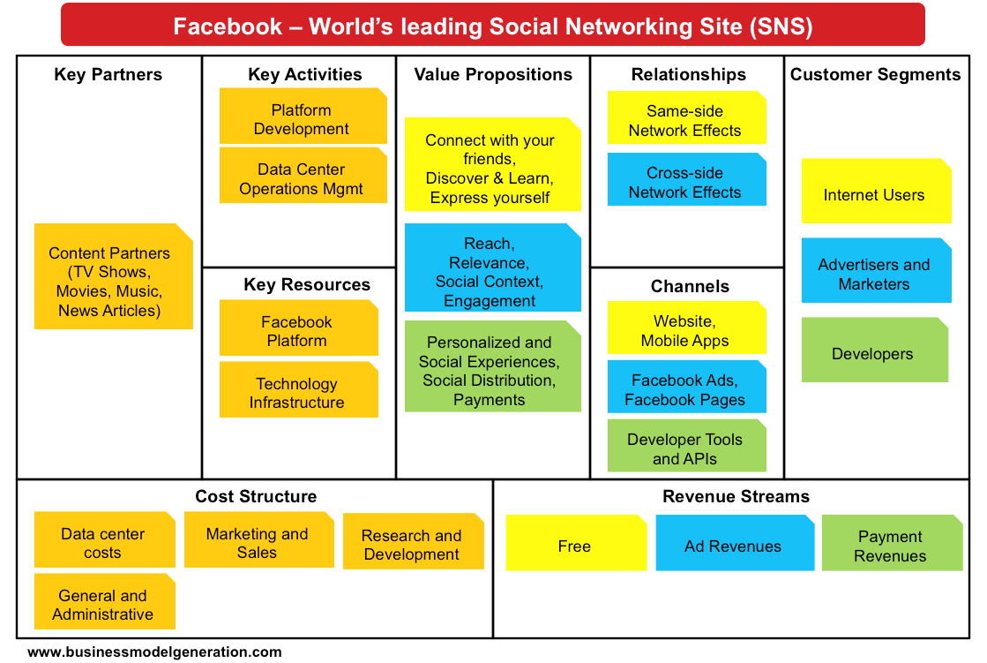
Canvas: Multiple Segments

Slide 80
Business Models
In groups:
Consider your assigned business idea.
Sketch out the key components of their business model.
Determine which component is most important or unique.
Be prepared to present:
Which component(s) of the Business Model Canvas is most important or unique for this business, and why?

Slide 81




1
NFL (Green Bay Packers) .
2
Luxe Box (Loose Button)
3
iPhone
4
Upwork

Slide 83
Concluding Thoughts?

Slide 84
Validating Your Idea

Slide 85
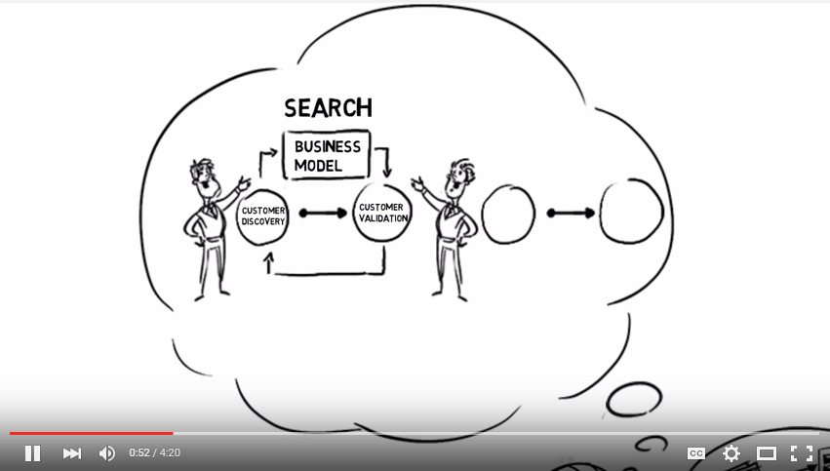

CUSTOMER DISCOVERY

Slide 86
Recommended Start up Process*
Generate idea
Assess market size and competition
Conceive business model hypotheses
Build validation tests and key metrics
Run validation tests and measure
Learn
Reiterate model and hypotheses
Repeat until new iterations not required
Establish resource requirements
Determine financial viability
Start venture or go back to step 1
Idea Validation
Cust. Discovery
Business Planning
*Not distinct or linear.

Slide 87
What Do Tests Look Like?
Customer conversations (f2f) – lots of them
Industry expert conversations
Surveys – in person and/or online
Test ads looking for currency*: Facebook, LinkedIn, Google Adwords
Test webpage looking for currency
Letters to clients to gauge follow up
Minimum viable product
* Currency = cash, orders, email addresses, sign ups, click throughs, downloads etc.

Slide 88
Minimum Viable Product: MVP
A minimum viable product has just those core features that allow the product to be deployed, and no more. The product is typically deployed to a subset of possible customers, such as early adopters that are thought to be more forgiving, more likely to give feedback, and able to grasp a product vision from an early prototype or marketing information.
Twitter MVP = status update
Google = just search
Zappos = web site + manual purchase
Virgin Airlines = one plane, one route

Slide 89
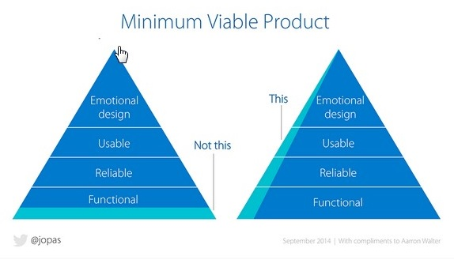

Slide 90
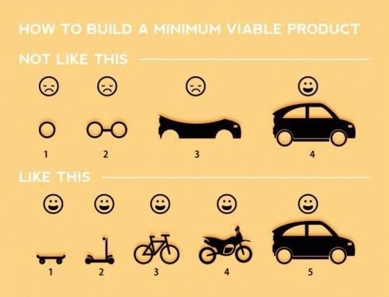

Slide 91
Customer Discovery Process

Slide 92
Validation Checklist
Pre Validation
What do you think the problem/gap is?
    What pain exists in the market or for the customer?
Who do think are your typical (first) clients?
    What is the size of the market?
    What is the profile (demographics etc) of you most likely customer?
What is your v1 solution? Is it reasonable?
Who do you need to talk to? How can you access them?
What are the most critical business model hypotheses you are trying to validate? What questions can you ask?
What are the tests? What metrics/thresholds are you looking for?

Slide 93
Typical Questions
Is there a problem or gap in the marketplace?
Who are the customers and do they recognize they have a problem?
How is the customer currently dealing with this task/problem? (What solution/process are they using?)
What do they like about their current solution/process?
What do they wish they could do that currently isn’t possible or practical?
Are customers willing to pay money for a different solution? (Duct tap test; desire, willingness, ability)
Would they buy a different/new solution? How? How much?
Are there competitors? What do they do well/poorly?
Is there some other solution/process they’ve tried in the past that was better or worse?
Who is involved with the buying process? How long does it take? Is there a budget?

Slide 94
Tips for Customer Interviews
Know your goals and plan your questions before leaving the building!
Do one-on-one interviews.
Validate the problem first, not the solution.
Listen, don’t pitch.
Be prepared for answers you don’t like.
Write your notes from the meeting immediately.
Focus on discovery. Don’t worry about features!
Never ask a yes and no question, always ask open ended ones.
Have behavior-focused interviews.
Ask to be able to follow up and for intros to others.

Slide 95
Validation Strategies methods
(In addition to customer conversations.)

Slide 96
Tools
Google Trends
Pinterest
Google Adwords
Unbounce.com
QuickMVP
Godaddy/Wix/Weebly
LinkedIn/Twitter/Facebook/etc.
eLance/Fiveer/oDesk
Survey Monkey

Slide 97





Test Web Page
Seeking to determine customer interest:
Sign ups
Pre-orders

Slide 98
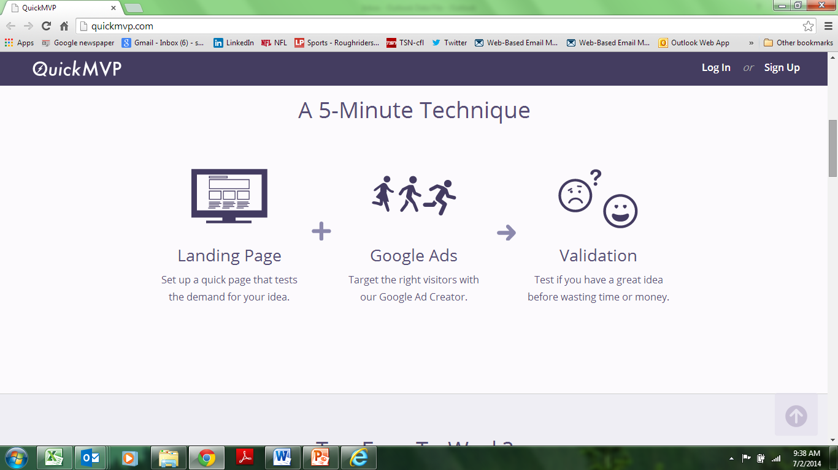
www.quickmvp.com

Slide 99
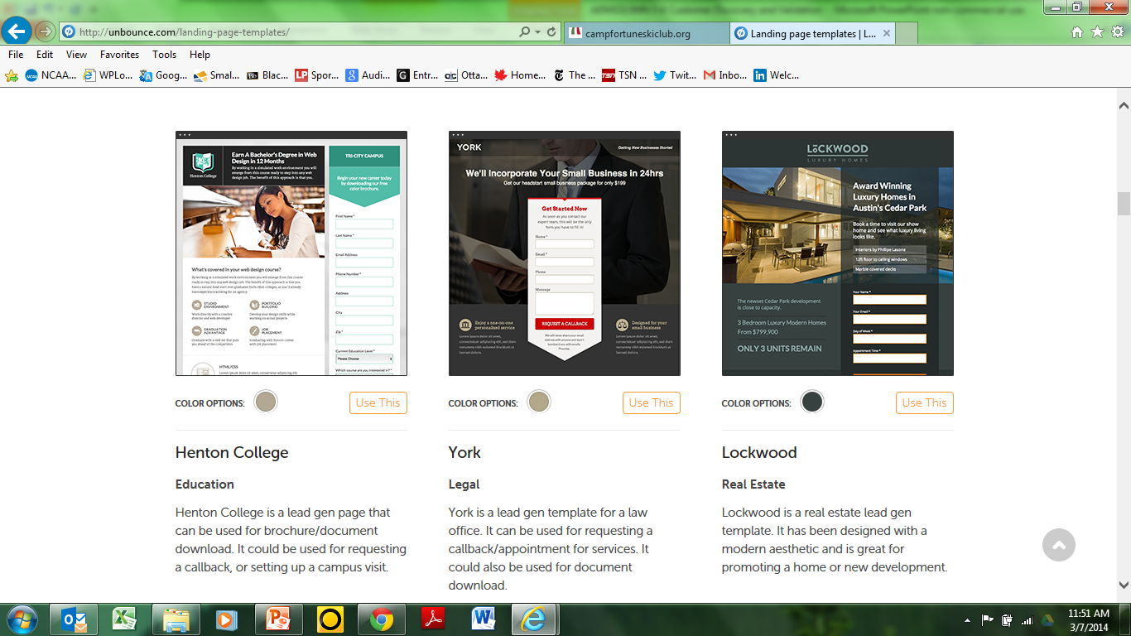
http://unbounce.com/

Slide 100
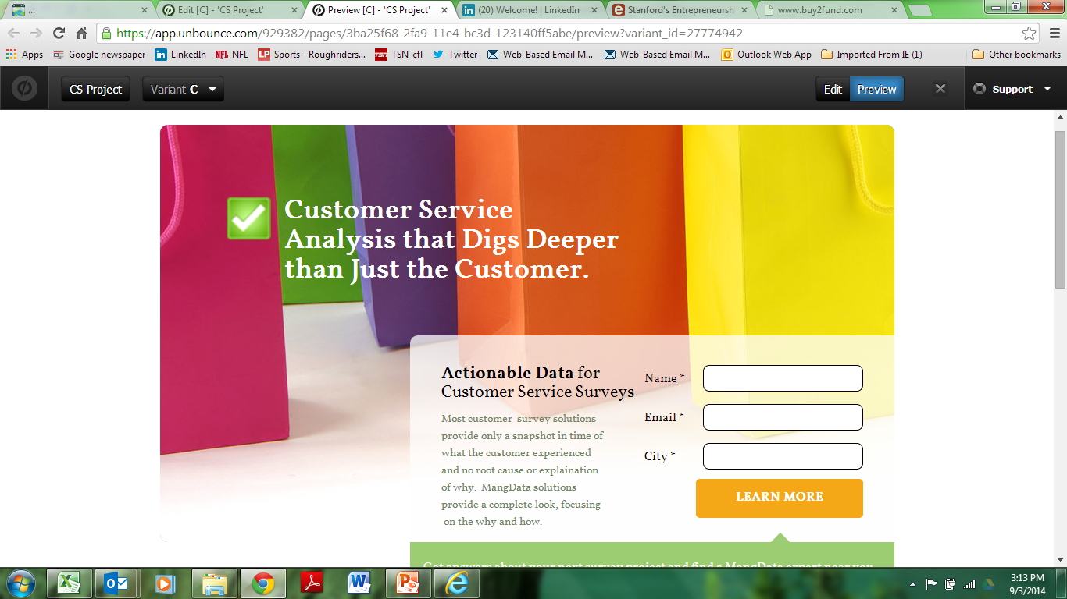

Slide 101
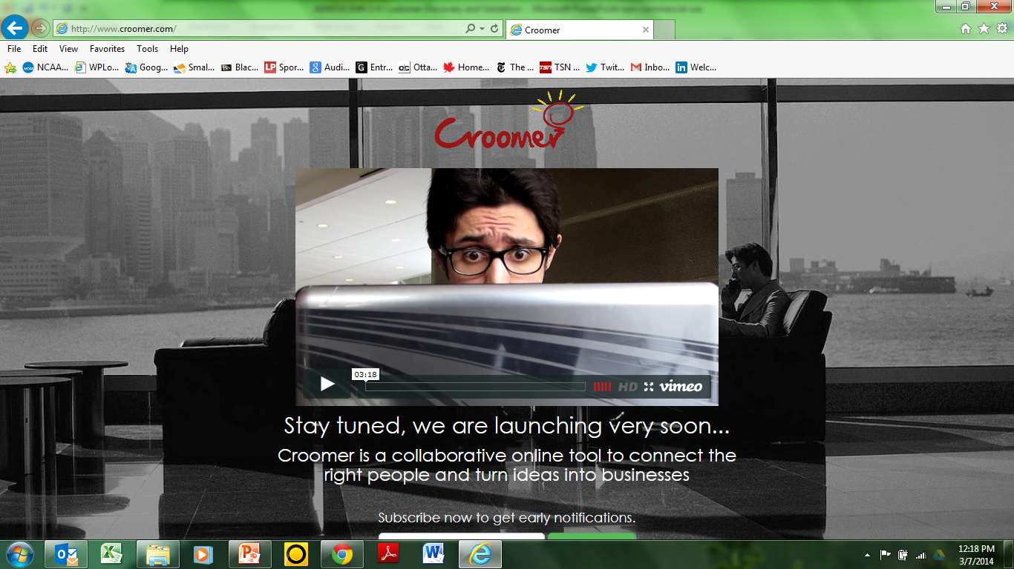

Slide 102
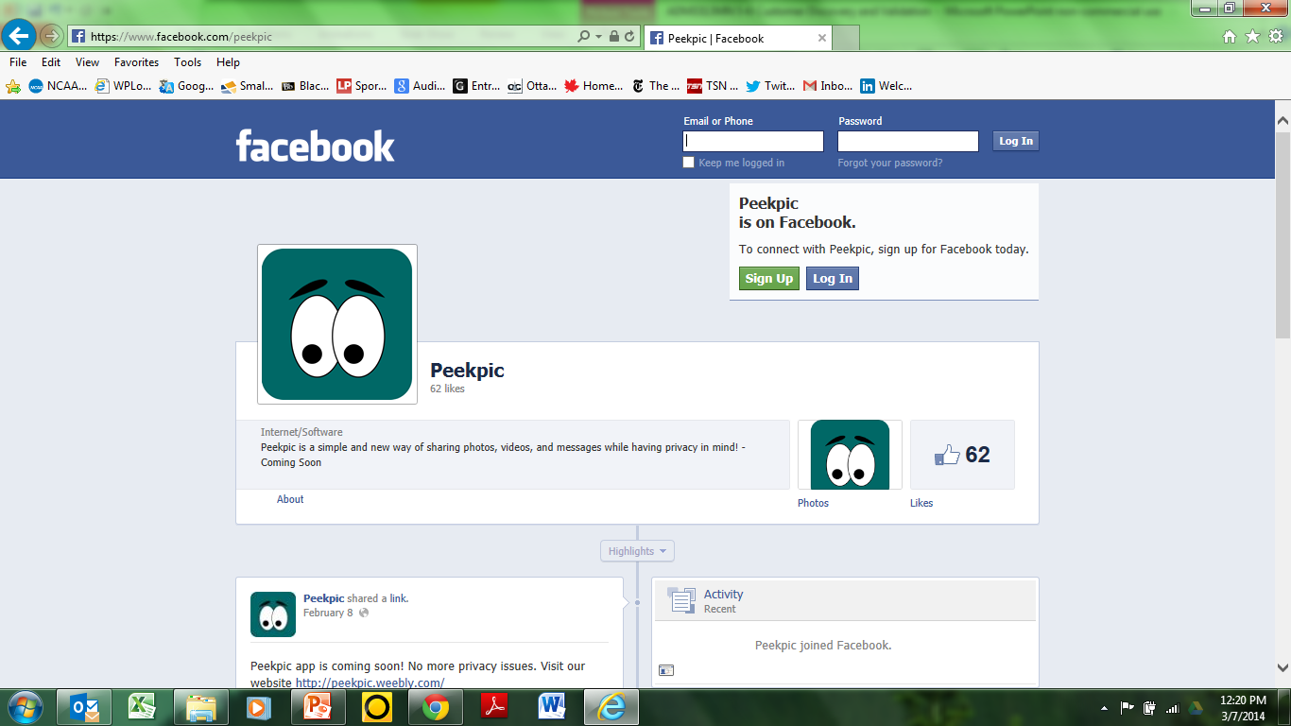

Slide 103
Crowd Funding Campaigns
http://www.indiegogo.com/Pub
http://www.indiegogo.com/projects/help-bring-victoire-to-toronto
https://www.kickstarter.com/projects/1470156778/wipebook

Slide 104
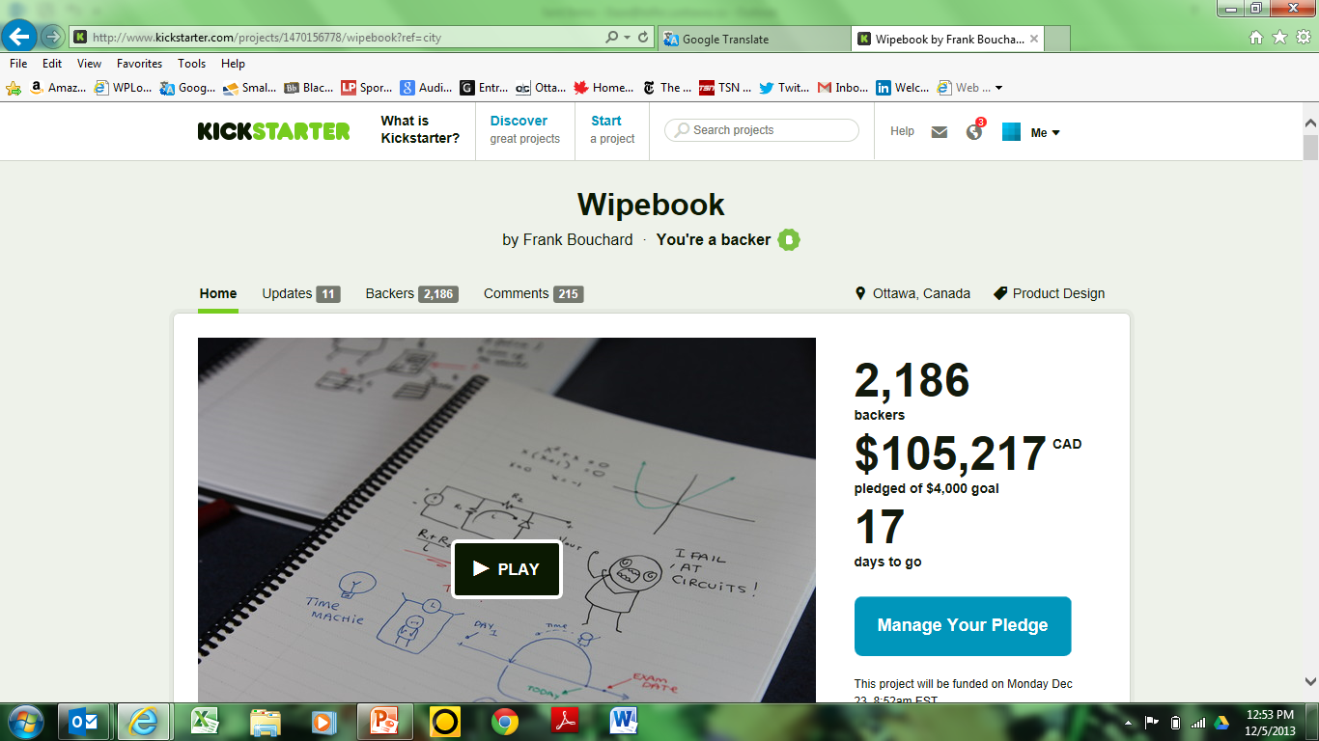

Slide 105
Case Study

Slide 106
Birth of an Idea

Slide 107
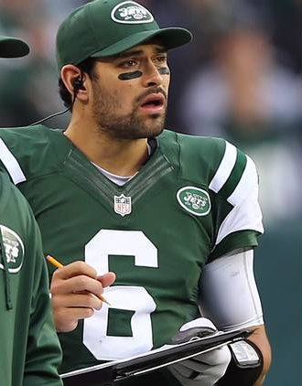
I’d like to help

Slide 108


Slide 109


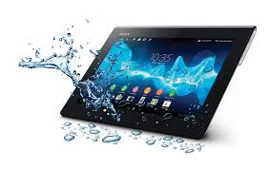
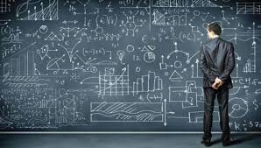

Slide 110
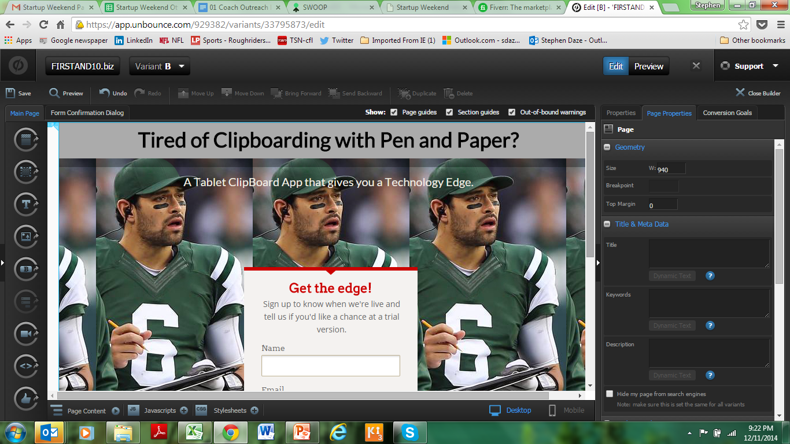
www.unbounce.com $54 (1 month free trial)

Slide 111
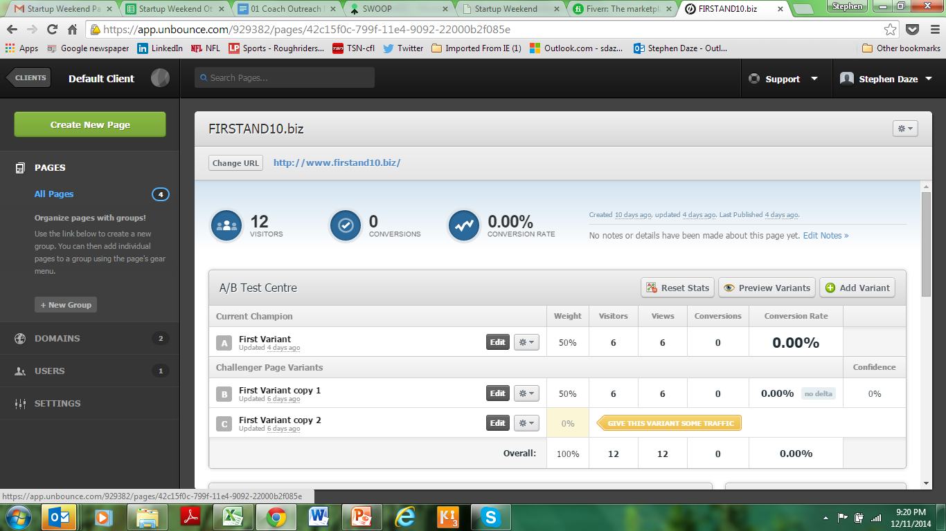

Slide 112
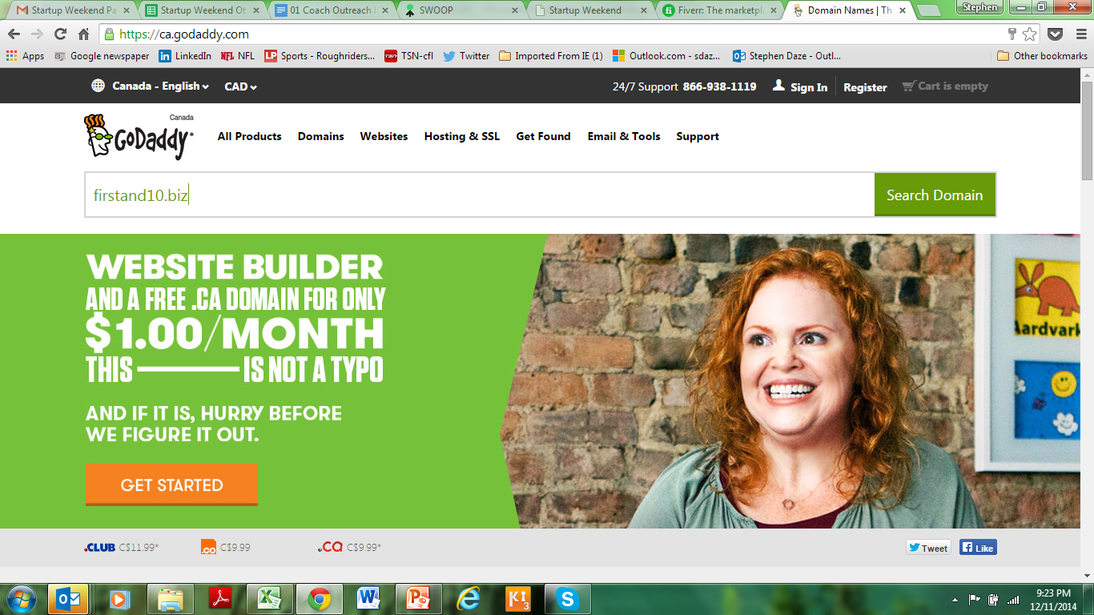
$16

Slide 113
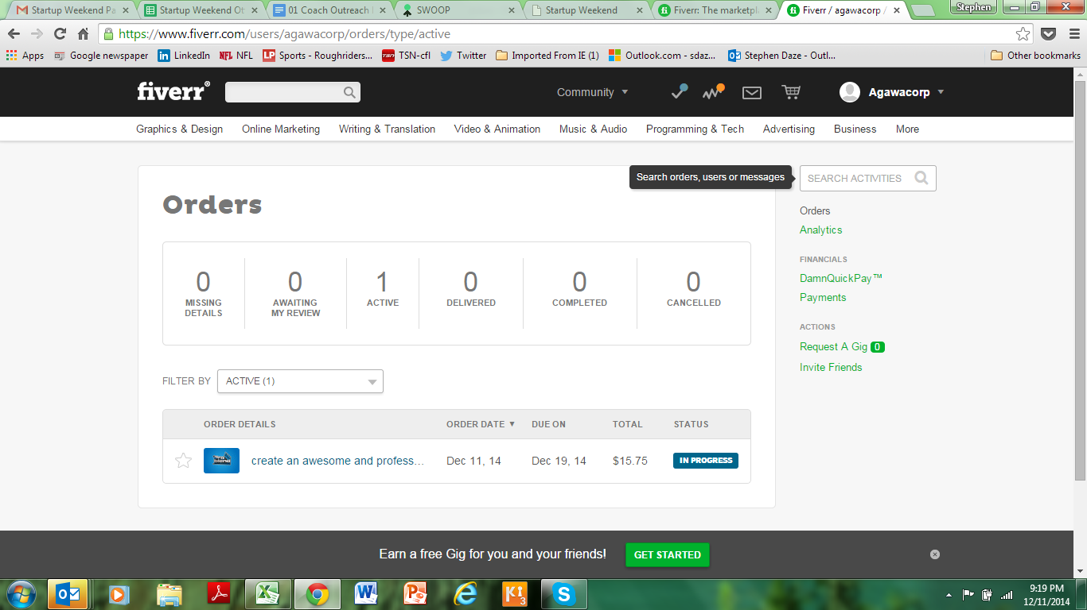
www.fiveer.com $15.75

Slide 114
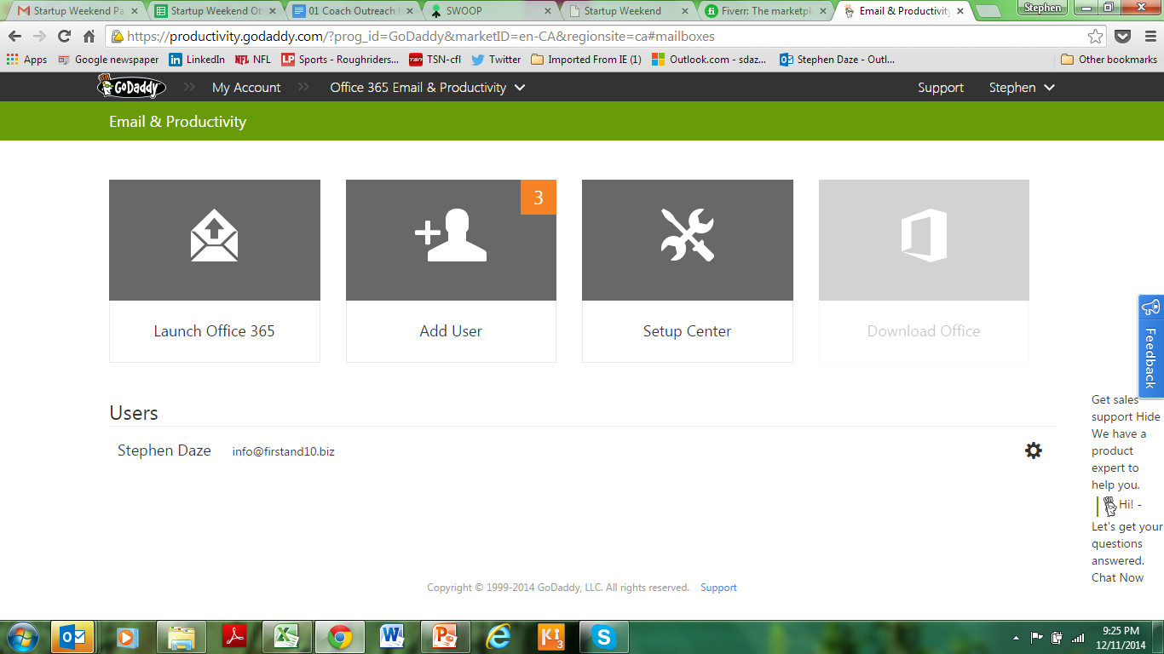
$5/month

Slide 115
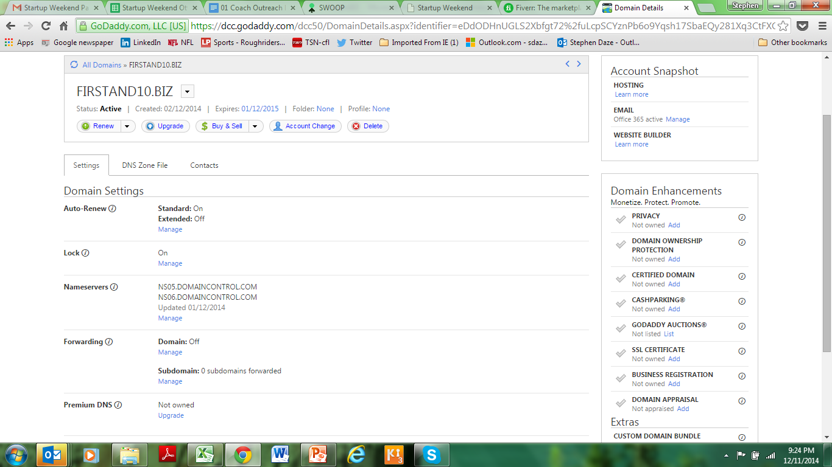

Slide 116
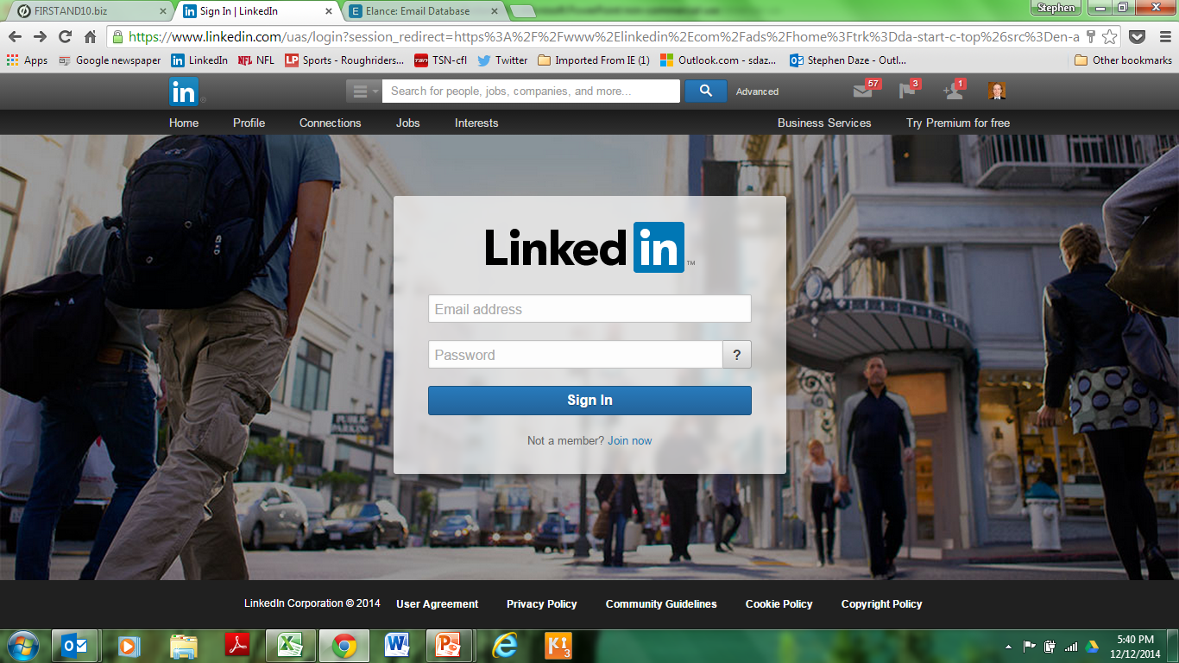

Slide 117
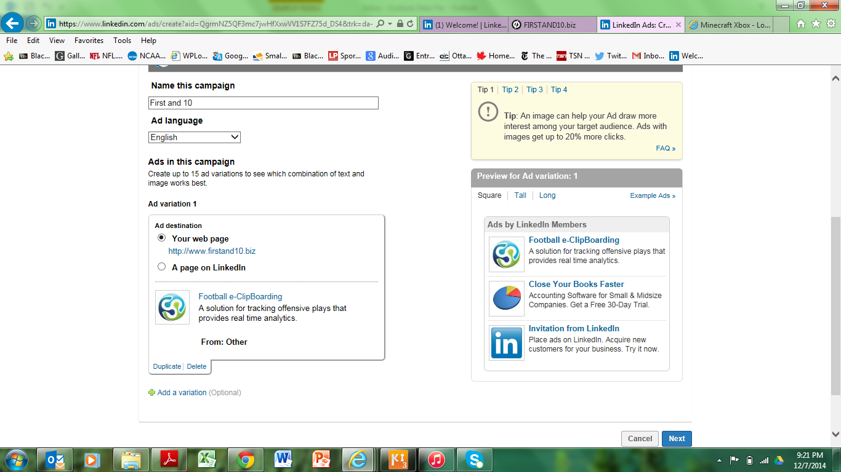

Slide 118
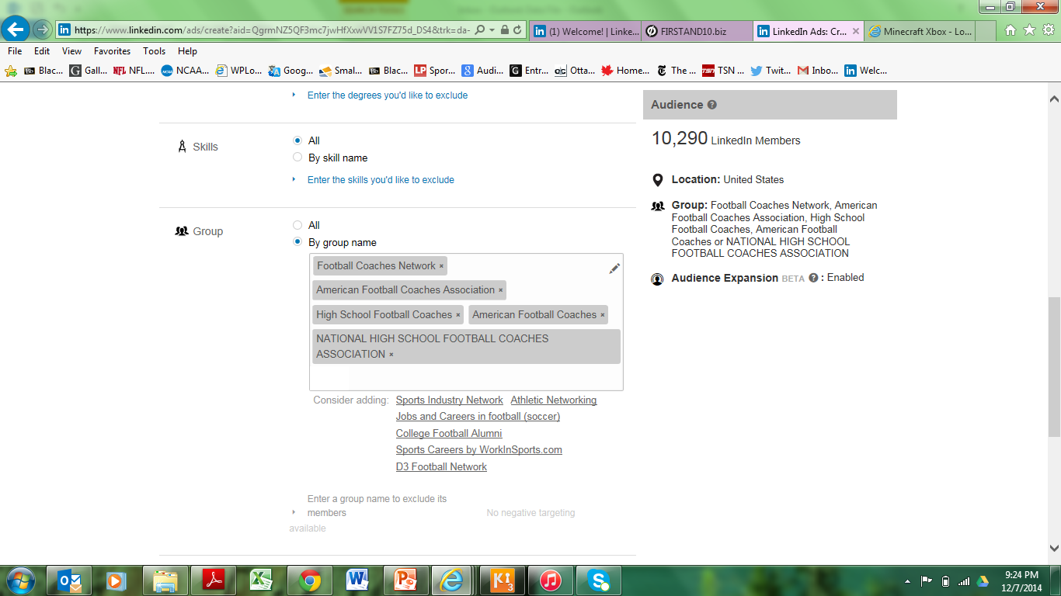

Slide 119
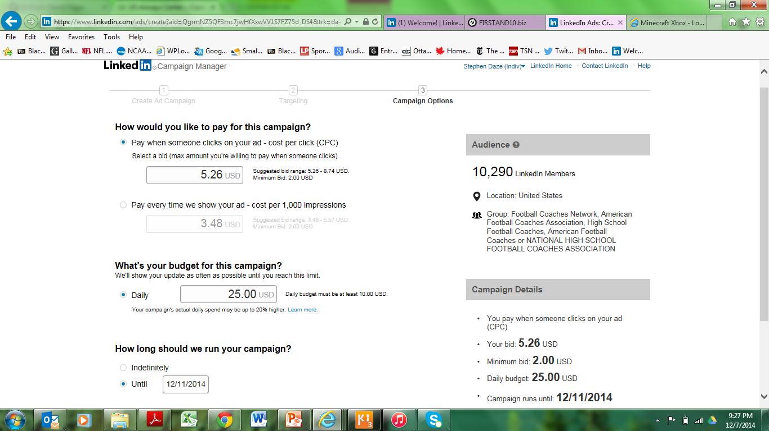
Google Adwords max. $25/day

Slide 120
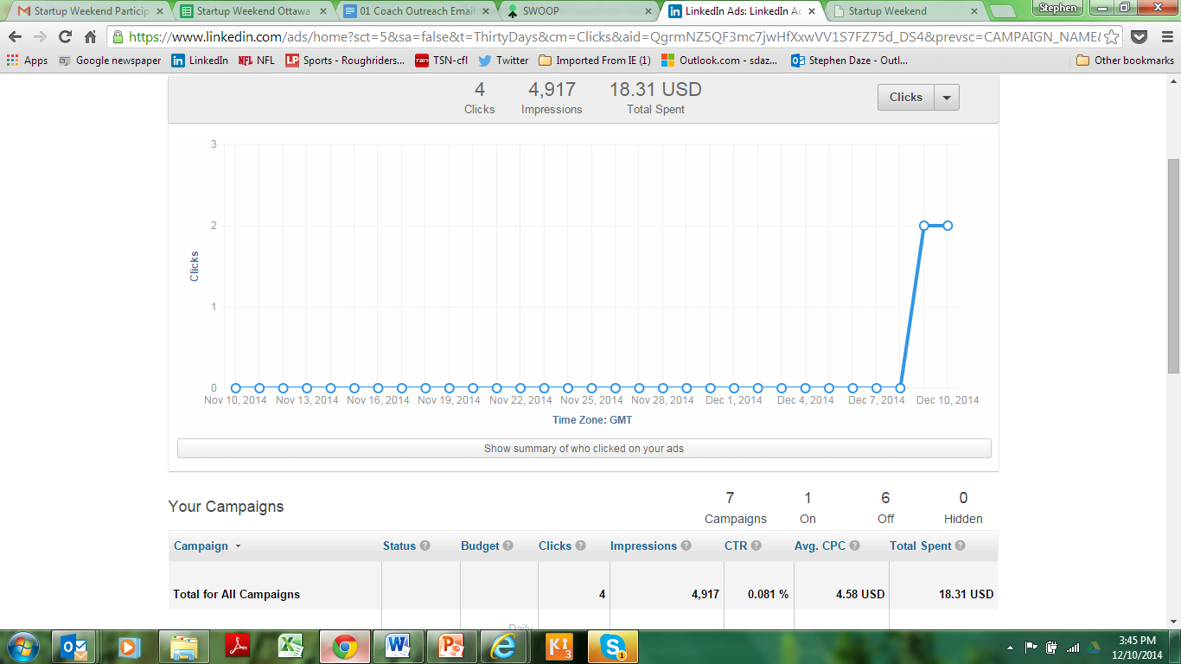

Slide 121


Slide 122

www.elance.com $54.79

Slide 123


Slide 124


Slide 125
Next (logical) steps
Build out of a demo version
Launch of actual website (more validation; sign ups; early sales?)
Pre sales
Finalize development

Slide 126
Tools and Resources
www.businessmodelgeneration.com/canvas and related https://canvanizer.com/ to organize your validation.
www.unbounce.com, www.quickmvp.com and www.launchrock.com – build landing pages to gauge clicks and interest/ collect email addresses/ combine with Google Adwords and other advertising mediums/ test variants of your message.
http://buzzsumo.com/ - look for key influencers in your industry.
www.indegogo.com and www.kickstarter.com – build awareness, raise funds and pre-sell your product online.
https://gomockingbird.com/, http://proto.io/ or others - create a mockup of your app or website in minutes.
http://startupstash.com/mockups-wireframing/- Mockup and Wireframes
http://startupstash.com/mvp/ - A curated directory of resources & tools to help you build your Startup
https://www.zoho.com/crm/?src=zoho - Customer Relationship Management to track your validation contacts and early leads
Other validation tools and resources:
Customer Discovery Tips and Templates - http://leanstartup.pbworks.com/w/page/54918676/Customer%20Interview%20Templates%20and%20Resources
Validation tools - http://leanstartup.pbworks.com/w/page/62585258/Validation%20Tools
Another similar list - http://www.squirrly.co/startup-tools-list-the-amazing-free-services-that-will-improve-your-work#.VNETZp3F_5G

Slide 127

Standing Desk

Slide 128
Standing Desk
Google Trends
Pinterest
Topsy
Landing page with mock image, looking for “purchases”
  Google Adwords
  Scheduled Tweets with Hootsuite
  Paid Facebook and Twitter Ads
*https://www.linkedin.com/pulse/sell-how-test-out-new-product-shoestring-ryan-holmes?trk=hp-feed-article-title-like

Slide 129

100% Vegan Restaurant?

Slide 130
100% Vegan Restaurant?
Catering
Small shows
LCBO events
Mail list
Pre-sold gift certificates and meals

Slide 131
Pitching Your Validation results

Slide 132

EXAMPLE

Slide 133
Report/Presentation
What problem in what industry?
How big is the market? Other uses?
What was your v1 BMC?
What validation tests did you run? (real numbers)
What did you learn?
How did this influence your thinking (i.e. v2 BMC)
What are your next steps?

Slide 134
Pitch Template

Slide 135
Validation efforts to date:
PROJECT or TEAM NAME
Number of Customer Interviews (f2f) - XX
Number of Surveys Completed - XX
Number of Industry Experts Consulted - XX
Other Tests/Validation Methods -
__________________________________________
__________________________________________

Slide 136
Business Premise
1. Industry description
  Size
  Significance
  Other possible markets/opportunities

Slide 137
Business Premise Con’t.
2. Problem hypothesis or gap anticipated.
3. Possible solution.
4. How do you think you’ll make money (revenue model).

Slide 138

Business Model Canvas v.1

Slide 139
Summary of Validation Tests
What did you actually do?
Strategies, techniques, numbers and results

Slide 140
Key Learnings
About this Industry/business/client group etc.
About our business model and key elements
About the likelihood of moving forward
About what the next steps for this idea would be.

Slide 141
Business Model Canvas v.2..etc

Slide 142
Next Steps
What and how are we continuing with the validation process? (What is the plan of action.)

Slide 143
Example

Slide 144
Model and Validation for PeekPic
Last two weeks validation (Adults Segment)
Number of Customer Interviews - 64
Number of Surveys Completed - 39
Number of Industry Experts Consulted – 1
Other Tests/Validation Methods:
  Peekpic Website – www.peekpic.weebly.com
  Facebook Page – www.facebook.com/peekpic
Last two weeks interviews/surveys: 103
Total interviews/survey for the term: 282
Notes:
This needs to be updated.

Slide 145

Peekpic App Peekpic App Industry description and Size
Instant Messaging Industry (IM)
  http://finance.yahoo.com/news/radicati-group-releases-instant-messaging-110000818.html
Notes:
1. http://finance.yahoo.com/news/radicati-group-releases-instant-messaging-110000818.html

Slide 146

Peekpic App Industry description and Size
  http://finance.yahoo.com/news/radicati-group-releases-instant-messaging-110000818.html

Slide 147
Peekpic App
Industry description and size:
Instant Messaging Industry (IM)
Main players : Whatsapp, Viber, Snapchat etc.
Current Market Value: $3.4 billion by 2013
Forecasted : $4.4 billion by 2017¹
Our targeted market share over next 3 years (0.25%) =~ $8 millions
Notes:
1. http://finance.yahoo.com/news/radicati-group-releases-instant-messaging-110000818.html

Slide 148
Peekpic App
Problem hypothesis or gap anticipated:
a) Lack of privacy and security based communication application
b) Not perfect user experience
  c) Convenience with peace of mind
Possible Solution:
Develop a mobile communication App that doesn’t store user data
Enhance user experience by having a better Software design
Notes:
1. http://finance.yahoo.com/news/radicati-group-releases-instant-messaging-110000818.html

Slide 149

Business Model Canvas v.1

Slide 150
Summary of Validation Tests
Information gathered (for adult segment)
  Current applications used for sharing pictures and messages with friends
  Reasons for choosing current applications
  Opinion about the fact that personal data is being saved forever
  Willingness to switch to a secure platform
  Reasons for using our competitor’s platform

Slide 151
What we Learned
Social Media,
Facebook,Twitter,Tumbler,Reddit,Weibo,Renren etc.
IM
Whatapp,Viber,QQ,Wechat,iMessage
Traditonal Ways
SMS,MMS,Email
Total number of customer Interviews/Surveys (Adults) - 103

Slide 152
What we Learned

Slide 153
What we Learned (Opinion about data being saved forever)

Slide 154
What we Learned

Slide 155
What we Learned

Slide 156


Slide 157

Peekpic Website
  www.peekpic.weebly.com

Slide 158

Peekpic website stats ~6 days

Slide 159

Peekpic Facebook Page

Slide 160

Peekpic Facebook stats ~ 9 days

Slide 161


Slide 162
Next Steps in Validation
Continue validating business model canvas version3
Analyze the potential competitors and their customers
Launch Minimum Viable Product (MVP)
Decide on the cloud service provider
Select a mentor to guide for validation

Slide 163
Next Steps in Starting (long term focus)
Develop Go-To-Market strategy
Develop the complete Peekpic Business Plan
Expand the revenue model
Develop the application software

Slide 164
Group Work
  Finalize idea
  List all hypotheses and underling assumptions
  Design a Version1 Business Model
  Develop test methodologies for each hypotheses and assumption
  Determine what pass/fail looks like
  Establish plan of action for tests
*** Pick ideas for which you can access potential customers and validate the market.

Slide 165
Concluding Thoughts?

Slide 166
Next Steps

Slide 167
Administrative Details
Banking
Accounting

Slide 168
3. Rules and Regulations
Legal Structure
  Partnership/Shareholder Agreement
HST
Licences
Zoning & Bylaws
Provincial and Federal Regulations
Industry Regulations

Slide 169
4. Business Planning

Slide 170
Business Plans
Exec. Summary
Marketing
Operations
Financial
- Appendices
Industry trends
Gap and Solution
Target market
Competitive analysis
Promotional strategy
Management team
Location/Distribution
Suppliers
Manufacturing plan
Operating requirements
Human resources
Financial requirements
Income statement
Cash flow

Slide 171












VC Explained
- Investment Thesis
- LP’s
- Term Sheet
- Valuation
- Due Diligence
- Economics of the Deal
- Exit

Slide 172
Venture Capital
VC Considerations | Entrepreneur Considerations
The Team Valuation Term Sheet Due Diligence Economics of the Deal Exit | Ownership % Long term ownership (exit) Control Value added (smart money?)

Slide 173

Some Perspective

Slide 174


Angel Investing Explained
- Investment Thesis
- LP’s
- Term Sheet
- Valuation
- Due Diligence
- Economics of the Deal
- Exit

Slide 175
1. GENERATE AND ASSESS IDEA
2. CREATE V1 OF BUSINESS MODEL
3. RUN VALIDATION TESTS
4. GET A COMFORT WITH THE NUMBERS
5. CONSIDER RULES AND REGULATIONS
6. ADMINISTRATIVE DETAILS: BANK, ACCOUNTING
7. GO!
8. WRITE A BUSINESS PLAN
9. GROW!

