Slide 1
Start up Ideation and the Perfect Pitch
Stephen Daze
Telfer School of Management
November 2013

Slide 2
Idea Generation Principles
1. Good idea vs. good business idea = a gbi makes money!
These ideas may not make money: http://www.ted.com/talks/dale_dougherty_we_are_makers.html

Slide 3
Idea Generation Principles
2. Ideas evolve over time, eg. Facebook, Blackberry; or start as mistakes, eg. 3M Sticky Notes.

Slide 4
Idea Generation Principles
3. Have a value proposition for a critical mass of addressable customers. (So what, who cares, why you?)

Slide 5
Idea Generation Principles
4. Ideas can come from anywhere, most often we see good business ideas starting with one (or more) of the following:

Slide 6
Personal Pain
I have a problem that needs solving.
“From online Snowboard shop to 70,000 customers in 80 countries.”

Slide 7
Market Gap
A critical mass of customers are looking for solution.
“I had never built a fence or deck before.”

Slide 8
Interest
I love this so much, I can see myself working on it 24/7.

Slide 9
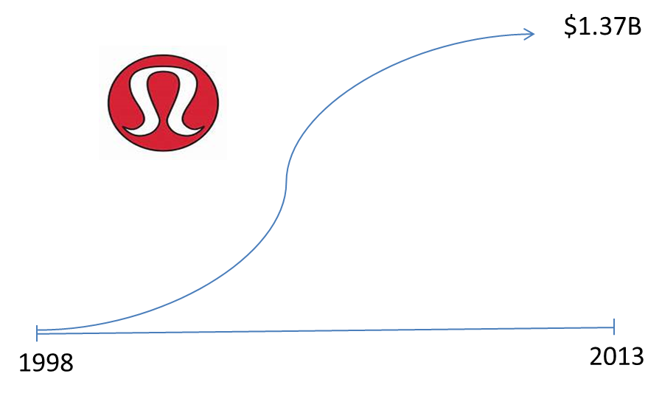
Insight
I understand the industry and see where it is going.

Slide 10
Good Business Ideas
Necessary conditions:
Can make money (or not loose it).
Has value (value proposition) to someone.
And:
Evolve over time.
Usually start with one or a combination of:
Personal pain (I have a problem that needs solving.)
Market gap/need (Others will pay for a solution.)
Interest (I can see myself doing this 24/7.)
Insight (I understand the industry and the trends.)
The best business ideas satisfy most (or all) conditions!
- If your current idea doesn’t, look to evolve it sufficiently such that it does.

Slide 11
Questions?

Slide 12
Value Proposition
A positioning statement (elevator pitch) that explains what you do, why it’s important, who cares and why you can be successful.
Considerations

Slide 13
Is the problem Unworkable? Does your solution fix something that is broken and causing pain for the client?
Is fixing the problem Unavoidable? Does the client have to fix the problem? Now?
Is the problem Urgent? Is it a top priority for someone?
Is the problem Underserved? Is there a gap between what exists and what customers would pay for?
Is it worth fixing? Does duct tape work just fine?

Slide 14
Is there a gap in the marketplace where you can position your solution and make money?
Is it defensible? Disruptive?
Is there enough “gain” for the customer to endure the “pain” of using your solution?
Can you articulate your value proposition in a succinct way, that is understandable? i.e. the elevator pitch.

Slide 15
What is an Elevator Pitch?
A quick snapshot of your business opportunity delivered in a short amount of time – perhaps the amount of time you have in an elevator ride with an important funder or client.

Slide 16
Watch for Key Characteristics
https://www.youtube.com/watch?v=i6O98o2FRHw
https://www.youtube.com/watch?v=r_Dgsf4iiZg

Slide 17
Key Components
Quick overview of the concept: ________.
My product/service solves _______ problem or need.
My solution is ________.
People who will buy my product are _______.
The most important benefit of my product or service is _______.
This is a good/big idea because _______.

Slide 18
Tips
It has to be succinct and understandable – stay away from jargon, features and technical language.
Focus on the opportunity.
More information is not always better – leave them interested in learning more.
Practice until it’s as easy as saying your telephone number (i.e. without hesitation or second thought.)
Multiple versions may be necessary depending on the audience (funder, client, potential employee, etc.)

Slide 19
Questions?

Slide 20
Exercise
In groups:
Think of a possible business idea.
Brainstorm, share, combine etc. then choose the best.
Prepare a 2 minute Elevator Pitch.
Notes:
Jesse and Stephen

Slide 21
Other Considerations

Slide 23
Business Model Canvas
http://ecorner.stanford.edu/authorMaterialInfo.html?mid=2877

Slide 24
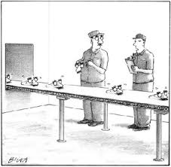
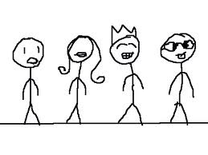
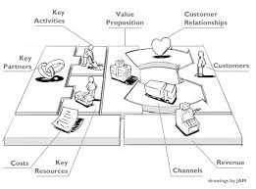
Idea to Viable Business
1
2
3
4
5
6
Business Model
Hypotheses
Validation
(incl. early sales?)
Business Plan
Production/scaling
Viable Business
Idea

