Slide 1
Validating Your idea using customer discovery
Stephen Daze

Slide 2
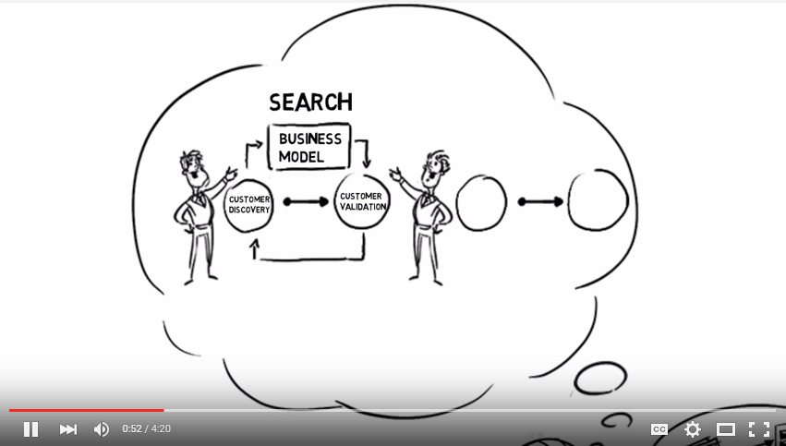


Slide 3
Recommended Start up Process*
Generate idea
Assess market size and competition
Conceive business model hypotheses
Build validation tests and key metrics
Run validation tests and measure
Learn
Reiterate model and hypotheses
Repeat until new iterations not required
Establish resource requirements
Determine financial viability
Start venture or go back to step 1
Idea Validation
Cust. Discovery
Business Planning
*Not distinct or linear.

Slide 4
Course Requirements
Conceive idea
Assess Market: size and competition
List all hypotheses and underling assumptions related to possible success (problem, issue, gap, customer group, purchase behavior, etc.)
Design a Version1 Business Model
Develop test methodologies for each hypotheses and assumption
Determine what pass/fail looks like
Establish plan of action for tests
Implement tests; measure, learn, repeat
Report
Repeat
Build and present associated Business Plan

Slide 5
What Do Tests Look Like?
Customer conversations (f2f)– lots of them
Industry expert conversations
Surveys – in person and/or online
Test ads looking for currency*: Facebook, LinkedIn, Google Adwords
Test webpage looking for currency
Letters to clients to gauge follow up
Minimum viable product
* Currency = cash, orders, email addresses, sign ups, click throughs, downloads etc.

Slide 6
Minimum Viable Product: MVP
A minimum viable product has just those core features that allow the product to be deployed, and no more. The product is typically deployed to a subset of possible customers, such as early adopters that are thought to be more forgiving, more likely to give feedback, and able to grasp a product vision from an early prototype or marketing information.
- Twitter MVP = status update
- Google = just search
- Zappos = web site + manual purchase
- Virgin Airlines = one plane, one route

Slide 7
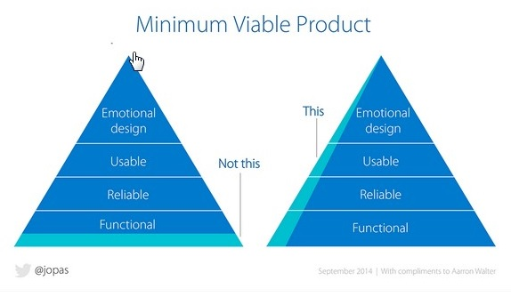

Slide 8
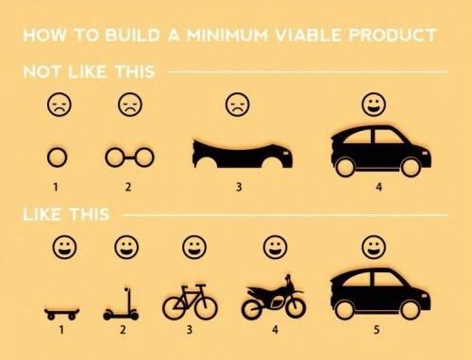

Slide 9
Customer Discovery Process

Slide 10
Validation Checklist
Pre Validation
What do you think the problem/gap is?
    What pain exists in the market or for the customer?
Who do think are your typical (first) clients?
    What is the size of the market?
    What is the profile (demographics etc) of you most likely customer?
What is your v1 solution? Is it reasonable?
Who do you need to talk to? How can you access them?
What are the most critical business model hypotheses you are trying to validate? What questions can you ask?
What are the tests? What metrics/thresholds are you looking for?

Slide 11
Typical Questions
Is there a problem or gap in the marketplace?
Who are the customers and do they recognize they have a problem?
How is the customer currently dealing with this task/problem? (What solution/process are they using?)
What do they like about their current solution/process?
What do they wish they could do that currently isn’t possible or practical?
Are customers willing to pay money for a different solution? (Duct tap test; desire, willingness, ability)
Would they buy a different/new solution? How? How much?
Are there competitors? What do they do well/poorly?
Is there some other solution/process they’ve tried in the past that was better or worse?
Who is involved with the buying process? How long does it take? Is there a budget?

Slide 12
Tips for customer interviews
Know your goals and plan your questions before leaving the building!
Do one-on-one interviews.
Validate the problem first, not the solution.
Listen, don’t pitch.
Be prepared for answers you don’t like.
Write your notes from the meeting immediately.
Focus on discovery. Don’t worry about features!
Never ask a yes and no question, always ask open ended ones.
Have behavior-focused interviews.
Ask to be able to follow up and for intros to others.

Slide 13
Tools and Resources for Validating

Slide 14





Test Web Page
Seeking to determine customer interest:
  Sign ups
  Pre-orders

Slide 15
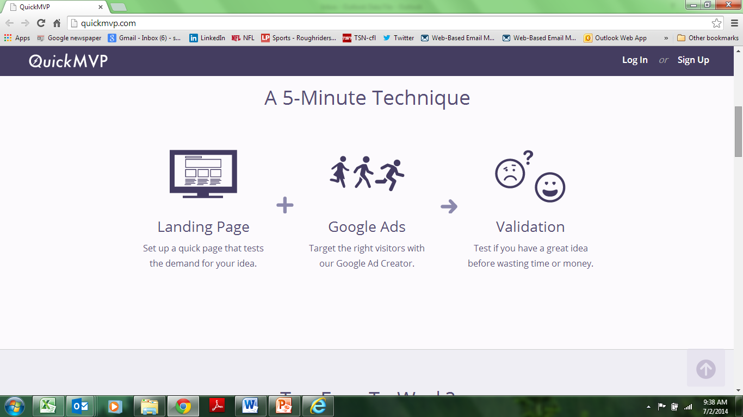
www.quickmvp.com

Slide 16
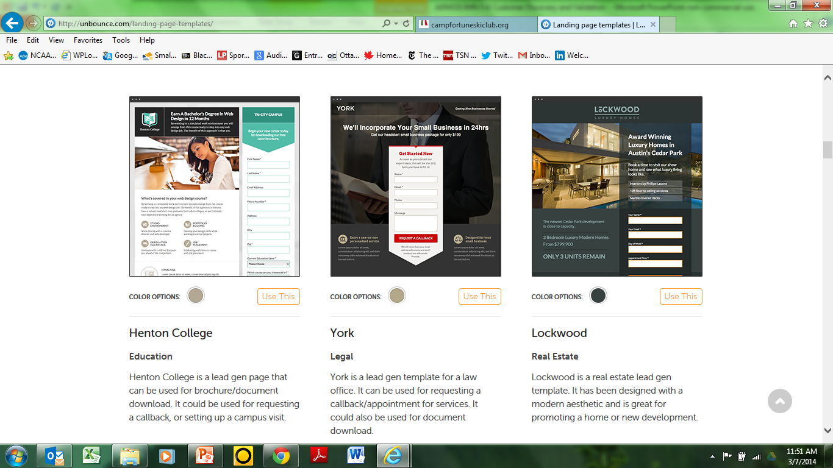
http://unbounce.com/

Slide 17
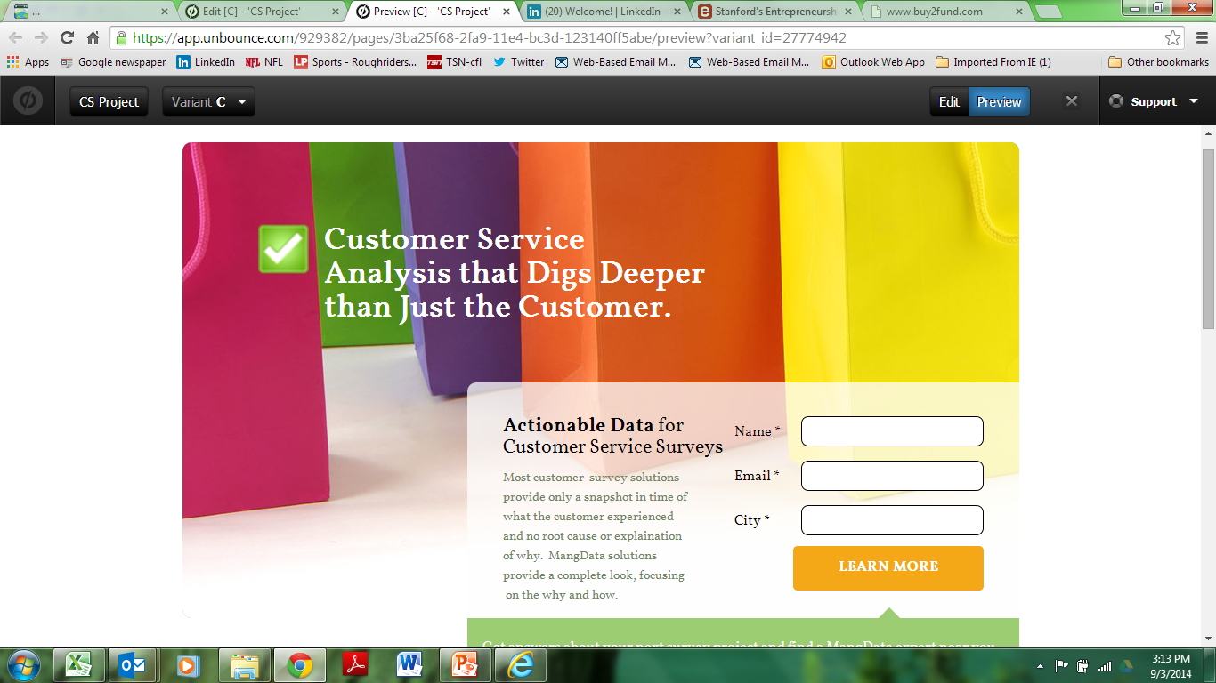

Slide 18
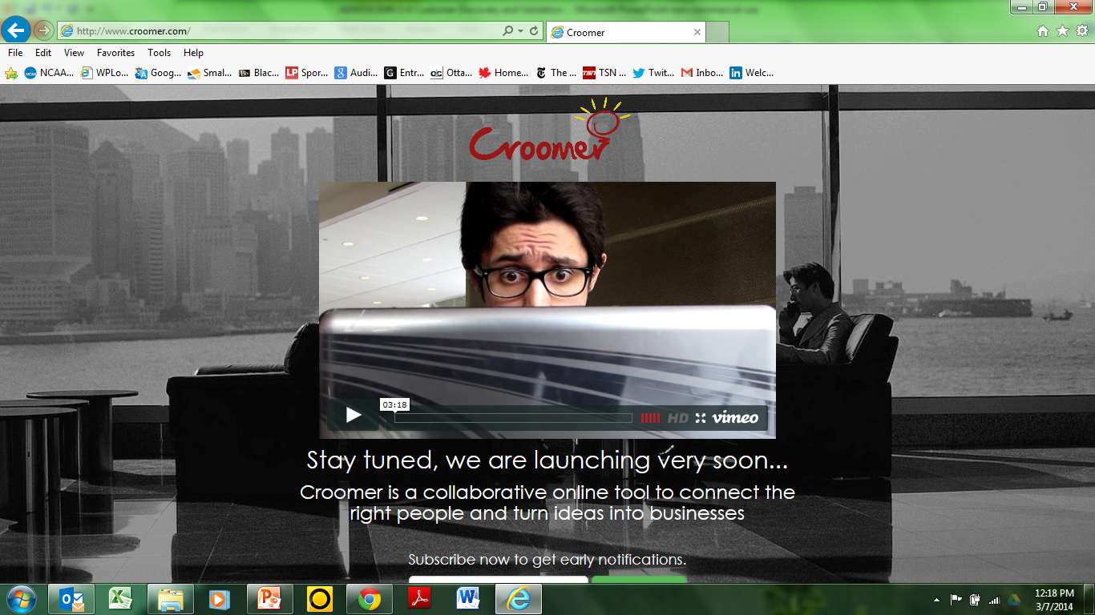

Slide 19
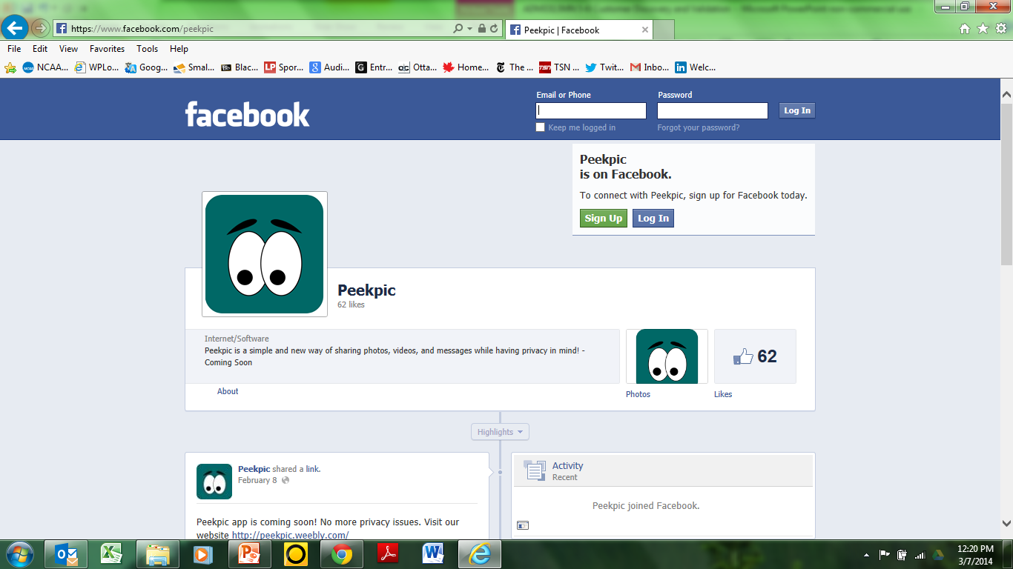

Slide 20
Crowd Funding Campaigns
http://www.indiegogo.com/Pub
http://www.indiegogo.com/projects/help-bring-victoire-to-toronto
https://www.kickstarter.com/projects/1470156778/wipebook

Slide 21
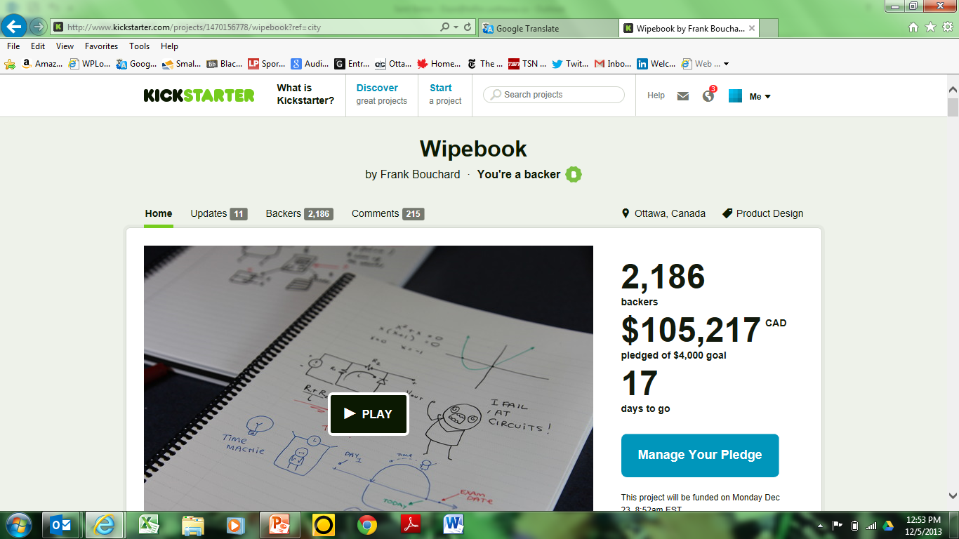

Slide 22
Examples

Slide 23
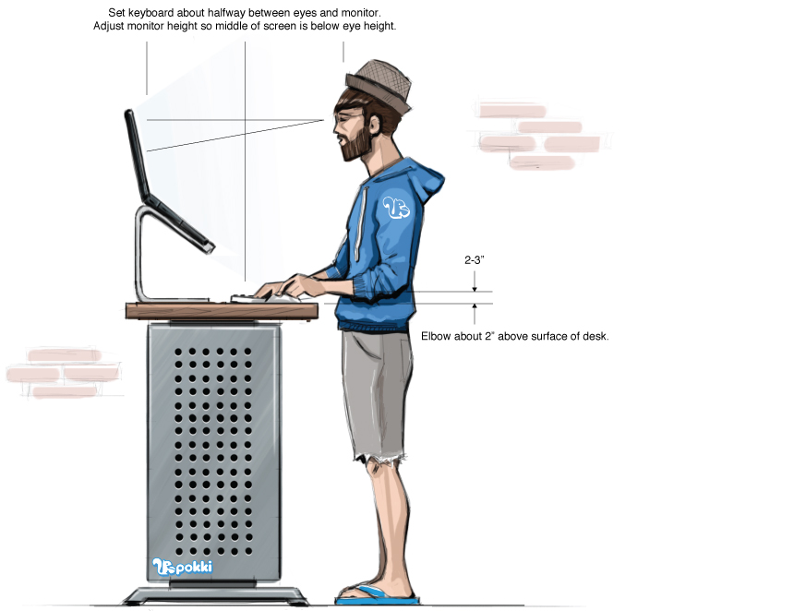
Standing Desk

Slide 24
Standing Desk
- Google Trends
- Pinterest
- Topsy
- Landing page with mock image, looking for “purchases”
Google Adwords
Scheduled Tweets with Hootsuite
Paid Facebook and Twitter Ads
https://www.linkedin.com/pulse/sell-how-test-out-new-product-shoestring-ryan-holmes?trk=hp-feed-article-title-like

Slide 25

100% Vegan Restaurant?

Slide 26
100% Vegan Restaurant?
Catering
Small shows
Mail list
LCBO events
Pre-sold gift certificates and meals

Slide 27
Case study

Slide 28
Birth of an Idea

Slide 29
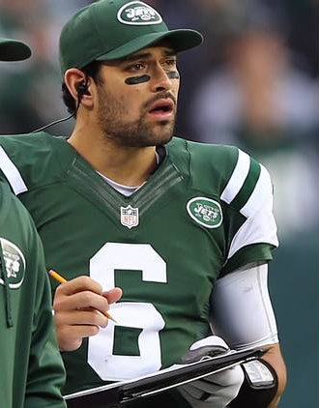
I’d like to help

Slide 30


Slide 31


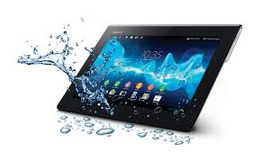


Slide 32
Group Exercise
A Clipboarding tablet app that allows for easy recording of plays and real time analytics.
  - List the low cost methods you would use to validate this idea.

Slide 33
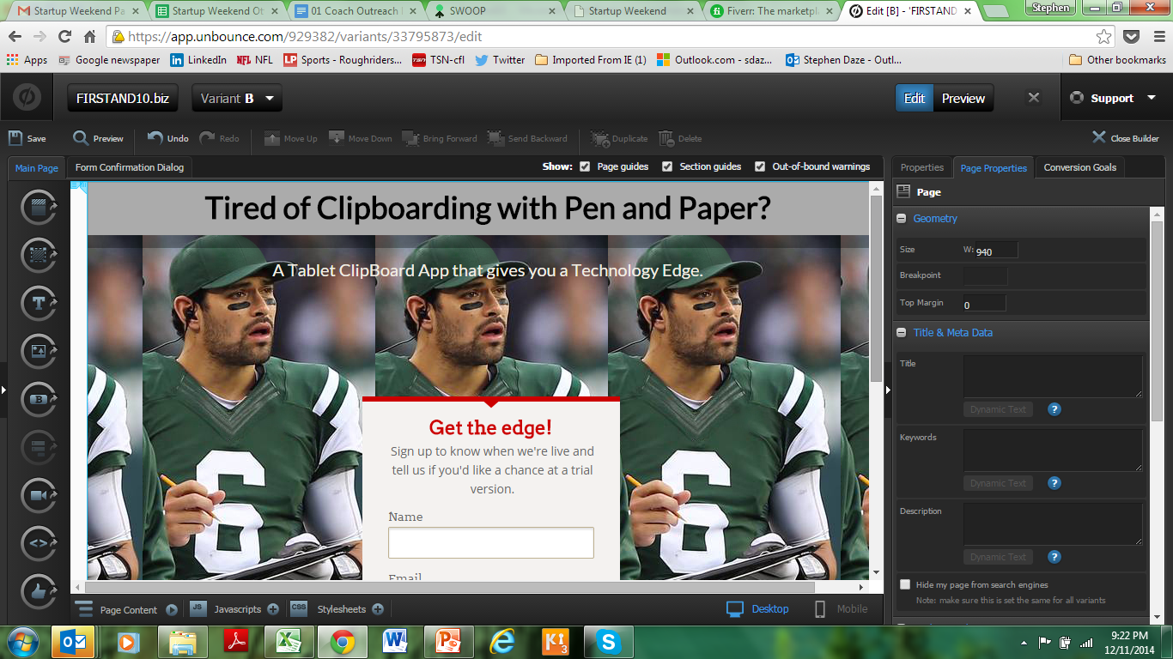
www.unbounce.com $54 (1 month free trial)

Slide 34
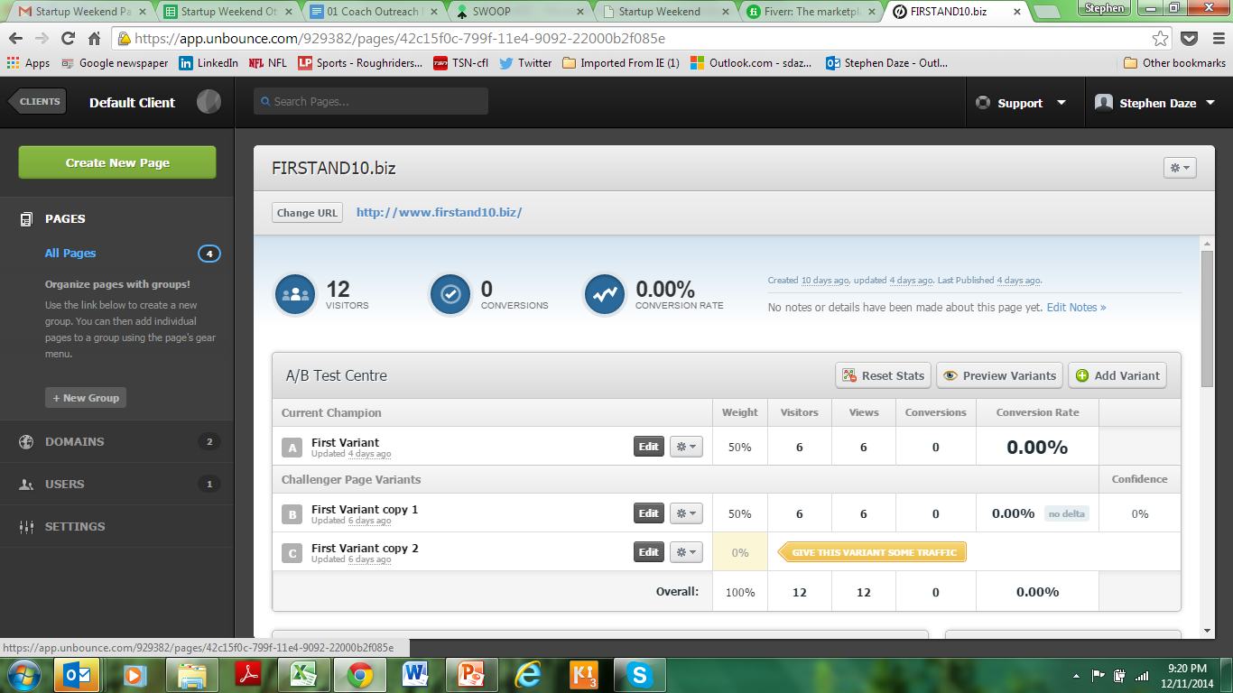

Slide 35
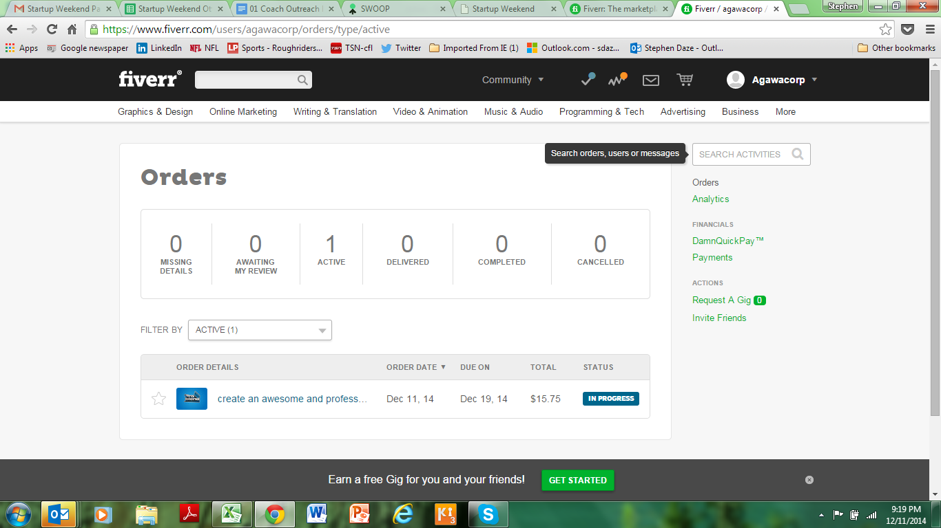
www.fiveer.com $15.75

Slide 36
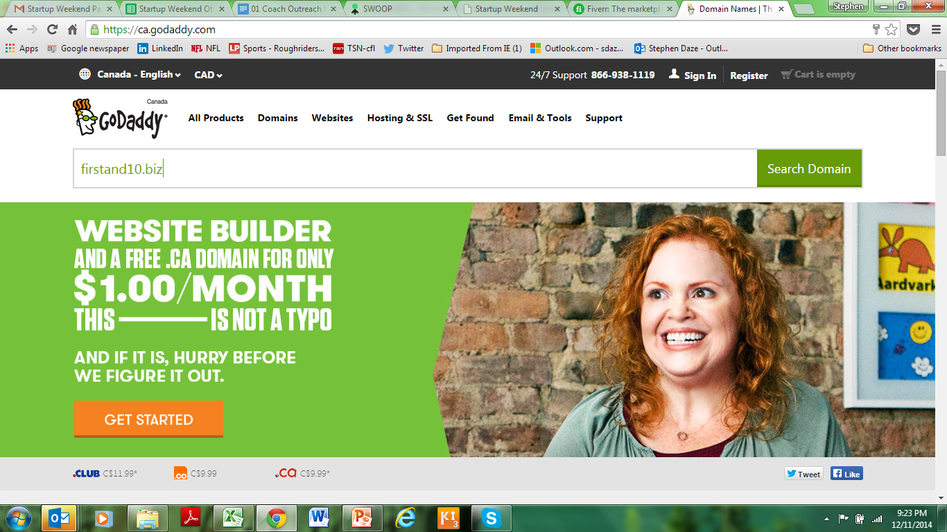
$16

Slide 37
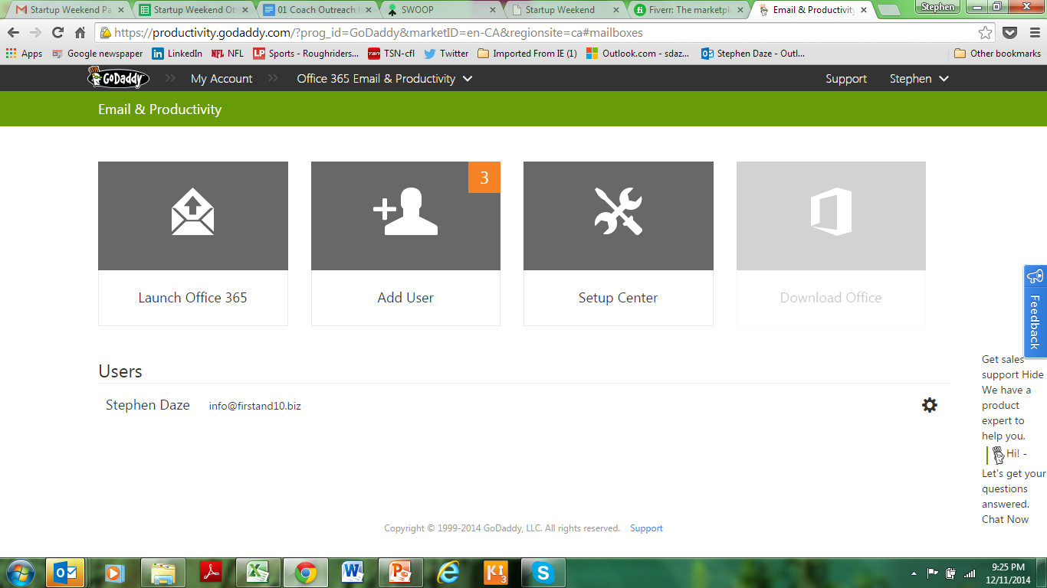
$5/month

Slide 38
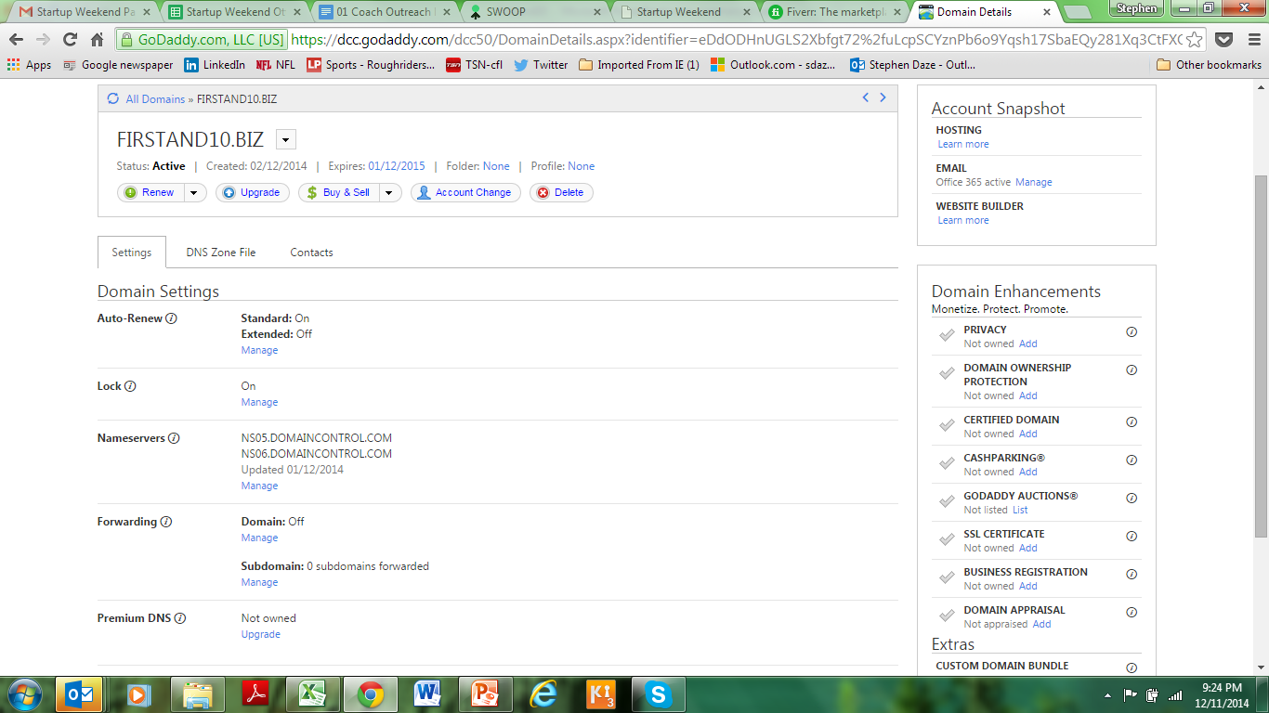

Slide 39
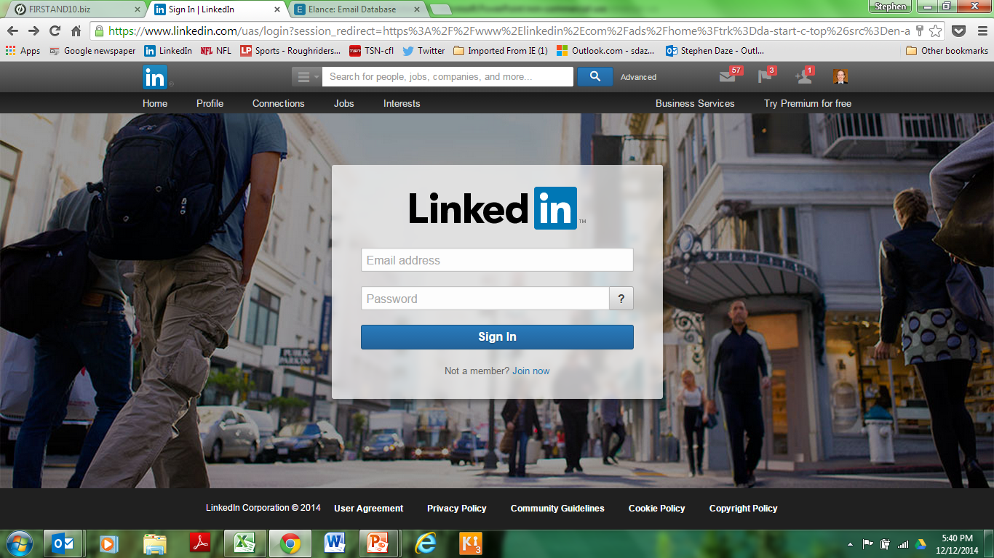

Slide 40
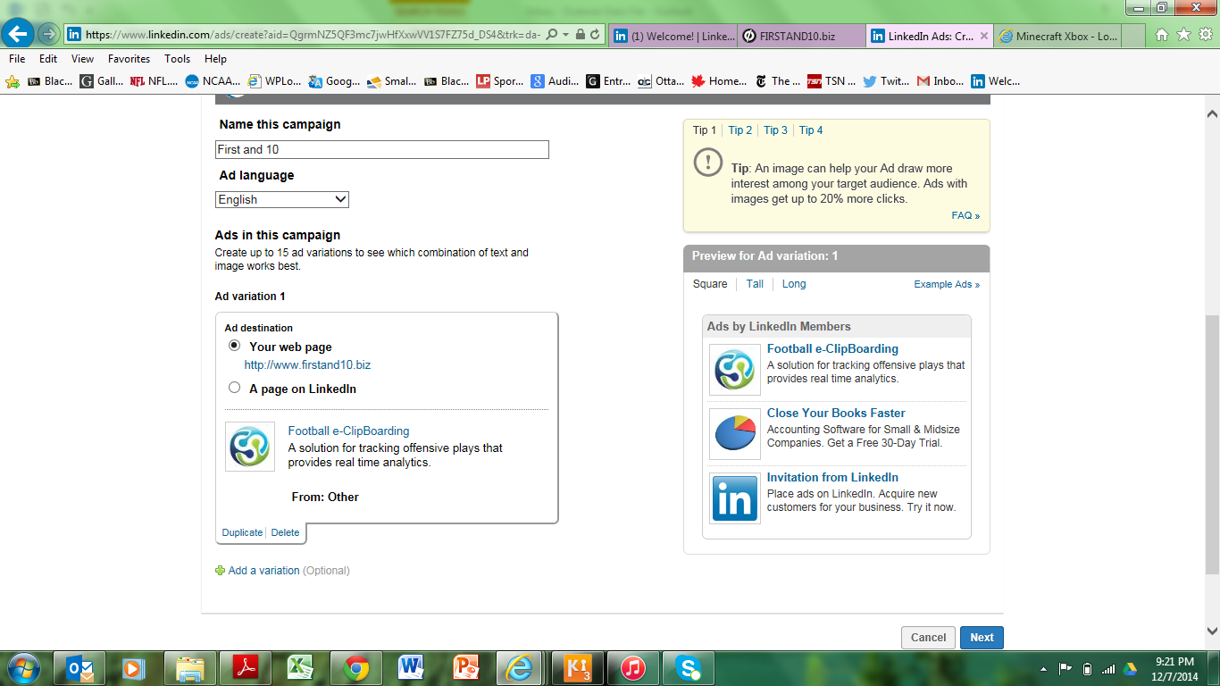

Slide 41
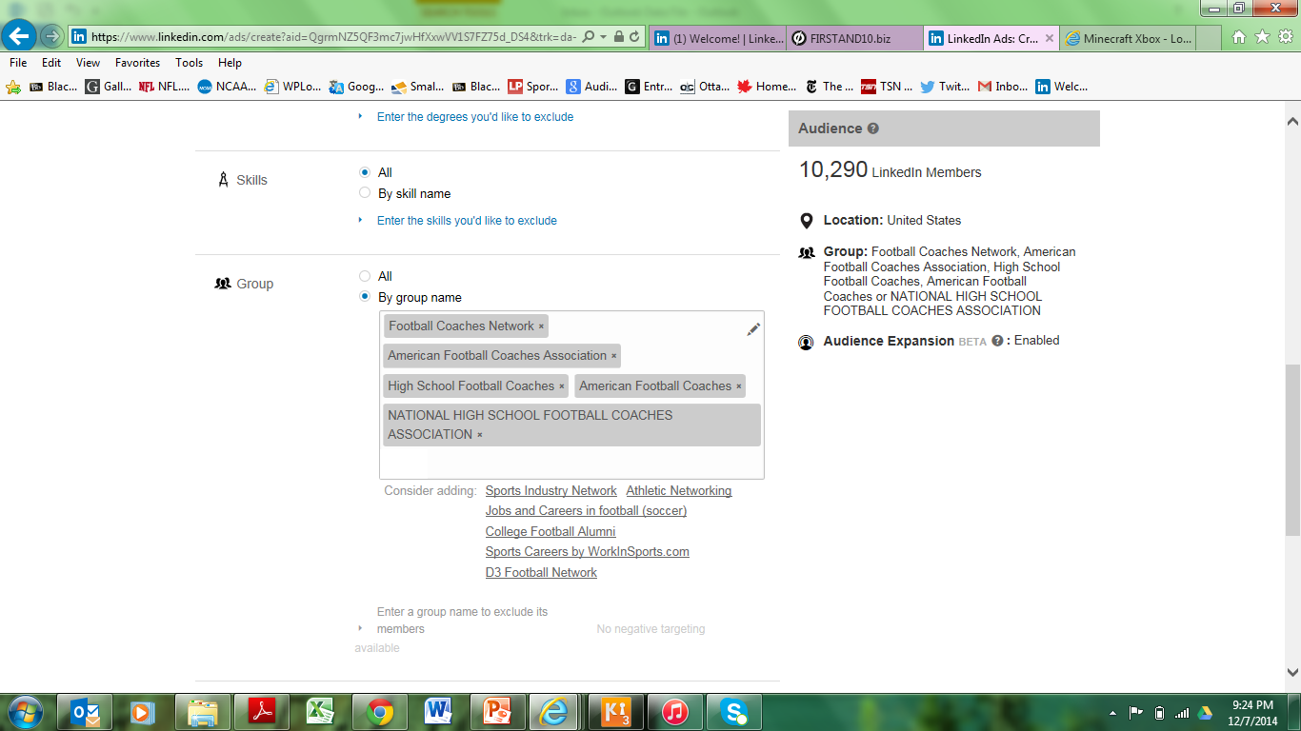

Slide 42
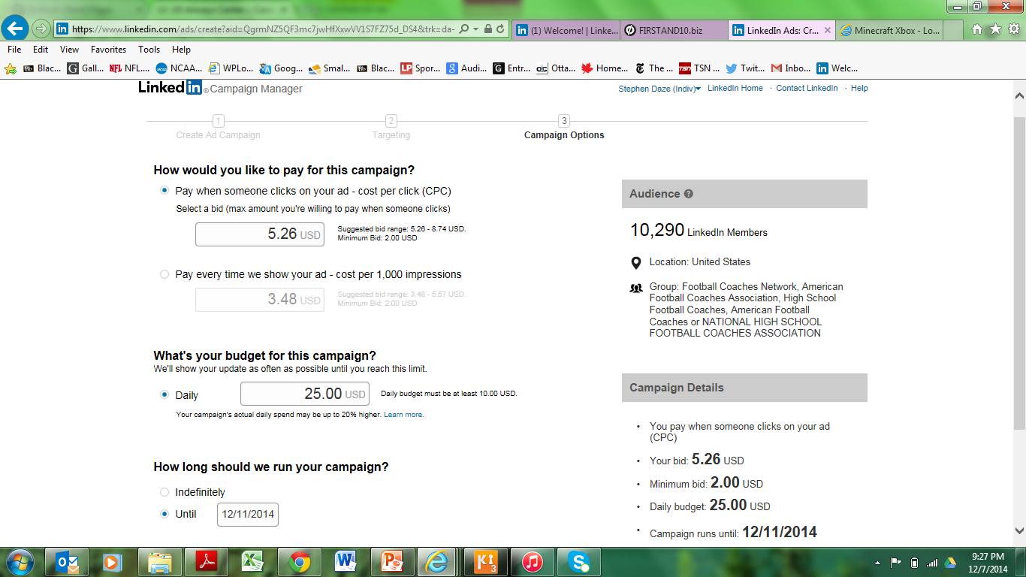
Google Adwords max. $25/day

Slide 43
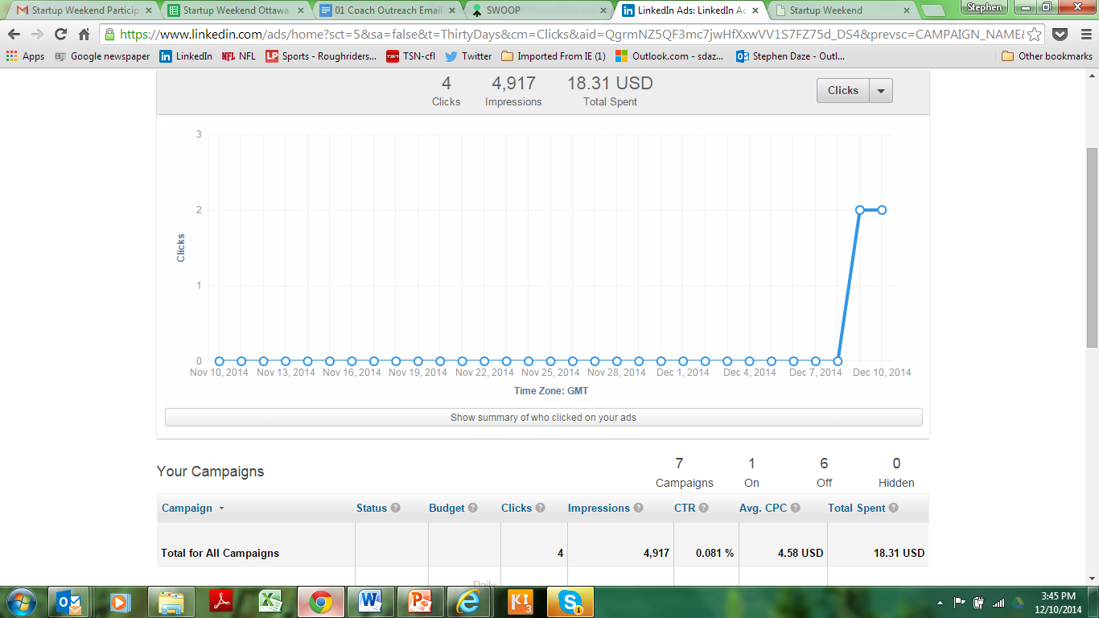

Slide 44
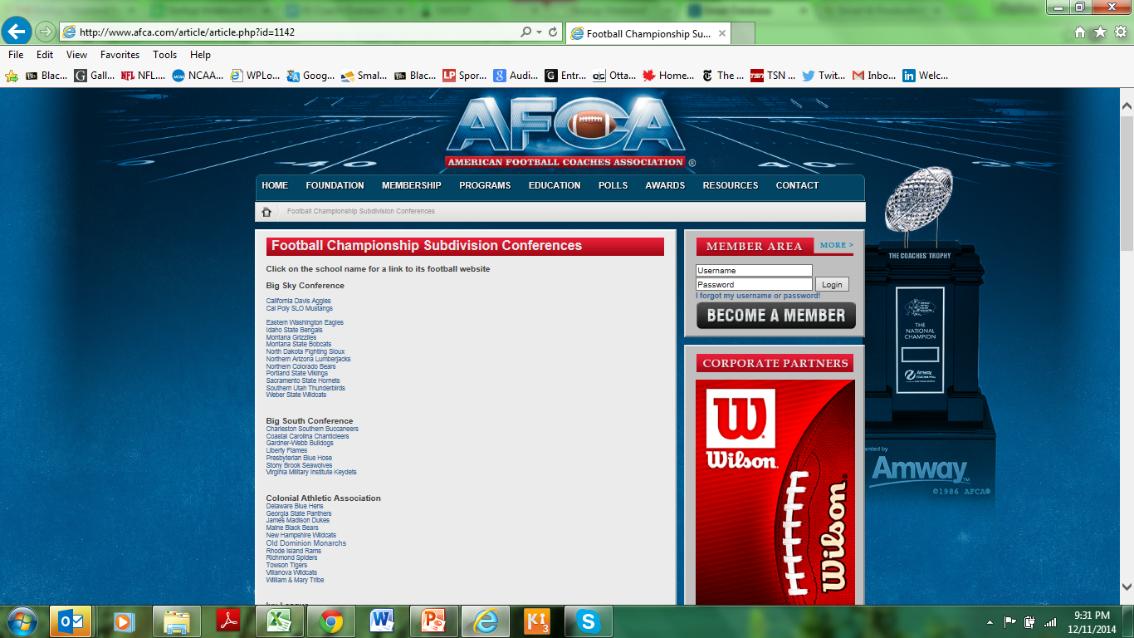

Slide 45
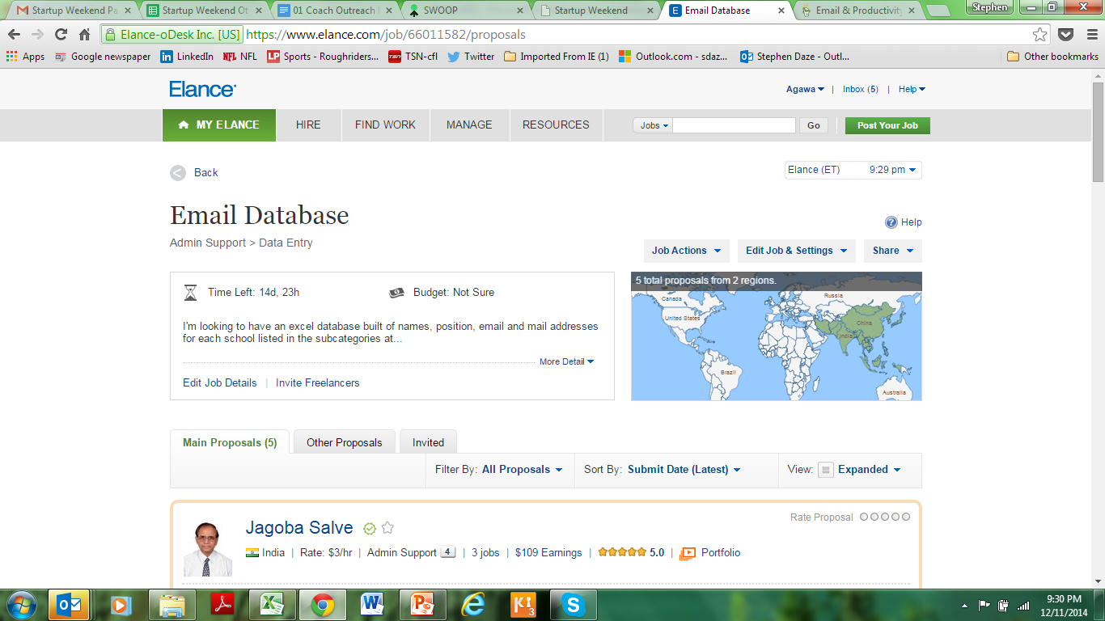
www.elance.com $54.79

Slide 46
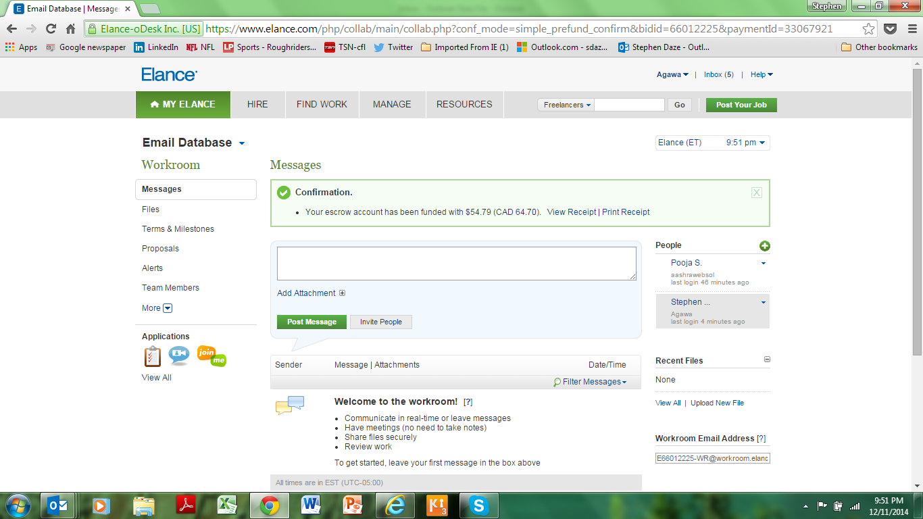

Slide 47
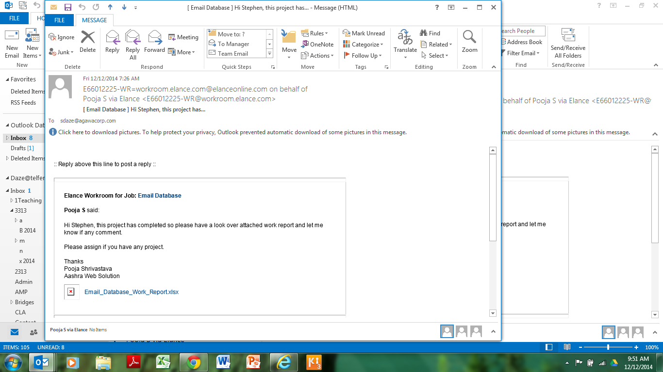

Slide 48
Next steps
Build out of a demo version.
Launch of actual website (more validation; sign ups; early sales?)
Participation in annual coaches show in January.

Slide 49
Tools

Slide 50
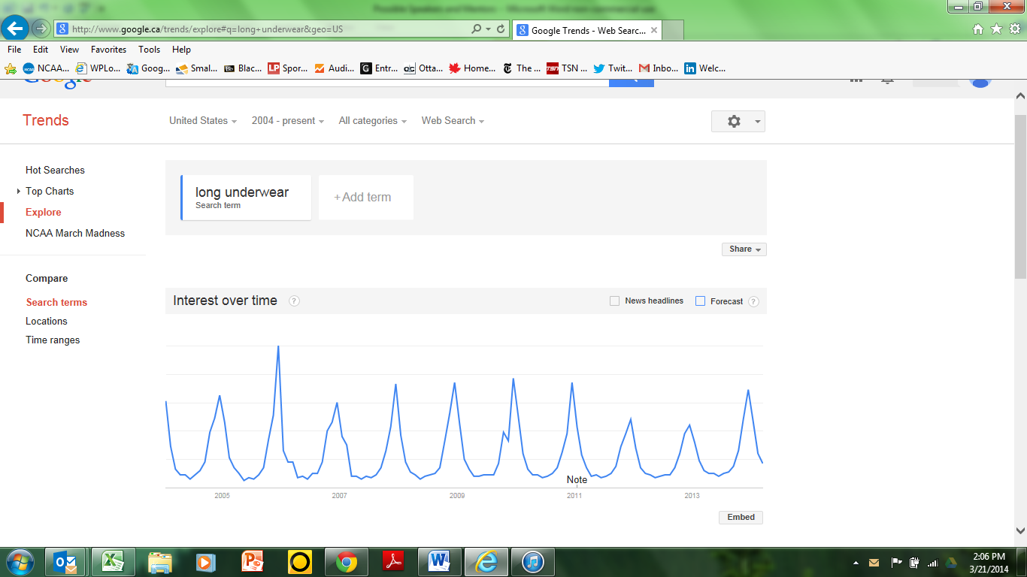
Google Trends

Slide 51
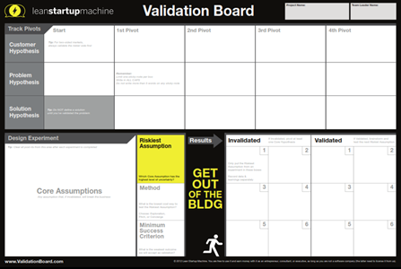
Validation Board
http://leanstartupmachine.com/
Overview
http://www.youtube.com/watch?feature=player_embedded&v=HhoducyStMw#
How to Use it
https://www.youtube.com/watch?v=G8Rk0c3axtI

Slide 52
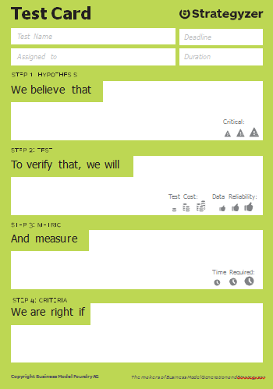
Strategyzer Test Card

Slide 53
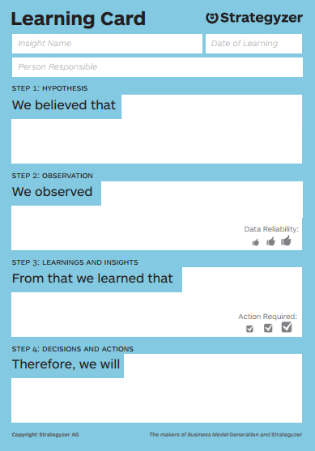
Strategyzer Learning Card

Slide 54
Pitching Validation results

Slide 55
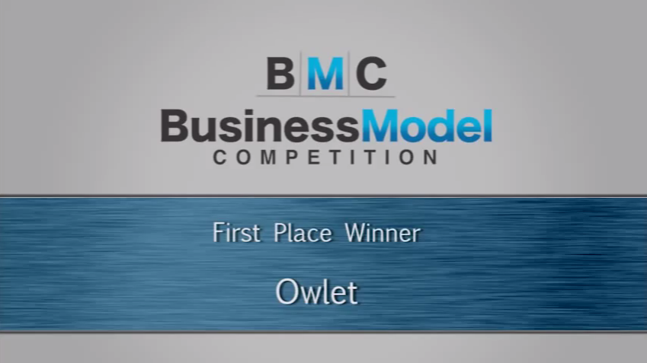

Slide 56
Pitch Template

Slide 57
Validation efforts to date:
PROJECT or TEAM NAME
Number of Customer Interviews (f2f) - XX
Number of Surveys Completed - XX
Number of Industry Experts Consulted - XX
Other Tests/Validation Methods -
__________________________________________
__________________________________________

Slide 58
Business Premise
1. Industry description
  Size
  Significance
  Other possible markets/opportunities

Slide 59
Business Premise Con’t.
2. Problem hypothesis or gap anticipated.
3. Possible solution.
4. How do you think you’ll make money (revenue model).

Slide 60
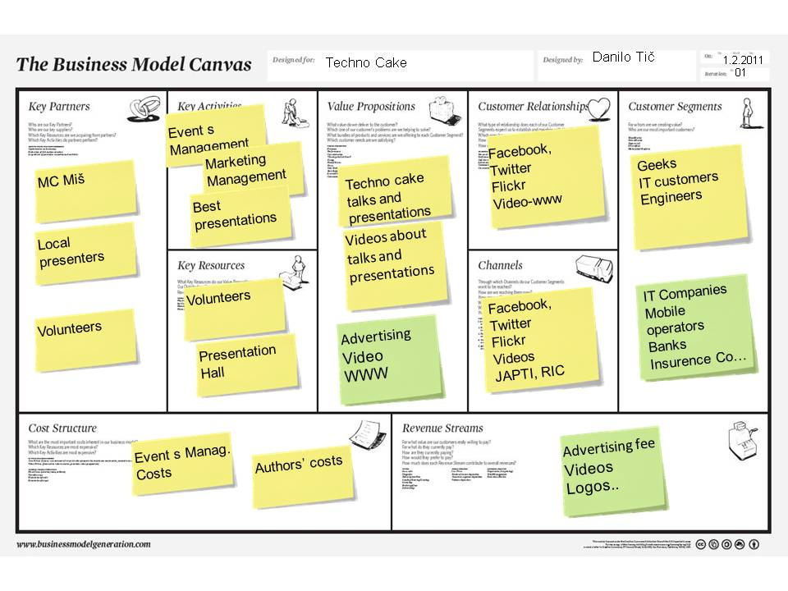
Business Model Canvas v.1

Slide 61
Summary of Validation Tests
What did you actually do?
Strategies, techniques, numbers and results

Slide 62
Key Learnings
About this Industry/business/client group etc.
About our business model and key elements
About the likelihood of moving forward
About what the next steps for this idea would be.

Slide 63
Business Model Canvas v.2..etc

Slide 64
Next Steps
What and how are we continuing with the validation process?

Slide 65
Example

Slide 66
Model and Validation for PeekPic
Last two weeks validation (Adults Segment)
Number of Customer Interviews - 64
Number of Surveys Completed - 39
Number of Industry Experts Consulted – 1
Other Tests/Validation Methods:
  Peekpic Website – www.peekpic.weebly.com
  Facebook Page – www.facebook.com/peekpic
Last two weeks interviews/surveys: 103
Total interviews/survey for the term: 282
Notes:
This needs to be updated.

Slide 67
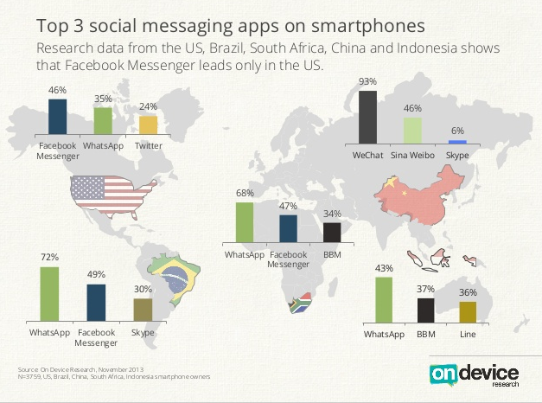
Peekpic App Peekpic App Industry description and Size
Instant Messaging Industry (IM)
  http://finance.yahoo.com/news/radicati-group-releases-instant-messaging-110000818.html
Notes:
1. http://finance.yahoo.com/news/radicati-group-releases-instant-messaging-110000818.html

Slide 68
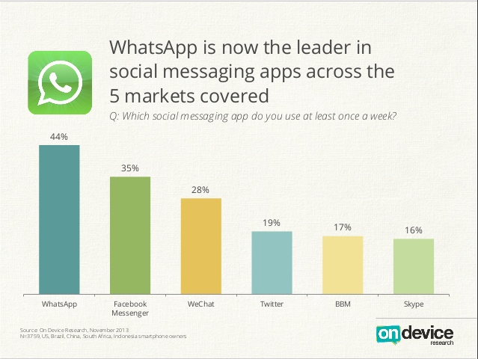
Peekpic App Industry description and Size
  http://finance.yahoo.com/news/radicati-group-releases-instant-messaging-110000818.html

Slide 69
Peekpic App
Industry description and size:
Instant Messaging Industry (IM)
Main players : Whatsapp, Viber, Snapchat etc.
Current Market Value: $3.4 billion by 2013
Forecasted : $4.4 billion by 2017¹
Our targeted market share over next 3 years (0.25%) =~ $8 millions
Notes:
1. http://finance.yahoo.com/news/radicati-group-releases-instant-messaging-110000818.html

Slide 70
Peekpic App
Problem hypothesis or gap anticipated:
a) Lack of privacy and security based communication application
b) Not perfect user experience
  c) Convenience with peace of mind
Possible Solution:
Develop a mobile communication App that doesn’t store user data
Enhance user experience by having a better Software design
Notes:
1. http://finance.yahoo.com/news/radicati-group-releases-instant-messaging-110000818.html

Slide 71
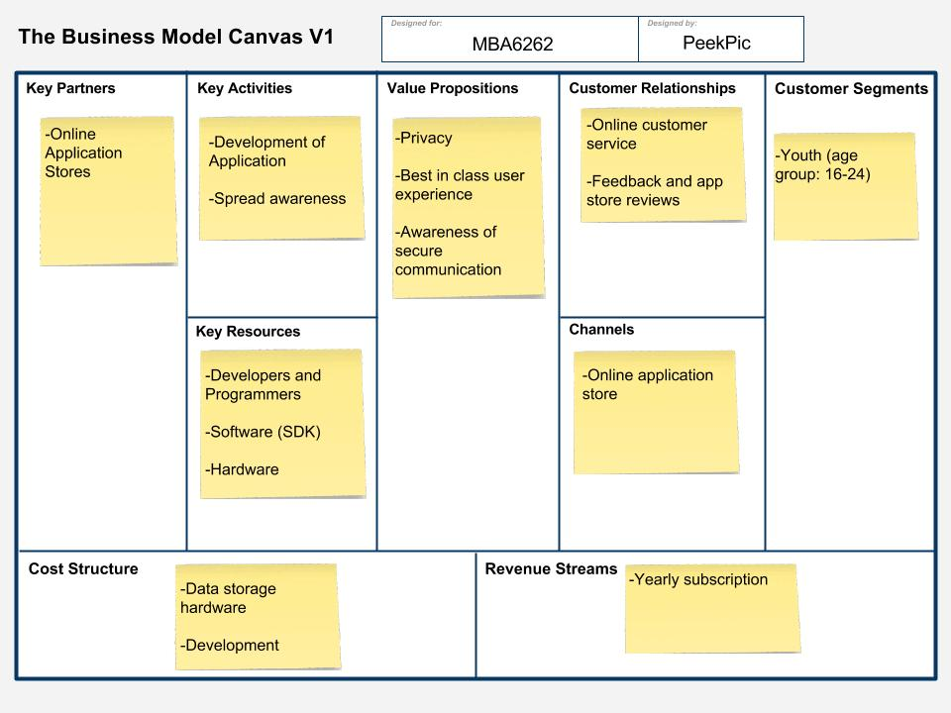
Business Model Canvas v.1

Slide 72
Summary of Validation Tests
Information gathered (for adult segment)
  Current applications used for sharing pictures and messages with friends
  Reasons for choosing current applications
  Opinion about the fact that personal data is being saved forever
  Willingness to switch to a secure platform
  Reasons for using our competitor’s platform

Slide 73
What we Learned
Social Media,
Facebook,Twitter,Tumbler,Reddit,Weibo,Renren etc.
IM
Whatapp,Viber,QQ,Wechat,iMessage
Traditonal Ways
SMS,MMS,Email
Total number of customer Interviews/Surveys (Adults) - 103

Slide 74
What we Learned

Slide 75
What we Learned (Opinion about data being saved forever)

Slide 76
What we Learned

Slide 77
What we Learned

Slide 78
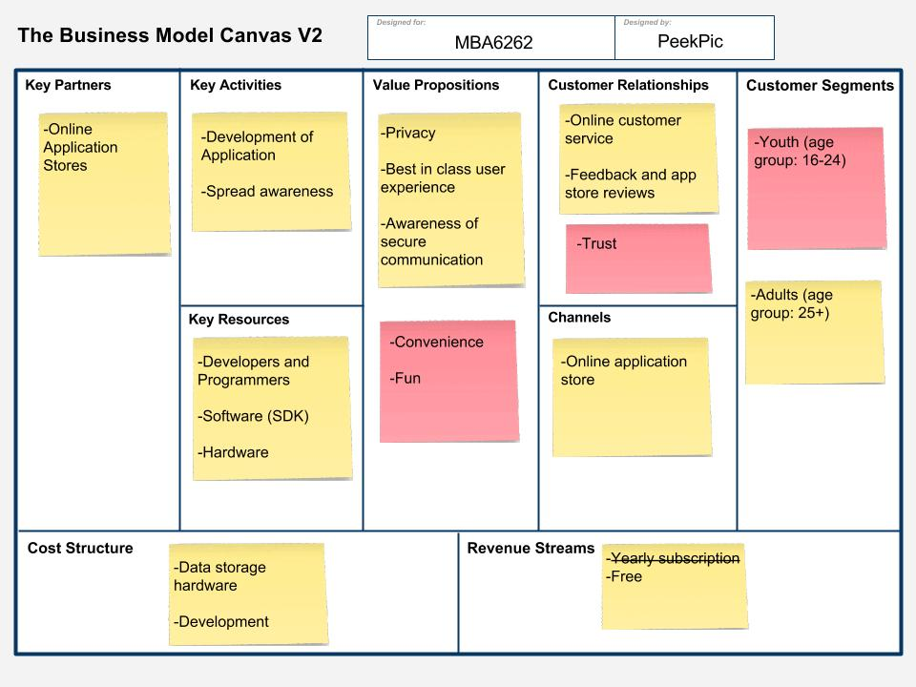

Slide 79
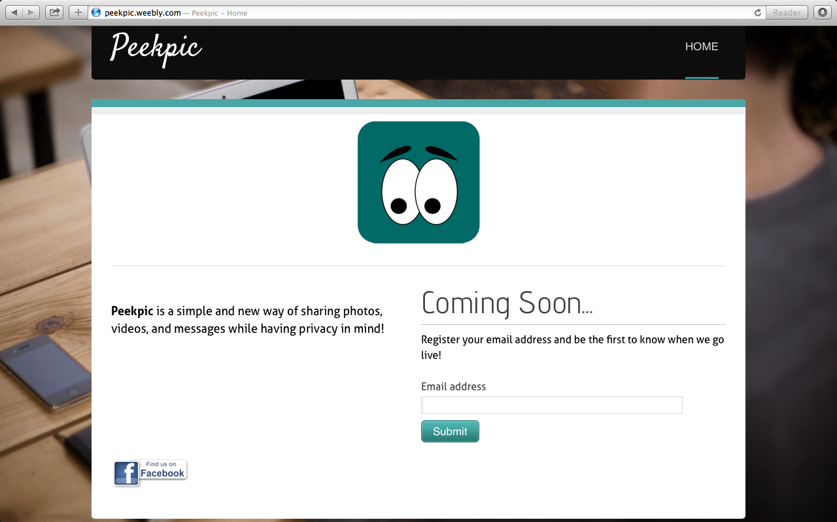
Peekpic Website
  www.peekpic.weebly.com

Slide 80
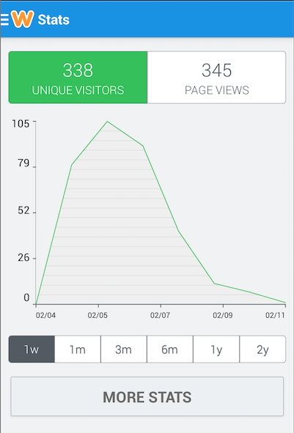
Peekpic website stats ~6 days

Slide 81
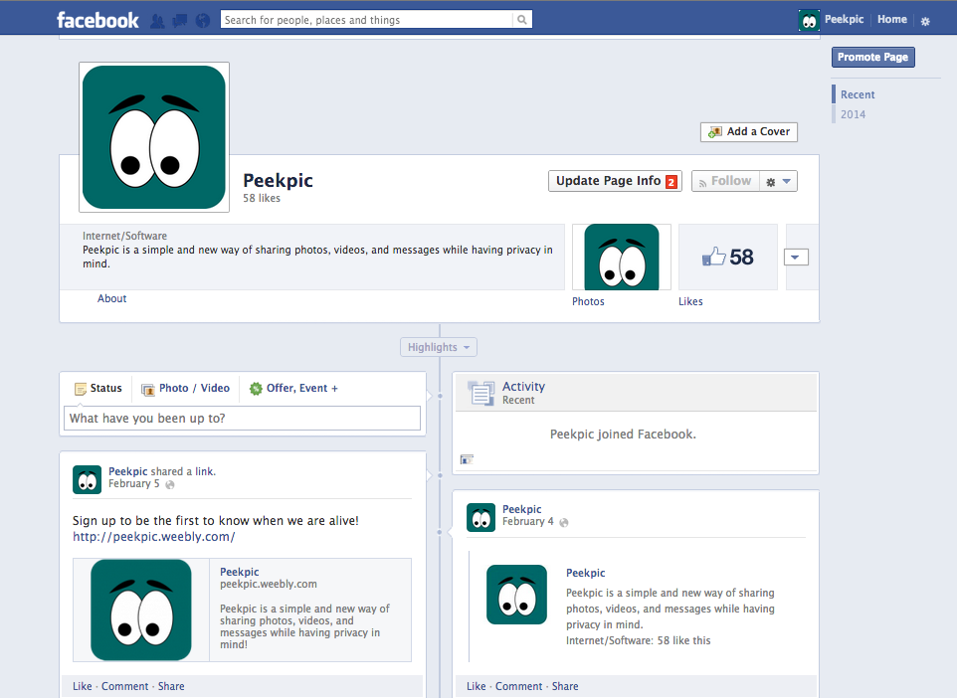
Peekpic Facebook Page

Slide 82
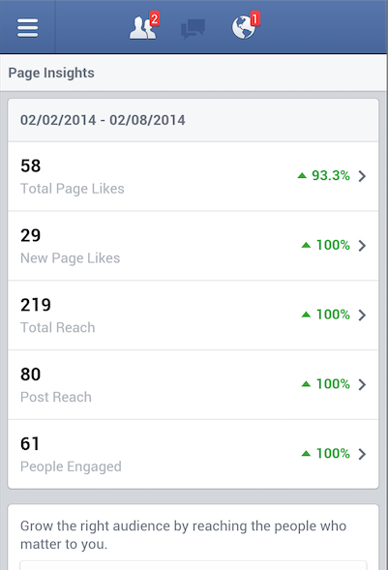
Peekpic Facebook stats ~ 9 days

Slide 83
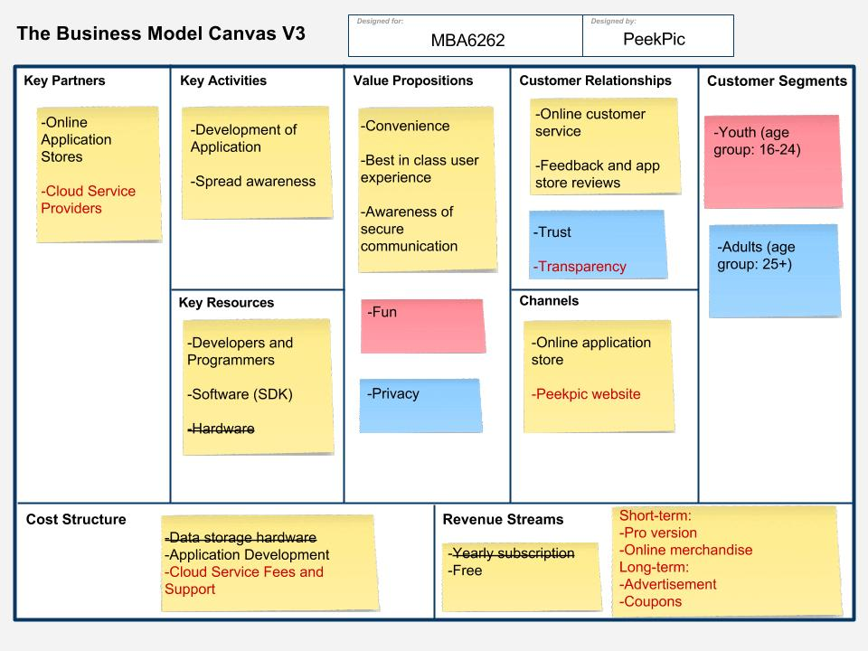

Slide 84
Next Steps in Validation
Continue validating business model canvas version3
Analyze the potential competitors and their customers
Launch Minimum Viable Product (MVP)
Decide on the cloud service provider
Select a mentor to guide for validation

Slide 85
Next Steps in Starting (long term focus)
Develop Go-To-Market strategy
Develop the complete Peekpic Business Plan
Expand the revenue model
Develop the application software

Slide 86
Parting Thoughts?

