Slide 1
Stephen Daze Dom Herrick Entrepreneur in Residence and Visiting Professor uOttawa, Telfer School of Management
Business Models

Slide 2
About me
Education
Entrepreneurship Exec. Ed.
Babson College
Stanford Lean LaunchPad
Business Administration - University of Regina
Adult Education - St. FX
Work History
Dom Herrick Entrepreneur-in-residence and Visiting Professor- uOttawa TSoM
Founder: Agawa Entrepreneurship Development Co.
Various early stage concepts
Managing Director: Entrepreneurship Centre
Professional
Advisory Boards: Telfer Career Centre; uO Engineering's EIEF; Manning Innovation awards; Ottawa Innovation Centre Advisory Panel

Slide 3
Business Models
A sketch/summary of what the business will do and how it will make money.
Includes strategic components of the business idea and how it operates.
Often established based on trial and error.
Forms the basis for success or failure.

Slide 4
Why are Business Models Important?
Uber, the world’s largest taxi company, owns no vehicles.
Facebook, the world’s most popular media owner, creates no content.
Alibaba, the most valuable retailer, has no inventory.
And Airbnb, the world’s largest accommodation provider, owns no real estate.
Something interesting is happening.
Tom Goodwin,
Sr. Vice President of strategy and innovation at Havas Media

Slide 5
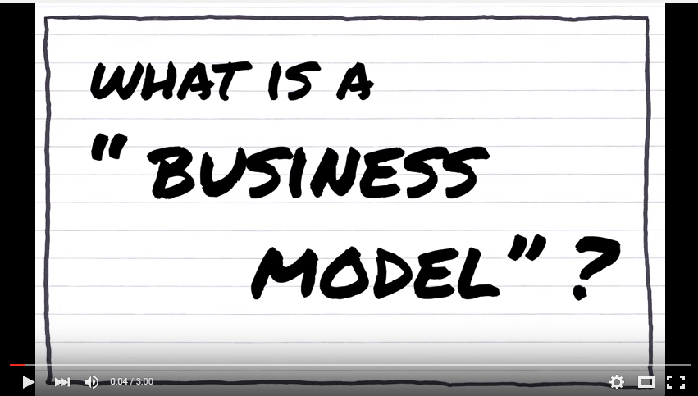
Business Models

Slide 6
Business Models vs. Business Plans
Business Plans
Assume full knowledge of the market, solution and customers.
Don’t require a lot of external interaction.
Are a useful implementation tool, focusing much on operationalizing strategies.
Usually written too soon; often not written at all.
Business Models
Assumes evolution: discovery and iteration.
Forces “getting out of the building” to talk with clients.
Forms foundation for success or failure.

Slide 7
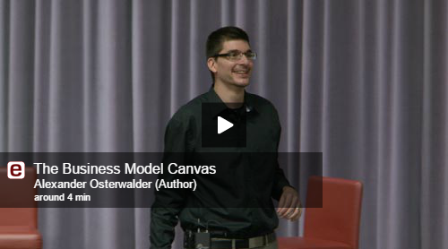
Business Model Canvas

Slide 8
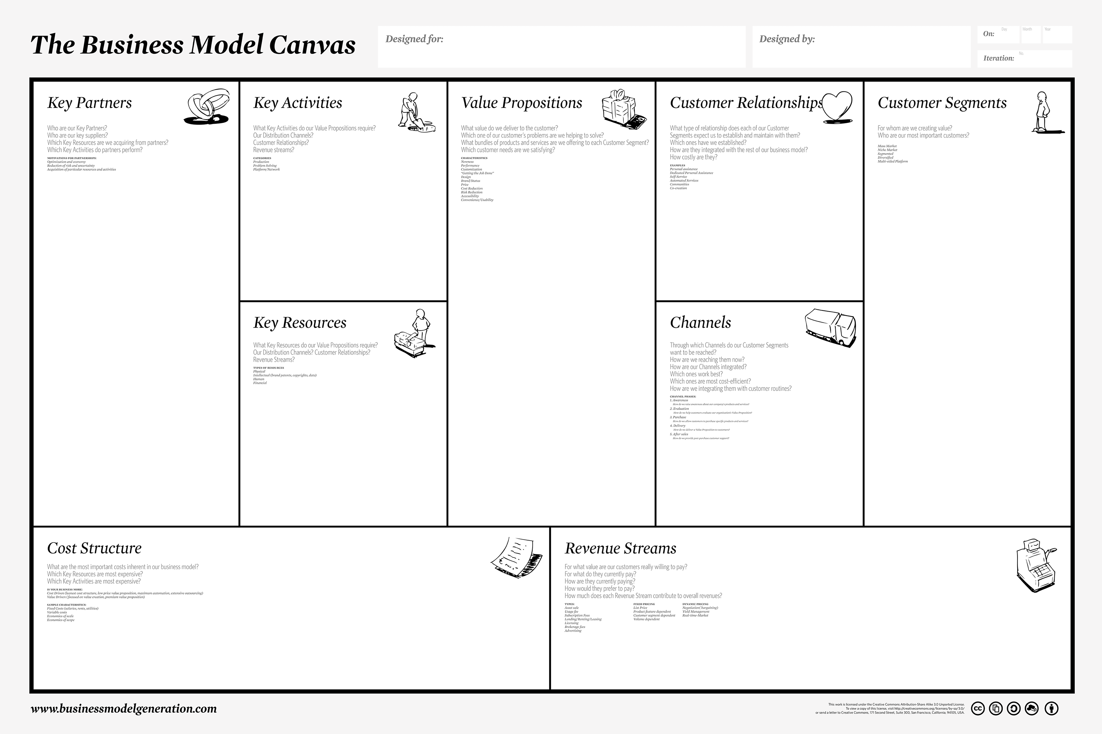

Slide 9
Business Model Examples
(….Xyz….) provides value to:
(…..customer/market segment……) | by offering (….xyz product and xyz value….), | they make money (…..from, by, through……).
1.
2.
3.
4.

Slide 10
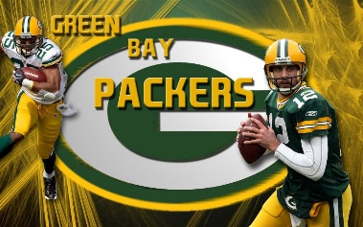
.
1
NFL Team (Green Bay Packers)
2
Luxe Box (Loose Button)
3
iPhone
4
Elance

Slide 11
Parting Thoughts?

