Slide 1
Stephen Daze Dom Herrick Entrepreneur in Residence and Visiting Professor uOttawa, Telfer School of Management
Business Models

Slide 2
About
Education
Entrepreneurship Exec. Ed.
Babson College
Stanford Lean LaunchPad
Business - University of Regina
Adult Education - St. FX
Work History
Dom Herrick Entrepreneur-in-residence and Visiting Professor- uOttawa TSoM
www.coachmystartup.com
Various early stage concepts
Managing Director: Entrepreneurship Centre
Retail management: Second Cup; ToysRus
Professional
Advisory Boards: Telfer Career Centre; uO Engineering's EIEF; Manning Innovation awards; Ottawa Innovation Centre Advisory Panel
More at:

Slide 3
Business Models
A sketch/summary of what the business will do and how it will make money.
Includes strategic components of the business idea and how it operates.
Often established based on trial and error.
Forms the basis for success or failure.

Slide 4
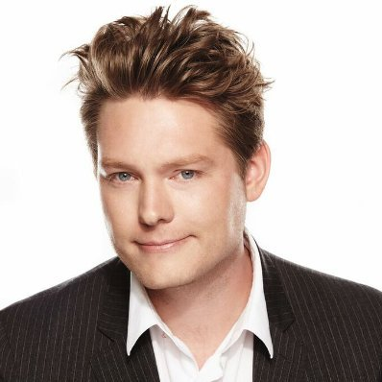
Why are Business Models Important?
Uber, the world’s largest taxi company, owns no vehicles.
Facebook, the world’s most popular media owner, creates no content.
Alibaba, the most valuable retailer, has no inventory.
And Airbnb, the world’s largest accommodation provider, owns no real estate.
Something interesting is happening.
Tom Goodwin,
Sr. Vice President of strategy and innovation at Havas Media

Slide 5
Business Models vs. Business Plans
Business Plans
Assume full knowledge of the market, solution and customers.
Don’t require a lot of external interaction.
Are a useful implementation tool, focusing much on operationalizing strategies.
Usually written too soon; often not written at all.
Business Models
Assumes evolution: discovery and iteration.
Forces “getting out of the building” to talk with clients.
Forms foundation for success or failure.

Slide 6
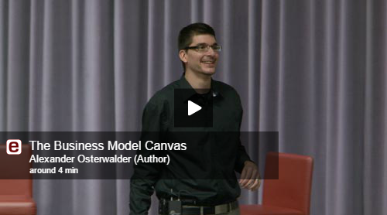
Business Model Canvas

Slide 7
The following slides thanks to Steve Blank and the Lean LaunchPad Educators Program

Slide 8
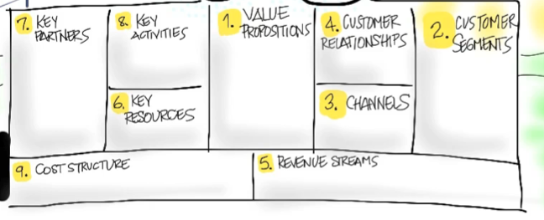
Value Proposition
What Are You Building and For Who?

Slide 9
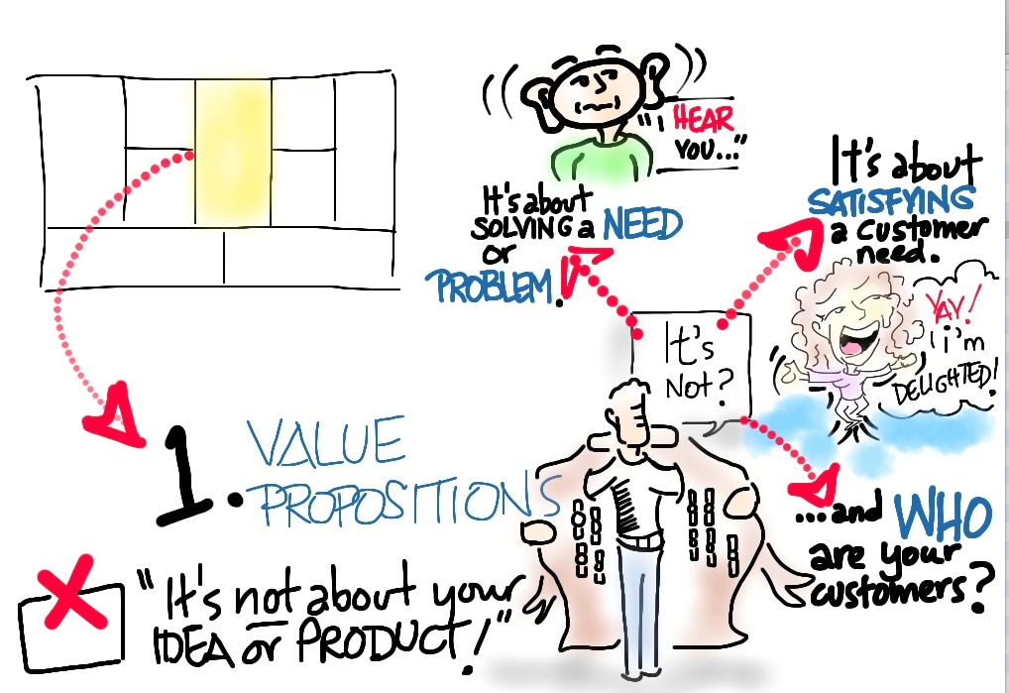

Slide 10
Customer Segments
Who Are They?
Why Would They Buy?

Slide 12
Multiple Customer Segments
Might have multiple segments of users
Might have users and payers
Might have 5 or 6 different customers
Medical devices have doctors, hospitals, patient, insurance company, FDA, etc.
For every customer segment you need:
Value proposition
Revenue model
And may have unique channels, customer relationships, etc.

Slide 13
Product/Market Fit
Does the Value Proposition MVP match the Customer Segment Archetype?

Slide 14
Channels
How does your Product Get to Customers?

Slide 16
Customer Relationships
How do you Get, Keep and Grow Customers?

Slide 18
Revenue Streams
How do you Make Money?

Slide 20
Key Resources
What are your most important Assets?

Slide 22
Key Partners
Who are your Partners and Suppliers?

Slide 24
Key Activities
What’s Most Important for the Business?

Slide 26
Cost Structure
What are the Costs and Expenses?

Slide 28
BUT...

Slide 29
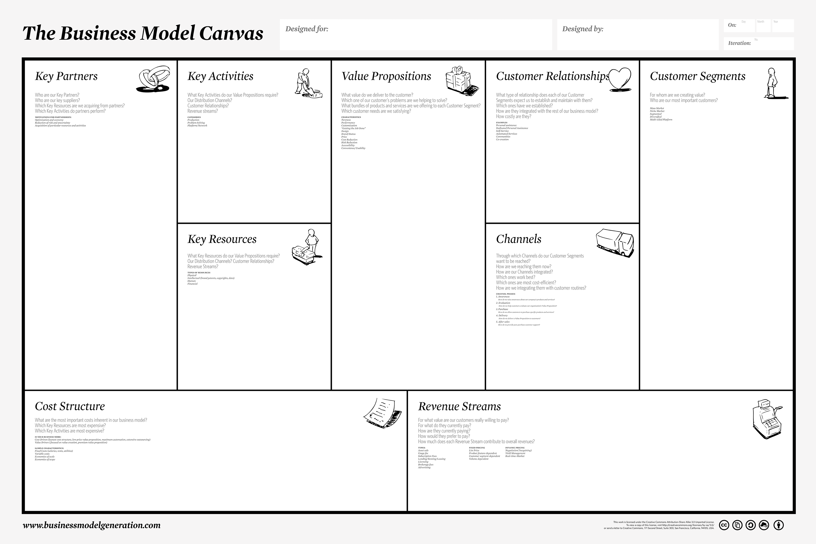
They are all Guesses
Guess
Guess
Guess
Guess
Guess
Guess
Guess
Guess
Guess

Slide 30
We have to Validate (test) our Assumptions
Test the Problem, then the solution.
Start with the riskiest.

Slide 31
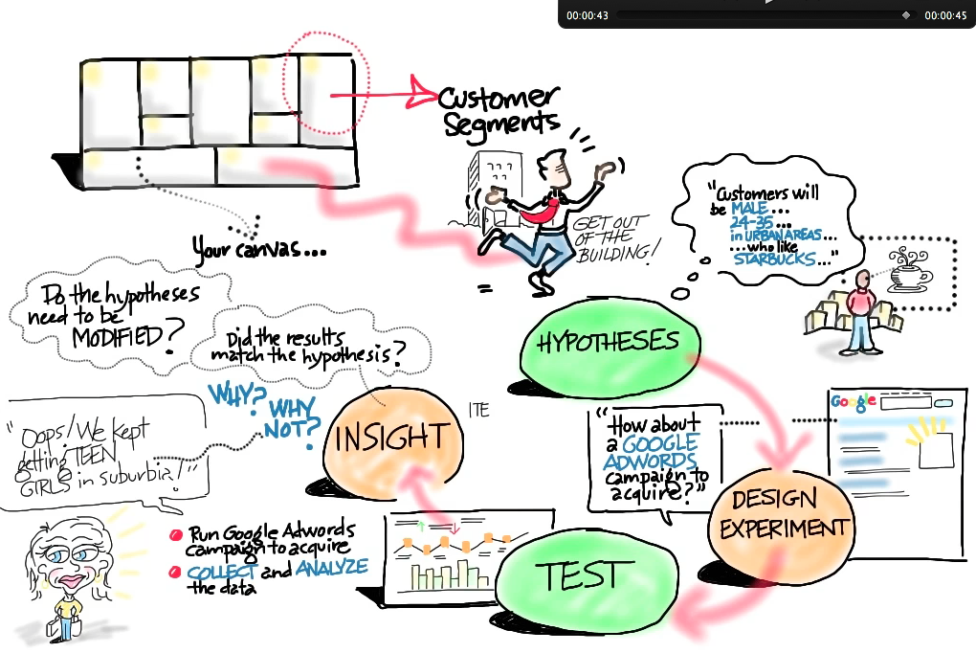

Slide 32
Business Model Examples

Slide 33
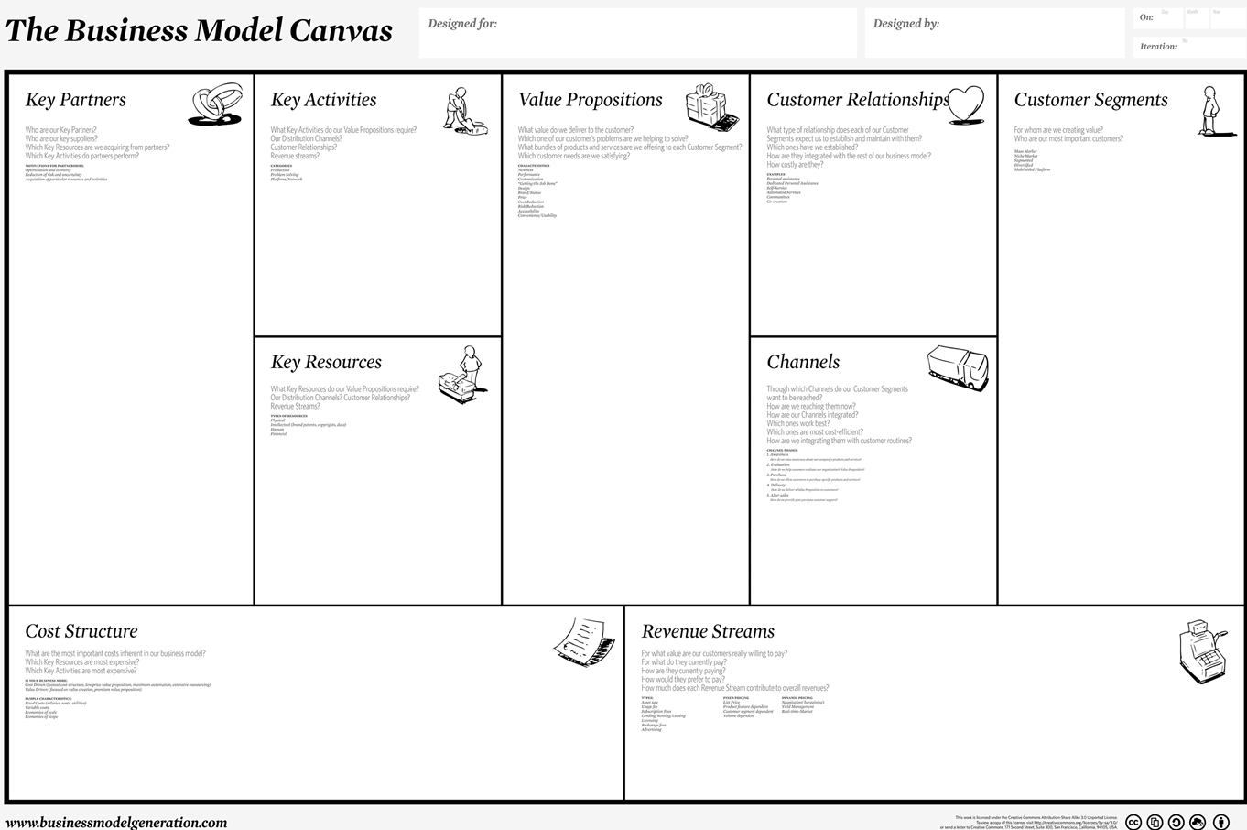
Lemonade Stand in City Park

Slide 34
Amazon Business Model Canvas

Slide 36
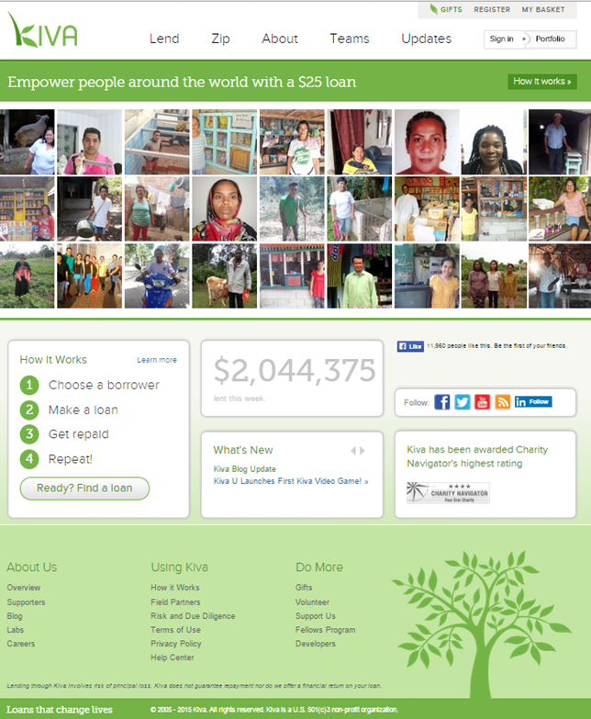
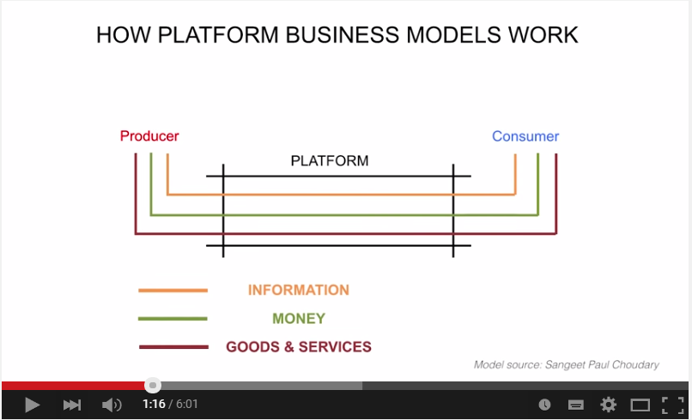
Kiva Business Model Example

Slide 37
What are the BMC Differences?

Slide 38
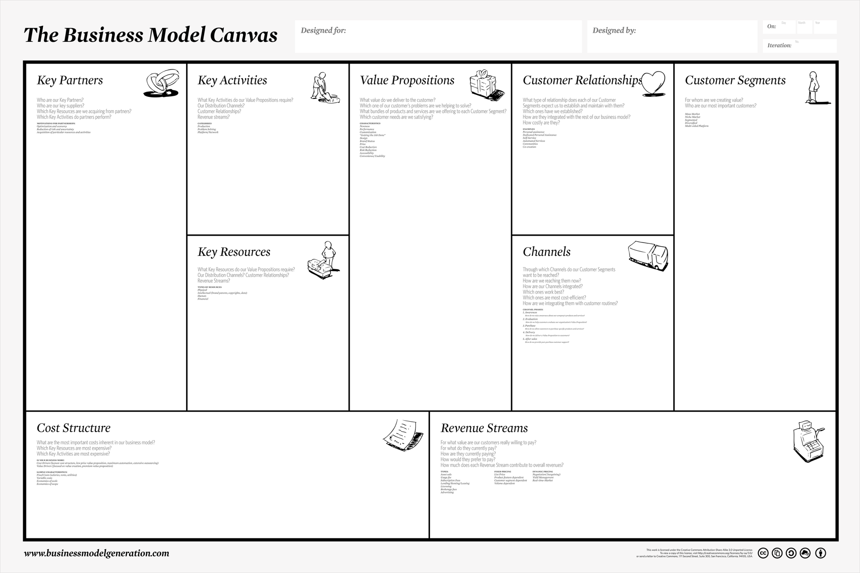

Slide 39
Relevant Exercise
In groups:
Which component(s) of the Business Model Canvas is most important or unique for this business and why?

Slide 41
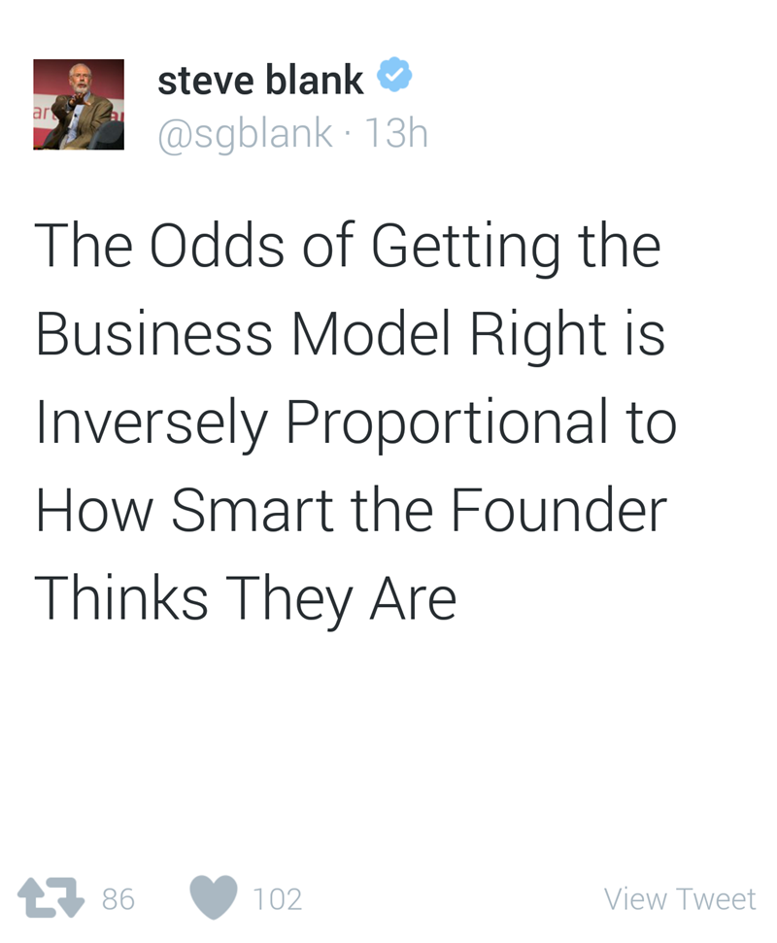

Slide 42
Parting Thoughts?

