Slide 1
Cash Flow
Stephen Daze
Dom Herrick Entrepreneur in Residence
daze@telfer.uottawa.ca

Slide 2
OBJECTIVES
1. Understanding the fundamentals of your cash flow statement.
2. Determine how your cash flow relates to the remainder of your Business Plan.
3. Complete a 12 month cash flow for a new business.

Slide 3
What is a Cash Flow Statement?
- It’s not a “statement of cash flows.”
- It is a projected financial statement.
- Likely similar to an individual “budget.”

Slide 4
Your cash flow helps you:
Determine when you can afford to take a draw out of the business.
Determine whether or not you can pay your bills each month.
Determine how much financing you need to run your business properly.
Determine when you can afford to grow your business through hiring staff, expanding your location or by purchasing capital equipment.
Determines how much money you have in the bank at the end of each month, it is not your profit.

Slide 5
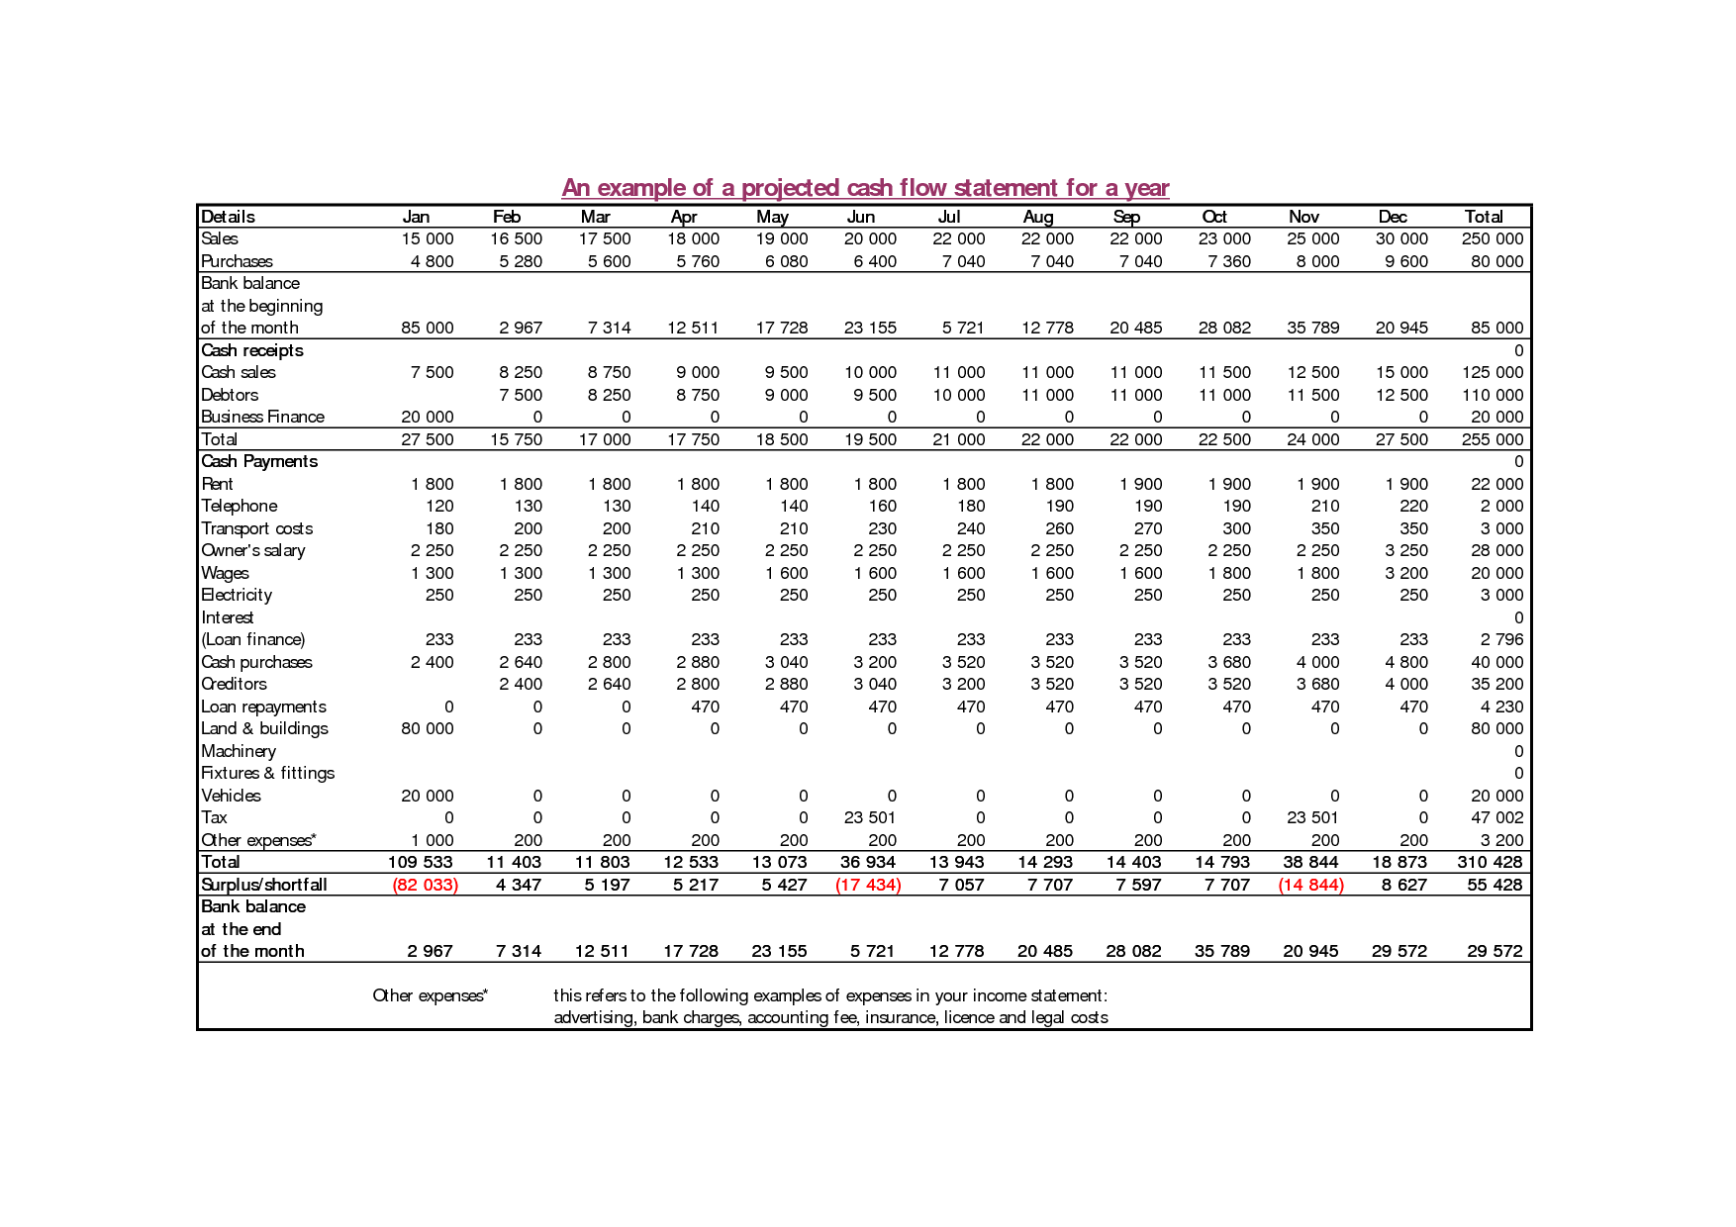

Slide 6
Cash Flow Forecasting:
… simply taking the words of the business plan
and translating them into numbers.
Actual money that is collected
from sales and actual money that is
paid out for expenses
on a monthly basis.

Slide 7
The Cash Flow Statement
There are three main sections in a cash flow statement:
Sources of Cash (Cash Receipts/Revenues)
• Cash revenues
• Loans
• Equity Investment (Personal or Outside Source)

Slide 8
2. Uses of Cash (Expenses or Disbursements)
• Actual Expenses that will be paid in that month
• Start-up Costs
Monthly Balance
• You can calculate how much cash you have left at the end of each month
• Revenue – Disbursements = Cash balance (monthly)
• Add your month end cash balances together to get a cumulative monthly total

Slide 9
Plus
Justification of your Revenue & Expenses Projections
How did you come up with the numbers?
Include a page of assumptions/footnotes.
Be able to explain each account line in your cash flow.

Slide 10
Projecting Disbursements
Consider the following factors when you are compiling your numbers:
1.. Include all your start-up costs
2. Promotional Mix Activities– will cause changes in your monthly expenses and sales.
3. Straight line approach – Your busy or slow periods should be reflected in your increasing or decreasing costs for those periods: avoid straight line/flat line of your expenses. Most of your costs are rarely the same every month.

Slide 11
Projecting Revenue
Your revenue projections are probably the most critical, yet difficult, aspects of completing an accurate cash flow statement. Consider the following factors when putting your numbers together:

Slide 12
If you have a sales history, go back and use those figures to help guide your projections.
Your promotional mix activities can have a direct impact on your revenues.
Seasonality factors may influence the increase or decrease of revenues.
Ensure that your projected growth rate is realistic for a new business entering the market place.
Monitor the competition- your revenues maybe influenced by their activity.
Continuously monitor current market conditions so you may react to changes in the industry (trends, gaps/needs, target market, competition)

Slide 13
FACTORS INFLUENCING YOUR REVENUE COLLECTION
q What percentage of your sales will be cash?
What percentage of your sales will be by credit?
q Will you take deposits on orders?
ü Customer Credit Rating
ü New customers must make a deposit
ü Amount ($) of the order
ü Customers payment history with my company

Slide 14
CALCULATING YOUR REVENUES
Generally, revenue projections are calculated from sourcing information from many places. Consider the following methods:
q Market Research
q Maximum Sales
q Industry Projections
q Historical Plus Projections – Monthly basis

Slide 15
Useful Starting Point
Industry Canada’s Small Business Profiles
- https://www.ic.gc.ca/eic/site/pp-pp.nsf/eng/home

Slide 16
CASH FLOW EXERCISE
Cash in bank - $3,790
Received loan - $5,000
Sales are already recorded
You must fill out expenses section and determine monthly and cumulative totals
Use Excel Spreadsheet on Brightspace; exercise details to be handed out in class
Highest, REALISTIC cash balance wins!

Slide 17
Concluding Thoughts?
daze@telfer.uottawa.ca

