Slide 1
Telfer Entrepreneurship Program
for Military Families
Stephen Daze
Dom Herrick Entrepreneur in Residence and
Visiting Professor
uOttawa, Telfer School of Management

Slide 2

@sdaze
Pt Prof. Entrepreneurship - 14 years; and, Entrepreneur in Residence, uOttawa Telfer School of Management.
Founder: Agawa Entrepreneurship Development Corporation: & www.coachmystartup.com. See also: https://startup.zeef.com/stephen.daze
Managing Director Entrepreneurship and Innovation: Ottawa Centre for Research and Innovation - 14 years.
Graduate: 1) uRegina – Business Degree; 2) St FX Adult Education Program; 3) Babson College Entrepreneur Educators Program; and 4) LeanLaunch Pad Educators Program, Stanford.
Previous: - Board Director: Ottawa Chamber of Commerce
  - Ottawa Chair: Manning Innovation Awards
  - Queen Elizabeth II Diamond Jubilee Medal Recipient
  - Ottawa Innovation Centre Advisory Panel

Slide 3
Day 1
Ideation
Business Modeling
Customer Validation
Practice
Day 2
Take up
Cash Flow and Financing
Next Steps
Program
Looks Like
Not typical
Fast Paced
Interactive: Group Work
Focus on skills: Practice
Get out of your comfort zone
Workbook
Supplement
Exercises
Resource Guide

Slide 4
Introductions

Slide 5
Introductions
Name
Idea?

Slide 6
Idea Generation
for Entrepreneurs

Slide 7

Fundamental Premise
“
”
Entrepreneurship is neither a science nor an art.
It’s a practice.
- Peter Drucker
Generating business ideas is nothing more then practice surrounded by some core principles.

Slide 8

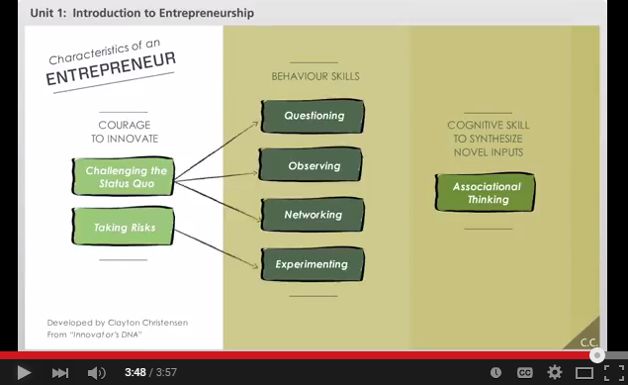
Foundation Elements of Entrepreneurial Idea Seeking
Innovator’s DNA:

Slide 9
Ideas and their Value
Ideas:
  Often not shared enough out of fear.
    Are infrequently stolen; but could be stolen at any time.
    Entrepreneurs get out of their comfort zone.
  Don’t determine success – executing on an idea does.
  Evolve and change, rarely staying the same over time.

Slide 10
Job/Hobby/Great Business Idea
Interest:
Excited
Stay awake
Want to learn
Passionate
Personal Assets:
Network
Expertise
Resources
Good idea for someone else!
Great Business Idea!
Opportunity:
Gap/need
Customers
Economics ($)
Hobby
Job

Slide 11
Idea Generation Principles
1

Slide 12
Idea Generation Principles
A
Good Business Ideas Generate Enough Revenue.
They have a value proposition for a critical mass of addressable customers.
Value Proposition
There is enough pain for someone to pay for a solution; and,
Relative to competition.
Critical Mass
Big enough market to matter.
Addressable
I can reach them with my revenues greater than expenses.

Slide 13



Idea Generation Principles
B
Ideas evolve over time or start as mistakes
Evolve over time
(eg. Facebook, Blackberry)
Start as mistakes
(eg. 3M Sticky Notes.)

Slide 14

Idea Generation Principles
IKEA - Ingvar Kamprad founded IKEA in 1943 at his Uncle Ernst’s kitchen table. IKEA was basically an acronym of his name Ingvar Kamprad and Elmtaryd, his family farm and the village Agunnaryd. At first the business was typically mail-order and included only small household goods such as picture frames, wallets, nylon stockings, pens and wallets.

Slide 15

Idea Generation Principles
Nintendo: The Nintendo Corporation’s domination of the gaming industry didn’t start with their first video game console. They have actually established themselves 70 years before the first video game came to life, in the 19th century when they brought back the popularity of card games to Japan. A new card game, Hanafuda, was invented, by Fusajiro Yamauchi (Nintendo founder) which used images instead of numbers, making it difficult for gambling.

Slide 16
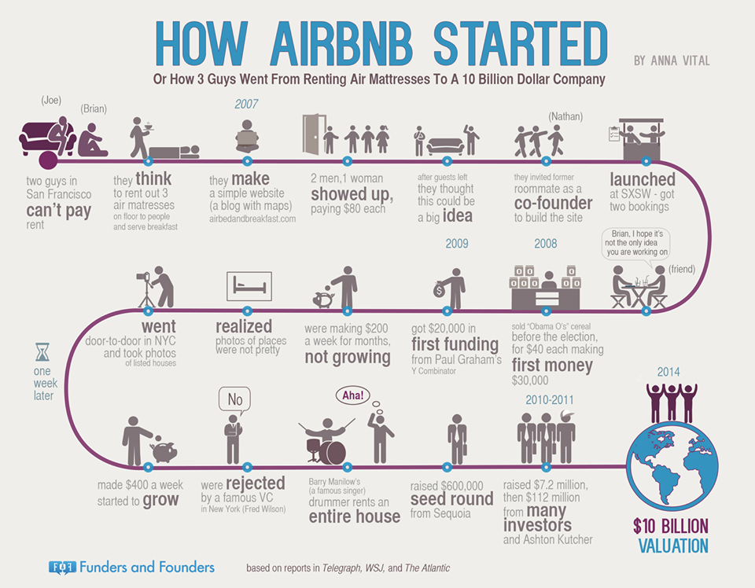

Slide 17

Idea Generation Principles
Netflix : The genesis of Netflix came in 1997 when I got this late fee, about $40, for Apollo 13. I remember the fee because I was embarrassed about it. That was back in the VHS days, and it got me thinking that there's a big market out there.
So I started to investigate the idea of how to create a movie-rental business by mail. I didn't know about DVDs, and then a friend of mine told me they were coming. I ran out to Tower Records in Santa Cruz, Calif., and mailed CDs to myself, just a disc in an envelope. It was a long 24 hours until the mail arrived back at my house, and I ripped them open and they were all in great shape. That was the big excitement point.

Slide 18

Idea Generation Principles
C
Ideas can come from anywhere, most often we see good business ideas starting with one (or more) of the following:
Personal Pain
I have a problem that needs solving.
120,000 customers
80 countries
$2B
valuation

Slide 19

Idea Generation Principles
C
Ideas can come from anywhere, most often we see good business ideas starting with one (or more) of the following:
Market Gap
A critical mass of customers are looking for a solution.

Slide 20

Idea Generation Principles
C
Ideas can come from anywhere, most often we see good business ideas starting with one (or more) of the following:
Interest
I love this so much, I can see myself working on it 24/7.

Slide 21

Idea Generation Principles
C
Ideas can come from anywhere, most often we see good business ideas starting with one (or more) of the following:
Insight
I understand the industry and see where it is going.
~$2B
1998
2015

Slide 22
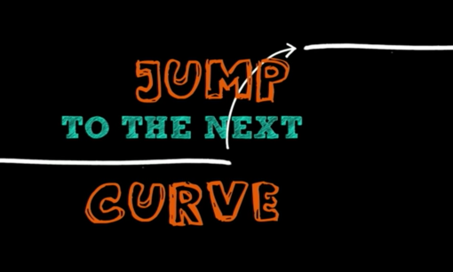

Idea Generation Principles
D
Ideas are truly innovative when you invent brand new solutions and industries rather than make an existing one a bit better.
Guy Kawasaki on Innovation (4:14 – 6:47):

Slide 23
Idea Generation Principles
E
Considerations for Military Families
- Must be Mobile*
- Frequent Moves
- Geographic Locations
- Supplies and Equipment
- Leases
- Rules and Regulations
- Speed to Profitability
- Cost Recovery
- Increased Family Responsibilities
- Others.. (Exercise)

Slide 24
Idea Generation Principles
The best business ideas satisfy most (or all) conditions
  If your current idea doesn’t, look to evolve it sufficiently such that it does.
Good Business Ideas
Necessary conditions:
Can make money (or not loose it): has value (value proposition) to a critical mass of addressable customers.
And
Evolve over time.
Usually start with one or a combination of:
  Personal pain (I have a problem that needs solving.)
  Market gap/need (Others will pay for a solution.)
  Interest (I can see myself doing this 24/7.)
  Insight (I understand the industry and the trends.)
Jump the innovation curve.
Factor in unique considerations for military families.

Slide 25
Individual Exercise
1
Generate as many potential business ideas as you can. They don’t have to be good.

Slide 26
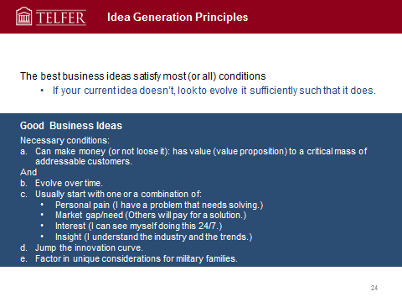
Group Exercise
1
DONE ☺
2
Look to combine ideas, eliminate and make existing ideas as good as possible.
3
Pick the best business idea.
4
Prepare to discuss why this is the best idea.

Slide 27
Other Considerations
3

Slide 28

Other Considerations
Expanded Thinking: Business Opportunities
What are the businesses associated with coffee?

Slide 29
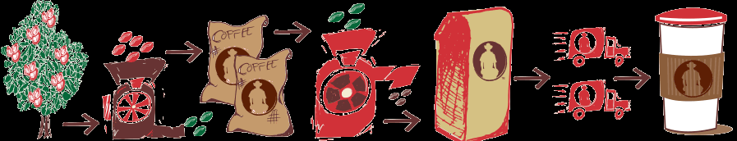
Any more?

Slide 30
Coffee Marketing Chain
Production Initial processing
Smallholder
Medium-sized farmers
Large farms and estates
Collection
Trader
Initial processing
(wet)
Manufacturer
Assembling
Trader/Agent
Curing
(hulling, grading)
Cooperative union
Manufacturer
Intermediation
Auction/Brokers
Shipping
Exporters
Roasting
Domestic roasters
Distribution
Wholesalers and retailers
Consumption
Domestic consumer
Importing consumer

Slide 31

Other Considerations
Design vs. User Experience

Slide 32
Concluding Thoughts?

Slide 33
Business Models

Slide 34
Business Models
A sketch/summary of what the business will do and how it will make money.
Includes strategic components of the business idea and how it operates.
Often established based on trial and error.
Forms the basis for success or failure.

Slide 35

Why are Business Models Important?
Uber, the world’s largest taxi company, owns no vehicles.
Facebook, the world’s most popular media owner, creates no content.
Alibaba, the most valuable retailer, has no inventory.
And Airbnb, the world’s largest accommodation provider, owns no real estate.
Something interesting is happening.
Tom Goodwin,
Sr. Vice President of strategy and innovation at Havas Media

Slide 36
Business Models vs. Business Plans
Business Plans
Assume full knowledge of the market, solution and customers.
Don’t require a lot of external interaction.
Are a useful implementation tool, focusing much on operationalizing strategies.
Usually written too soon; often not written at all.
Business Models
Assumes evolution: discovery and iteration.
Forces “getting out of the building” to talk with clients.
Forms foundation for success or failure.

Slide 37
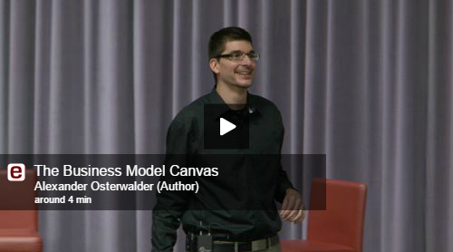
Business Model Canvas

Slide 38
The following slides thanks to Steve Blank and the Lean LaunchPad Educators Program

Slide 39
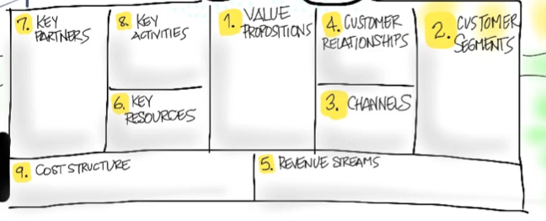
Value Proposition
What Are You Building and For Who?

Slide 40
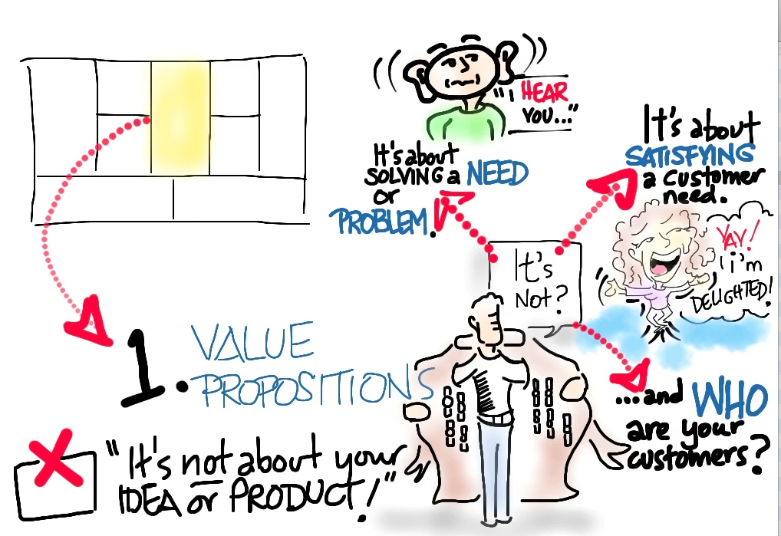

Slide 41
Customer Segments
Who Are They?
Why Would They Buy?

Slide 43
Multiple Customer Segments
Might have multiple segments of users
Might have users and payers
Might have 5 or 6 different customers
  Medical devices have doctors, hospitals, patient, insurance company, FDA, etc.
For every customer segment you need:
  Value proposition
  Revenue model
  And may have unique channels, customer relationships, etc.

Slide 44
Product/Market Fit
Does the Value Proposition MVP Match the Customer Segment Archetype?

Slide 45
Channels
How Does Your Product
Get to Customers?

Slide 47
Customer Relationships
How Do You Get, Keep and Grow Customers?

Slide 49
Revenue Streams
How Do You Make Money?

Slide 51
Key Resources
What Are Your Most Important Assets?

Slide 53
Key Partners
Who Are Your Partners and Suppliers?

Slide 55
Key Activities
What’s Most Important for the Business?

Slide 57
Cost Structure
What Are the Costs and Expenses?

Slide 59
BUT...

Slide 60
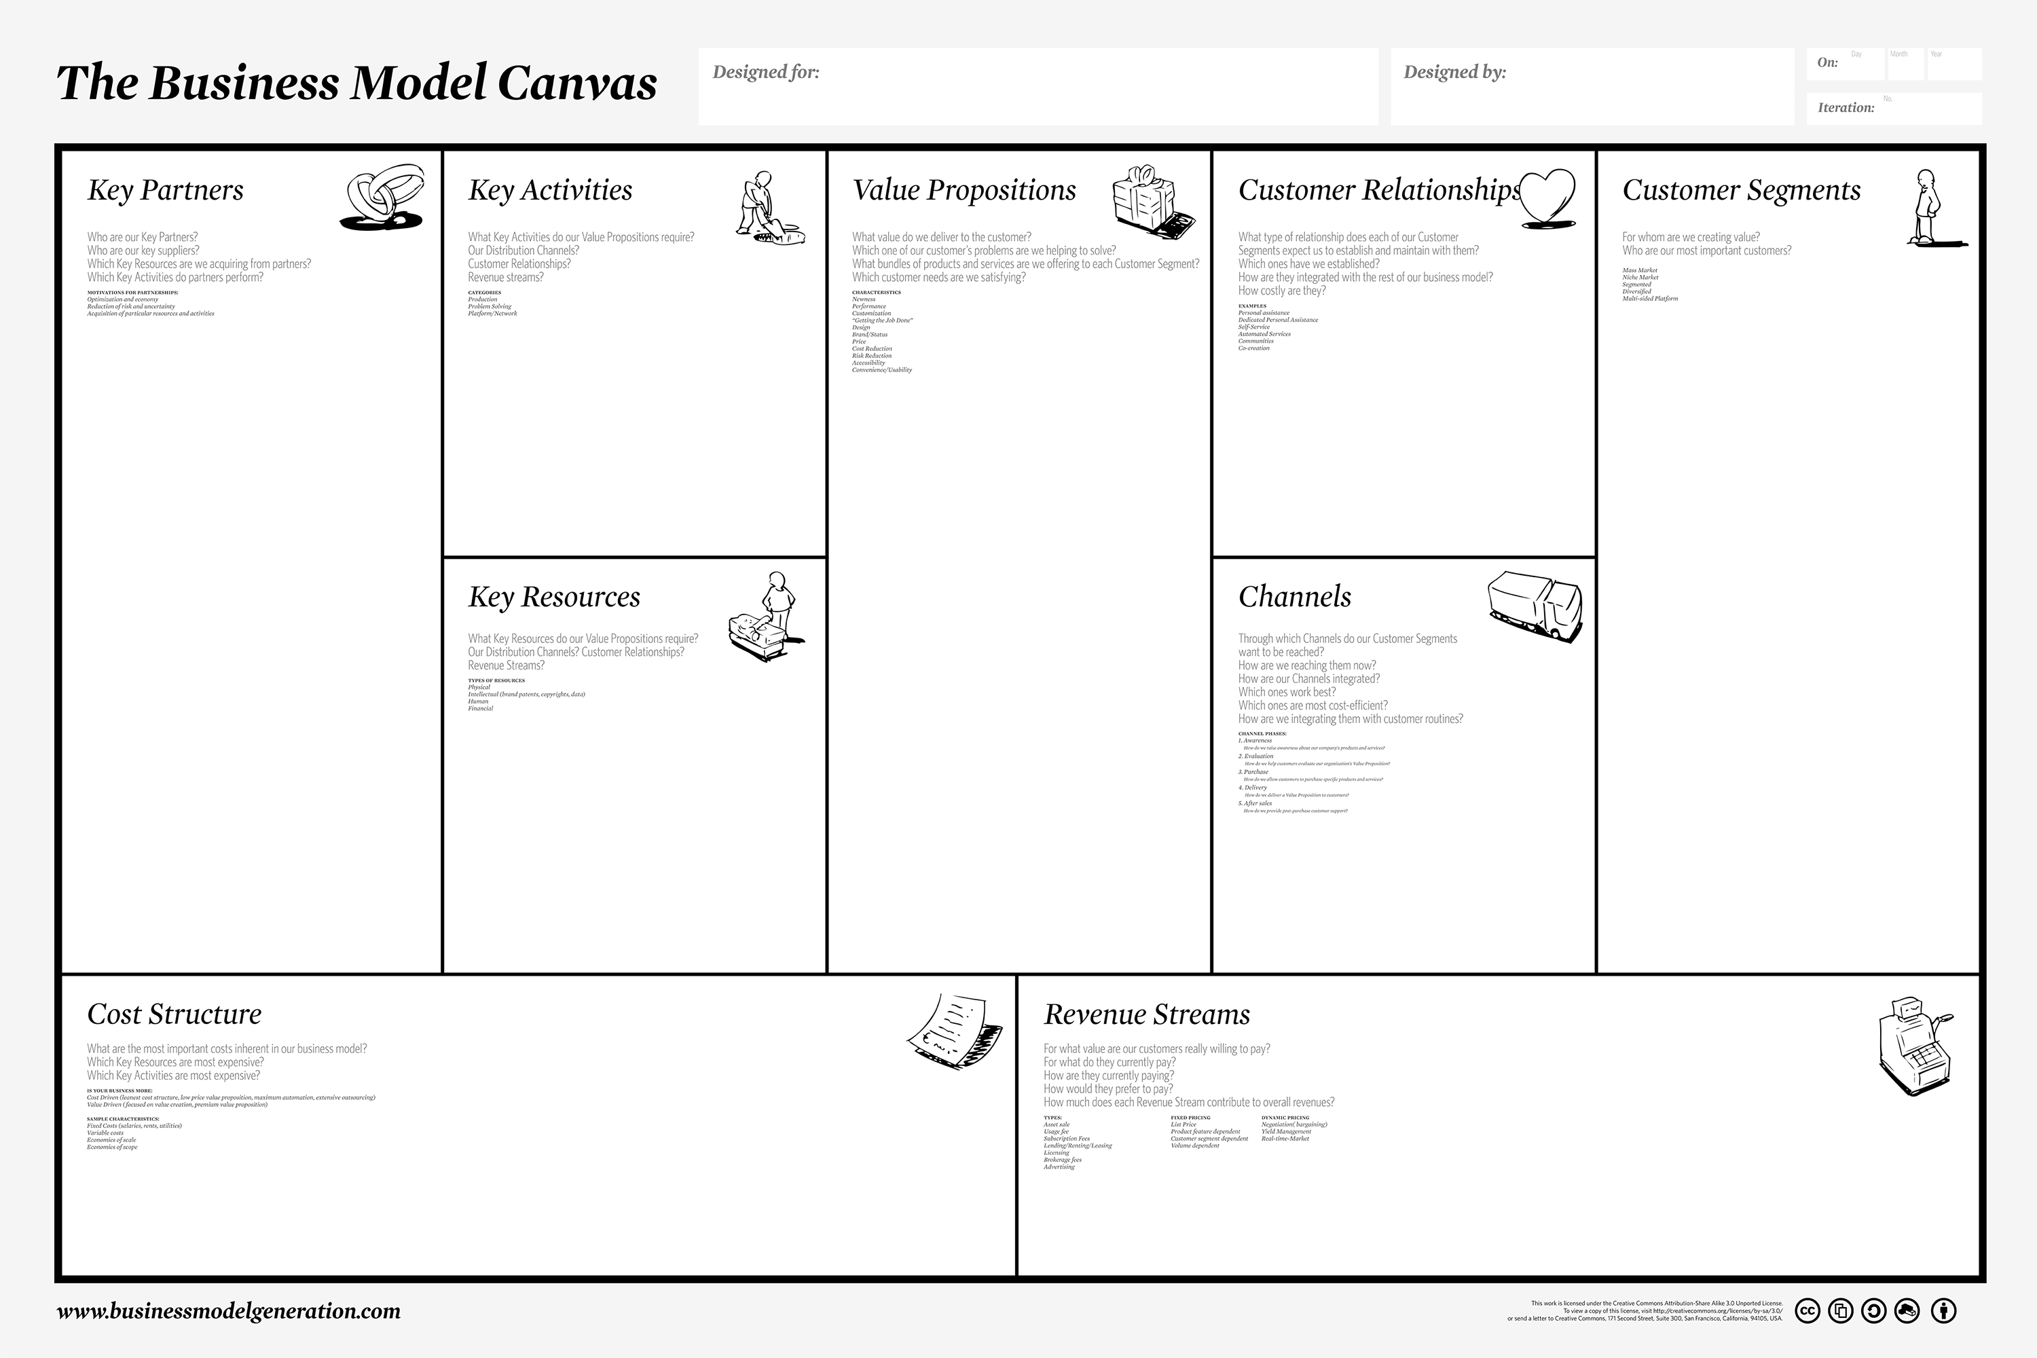
They Are All Guesses
Guess
Guess
Guess
Guess
Guess
Guess
Guess
Guess
Guess

Slide 61
We have to Validate (test) our
Assumptions
Test the Problem, then the solution.

Slide 62

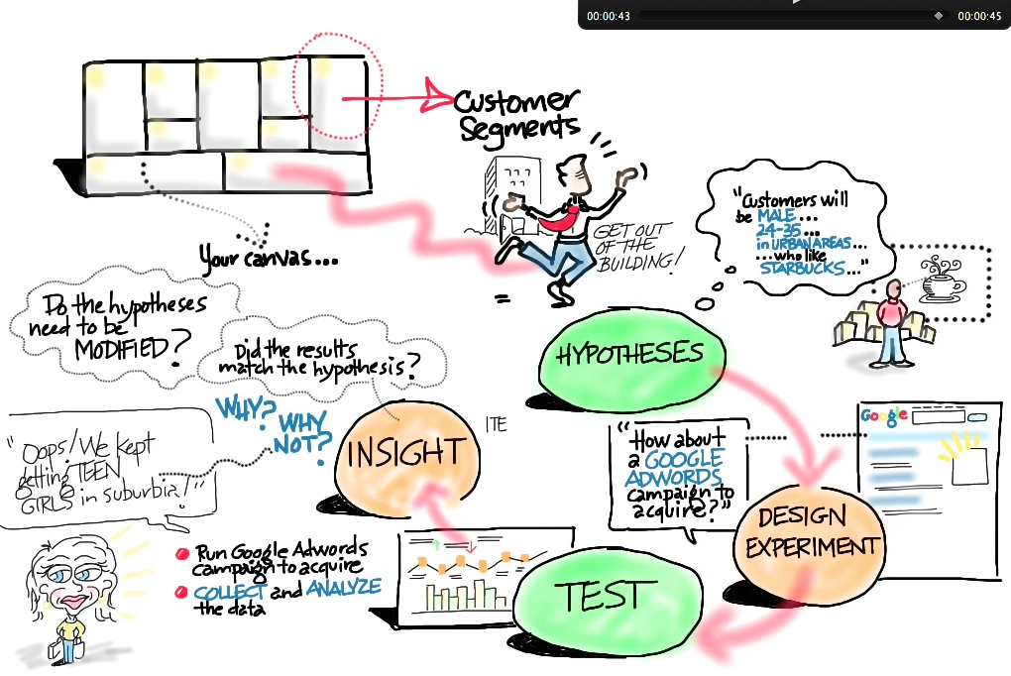

Slide 63
Business Model Examples

Slide 64
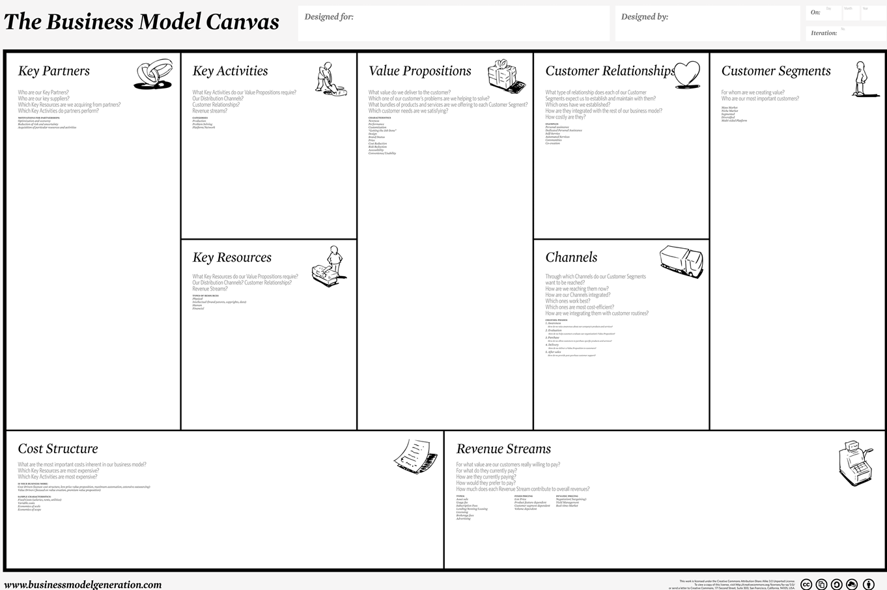
Lemonade Stand in City Park

Slide 65

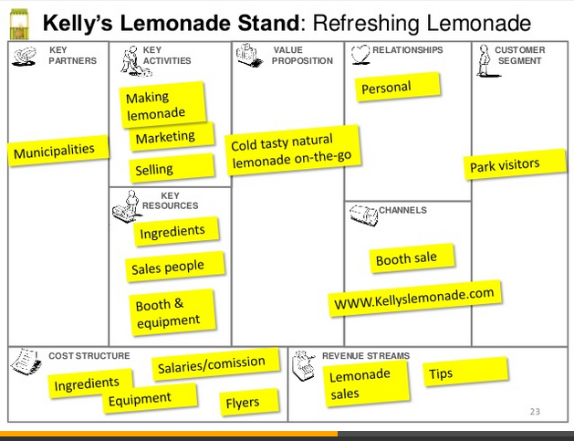
Kelly’s Lemonade Stand: Refreshing Lemonade

Slide 66
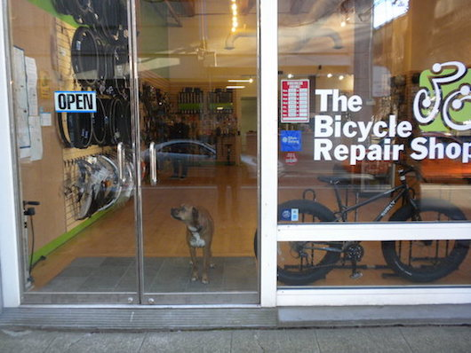

Slide 67
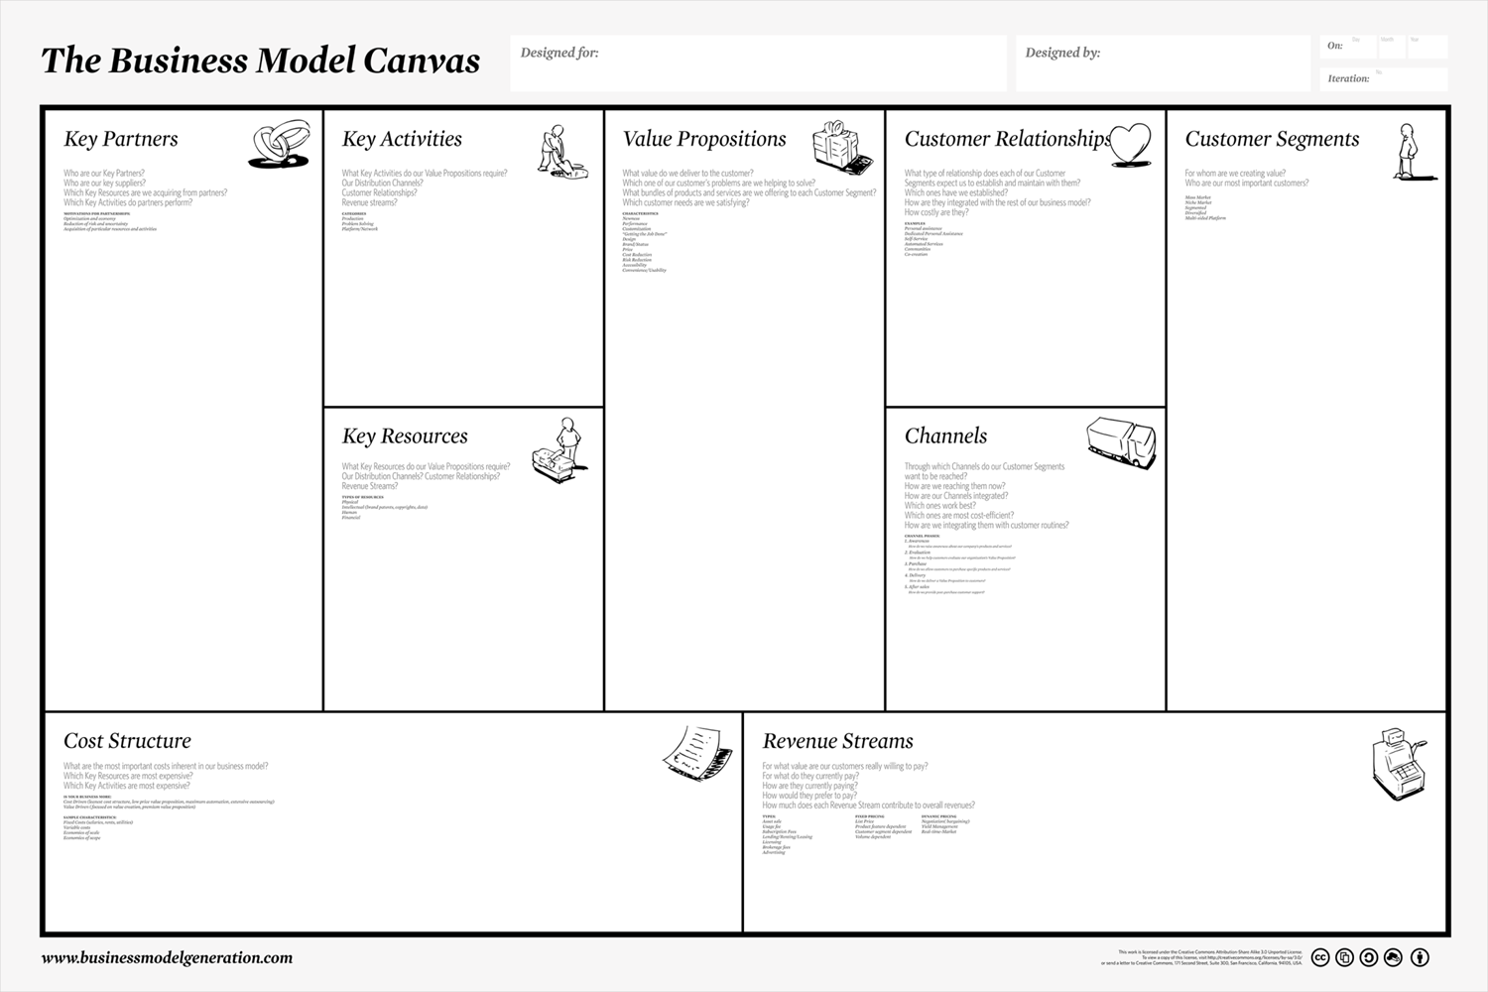

Slide 68
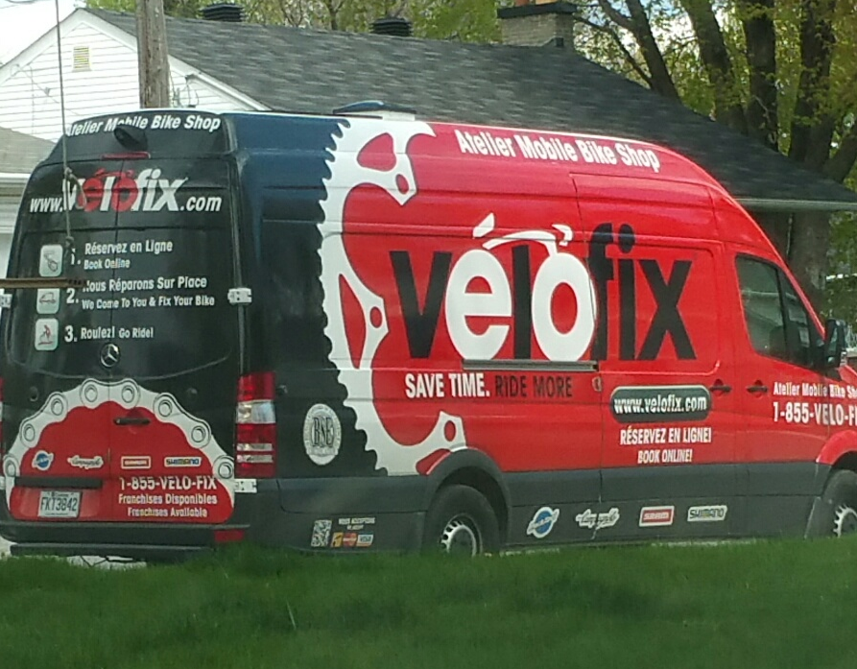

Slide 70

Amazon Business Model Canvas

Slide 71
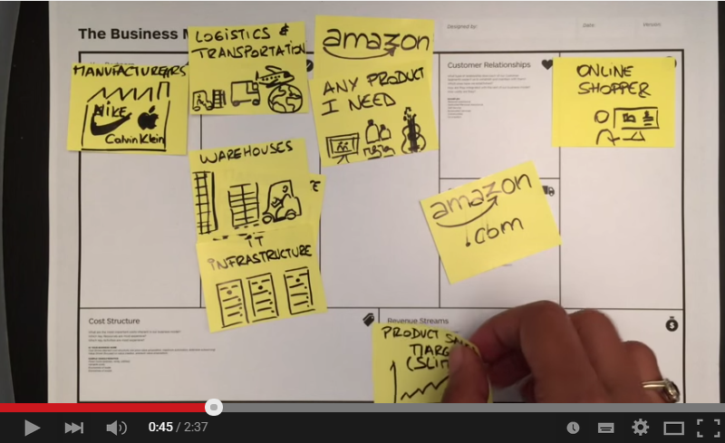
Amazon Business Model Canvas

Slide 73
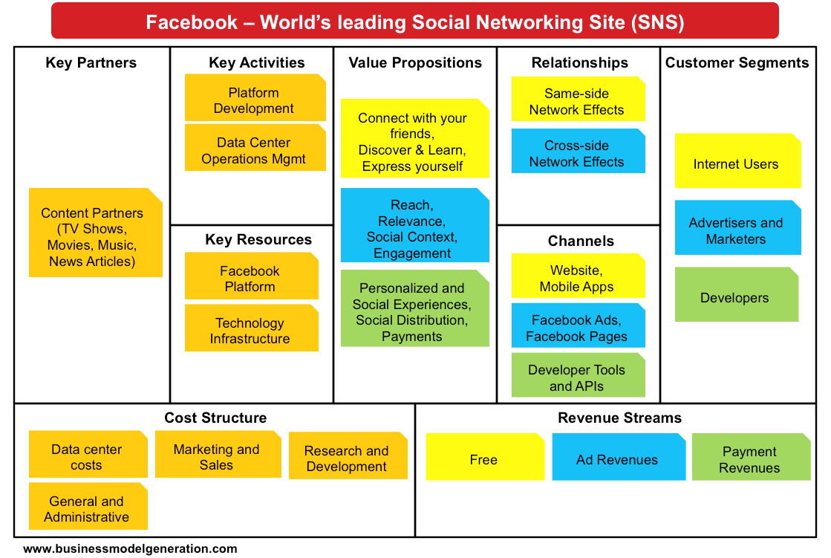
Canvas: Multiple Segments

Slide 74
Business Models
In groups or as an individual:
Consider your business idea, or the idea your group came up with earlier.
Sketch out the key components of their business model.
Determine which component is most important or unique.
Be prepared to present:
Which component(s) of the Business Model Canvas is most important or unique for this business, and why?

Slide 76
Concluding Thoughts?

Slide 77
Validating Your Idea

Slide 78
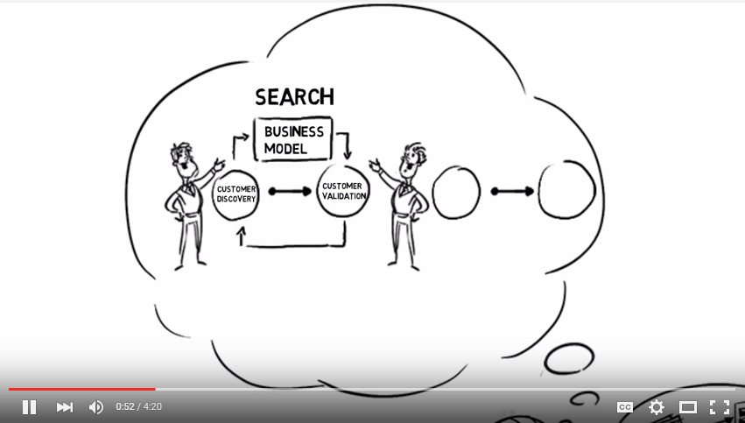

CUSTOMER DISCOVERY

Slide 79
Recommended Start up Process*
Generate idea
Assess market size and competition
Conceive business model hypotheses
Build validation tests and key metrics
Run validation tests and measure
Learn
Reiterate model and hypotheses
Repeat until new iterations not required
Establish resource requirements
Determine financial viability
Start venture or go back to step 1
Idea Validation
Cust. Discovery
Business Planning
*Not distinct or linear.

Slide 80
What Do Tests Look Like?
Customer conversations (f2f) – lots of them
Industry expert conversations
Surveys – in person and/or online
Test ads looking for currency*: Facebook, LinkedIn, Google Adwords
Test webpage looking for currency
Letters to clients to gauge follow up
Minimum viable product
* Currency = cash, orders, email addresses, sign ups, click throughs, downloads etc.

Slide 81
Minimum Viable Product: MVP
A minimum viable product has just those core features that allow the product to be deployed, and no more. The product is typically deployed to a subset of possible customers, such as early adopters that are thought to be more forgiving, more likely to give feedback, and able to grasp a product vision from an early prototype or marketing information.
Twitter MVP = status update
Google = just search
Zappos = web site + manual purchase
Virgin Airlines = one plane, one route

Slide 82
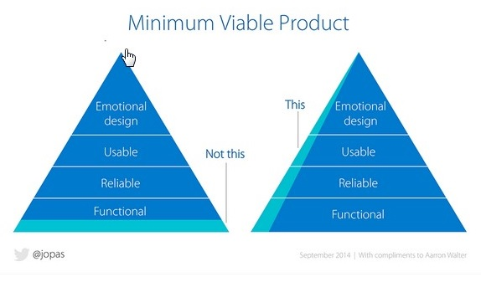

Slide 83
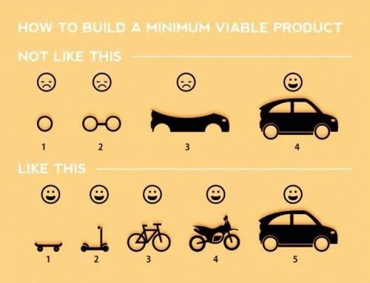

Slide 84
Customer Discovery Process

Slide 85
Validation Checklist
Pre Validation
What do you think the problem/gap is?
    What pain exists in the market or for the customer?
Who do think are your typical (first) clients?
    What is the size of the market?
    What is the profile (demographics etc) of you most likely customer?
What is your v1 solution? Is it reasonable?
Who do you need to talk to? How can you access them?
What are the most critical business model hypotheses you are trying to validate? What questions can you ask?
What are the tests? What metrics/thresholds are you looking for?

Slide 86
Typical Questions
Is there a problem or gap in the marketplace?
Who are the customers and do they recognize they have a problem?
How is the customer currently dealing with this task/problem? (What solution/process are they using?)
What do they like about their current solution/process?
What do they wish they could do that currently isn’t possible or practical?
Are customers willing to pay money for a different solution? (Duct tap test; desire, willingness, ability)
Would they buy a different/new solution? How? How much?
Are there competitors? What do they do well/poorly?
Is there some other solution/process they’ve tried in the past that was better or worse?
Who is involved with the buying process? How long does it take? Is there a budget?

Slide 87
Tips for Customer Interviews
Know your goals and plan your questions before leaving the building!
Do one-on-one interviews.
Validate the problem first, not the solution.
Listen, don’t pitch.
Be prepared for answers you don’t like.
Write your notes from the meeting immediately.
Focus on discovery. Don’t worry about features!
Never ask a yes and no question, always ask open ended ones.
Have behavior-focused interviews.
Ask to be able to follow up and for intros to others.

Slide 88
Validation Strategies methods
(In addition to customer conversations.)

Slide 89
Tools
Google Trends
Pinterest
Google Adwords
Unbounce.com
QuickMVP
Godaddy/Wix/Weebly
LinkedIn/Twitter/Facebook/etc.
eLance/Fiveer/oDesk
Survey Monkey

Slide 90





Test Web Page
Seeking to determine customer interest:
Sign ups
Pre-orders

Slide 91
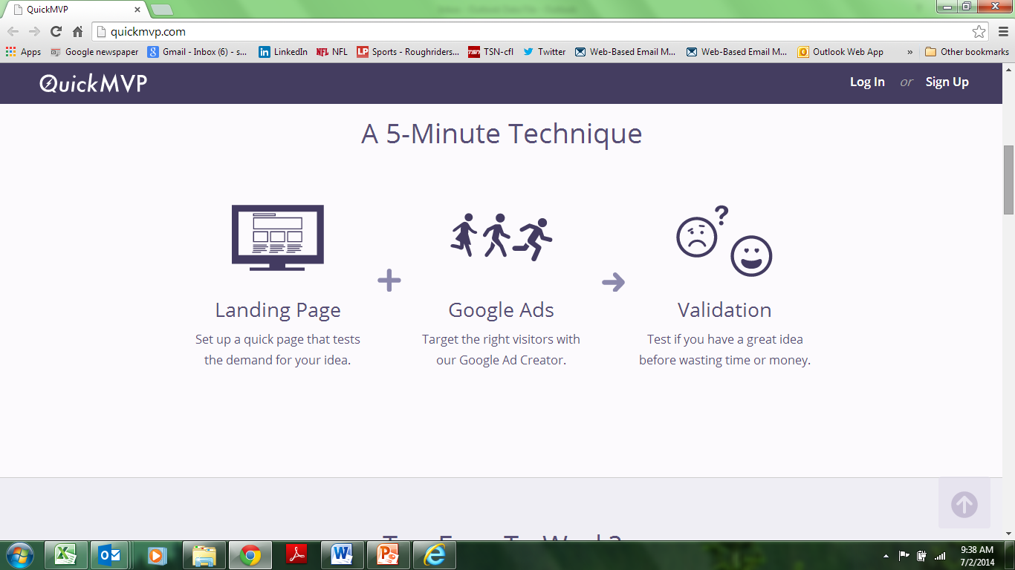
www.quickmvp.com

Slide 92
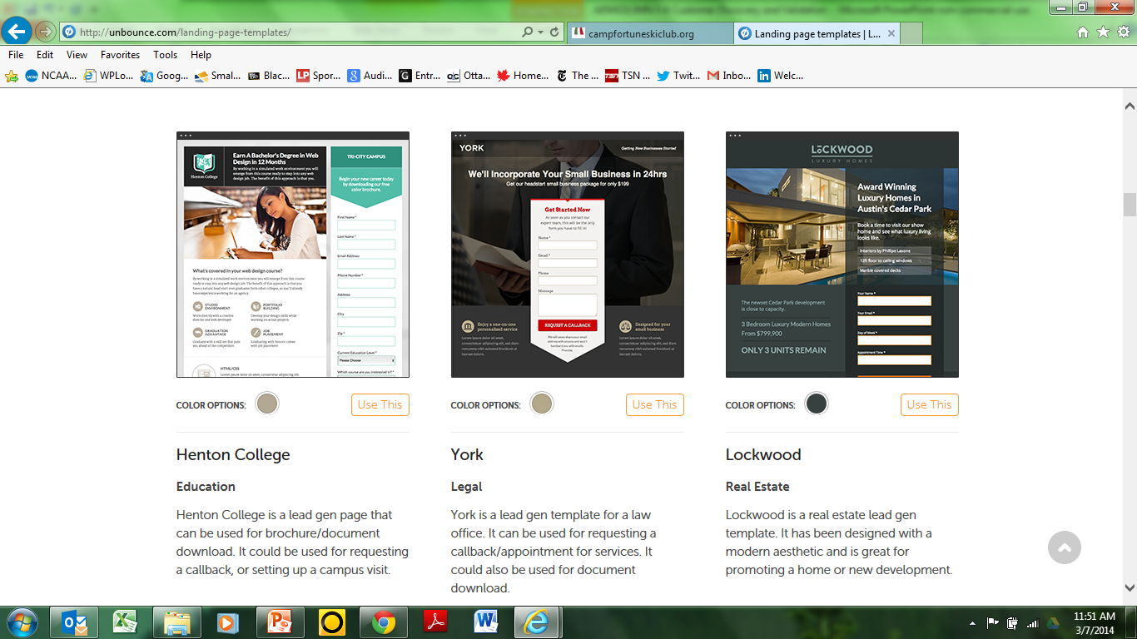
http://unbounce.com/

Slide 93
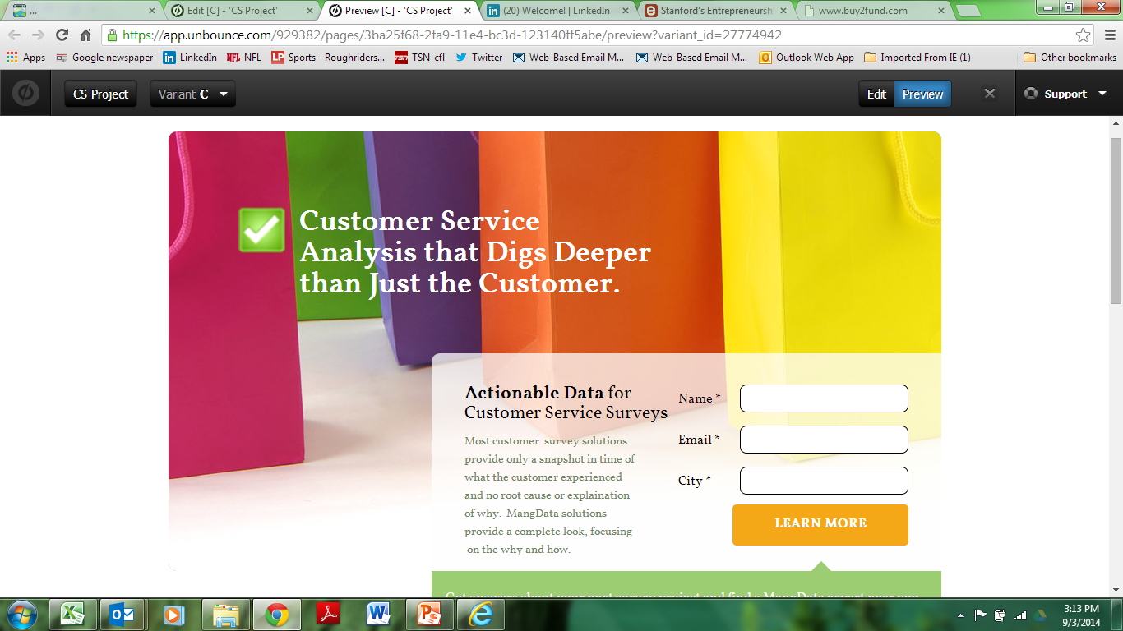

Slide 94
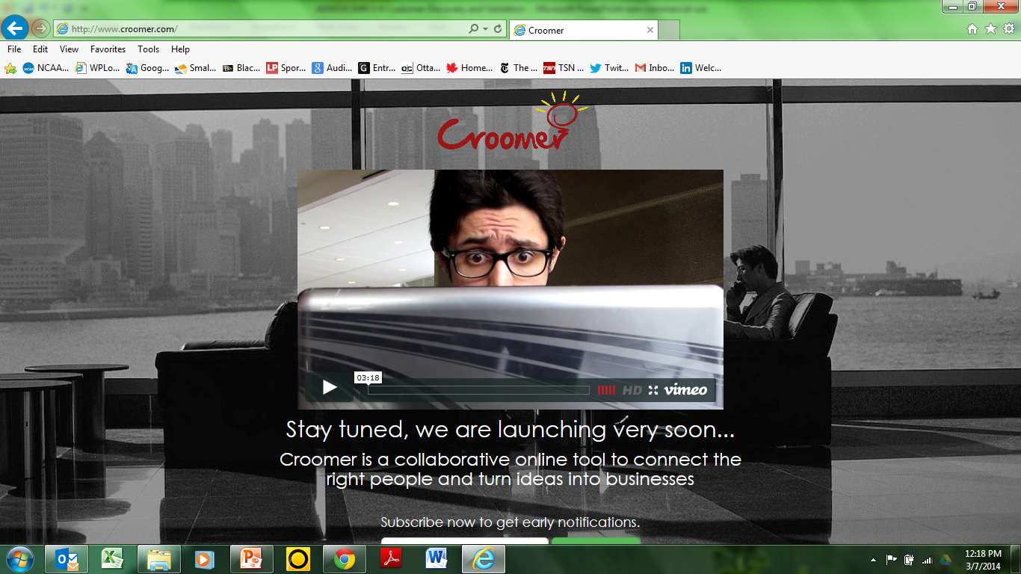

Slide 95
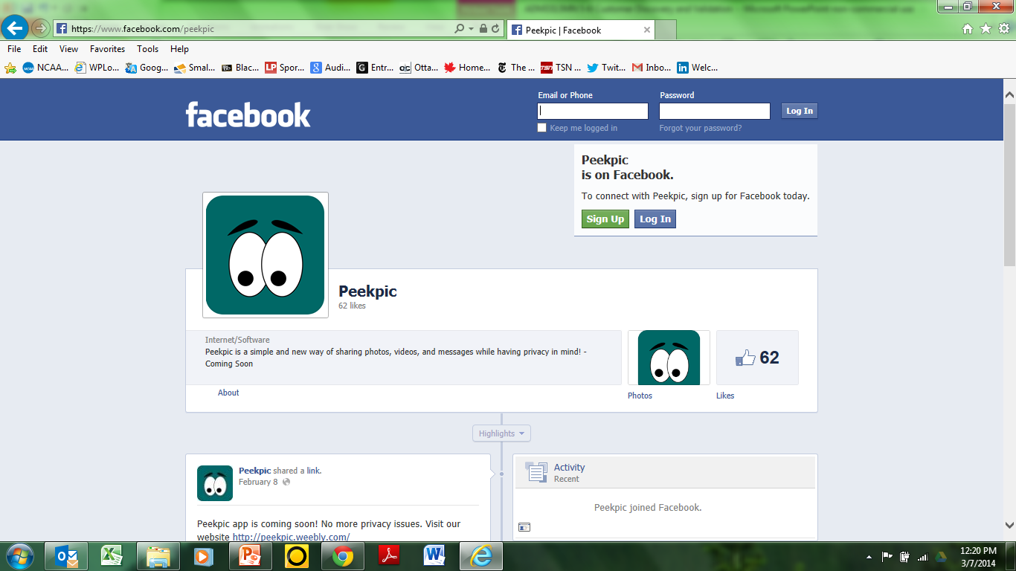

Slide 96
Crowd Funding Campaigns
http://www.indiegogo.com/Pub
http://www.indiegogo.com/projects/help-bring-victoire-to-toronto
https://www.kickstarter.com/projects/1470156778/wipebook

Slide 97
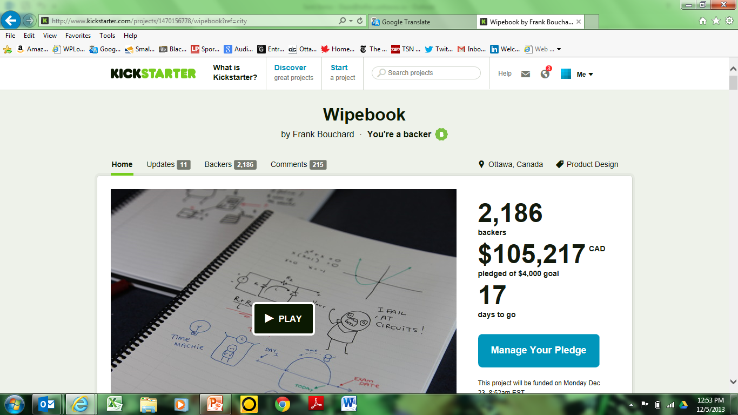

Slide 98
Examples

Slide 99

Standing Desk

Slide 100
Standing Desk
Google Trends
Pinterest
Topsy
Landing page with mock image, looking for “purchases”
  Google Adwords
  Scheduled Tweets with Hootsuite
  Paid Facebook and Twitter Ads
*https://www.linkedin.com/pulse/sell-how-test-out-new-product-shoestring-ryan-holmes?trk=hp-feed-article-title-like

Slide 101

100% Vegan Restaurant?

Slide 102
100% Vegan Restaurant?
Catering
Small shows
LCBO events
Mail list
Pre-sold gift certificates and meals

Slide 103
Case Study

Slide 104
Birth of an Idea

Slide 105
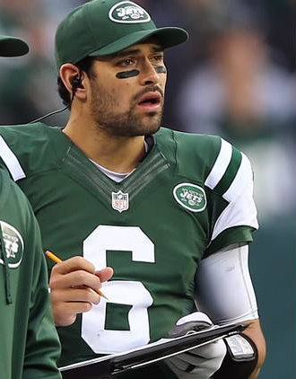
I’d like to help

Slide 106


Slide 107


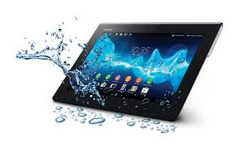


Slide 108
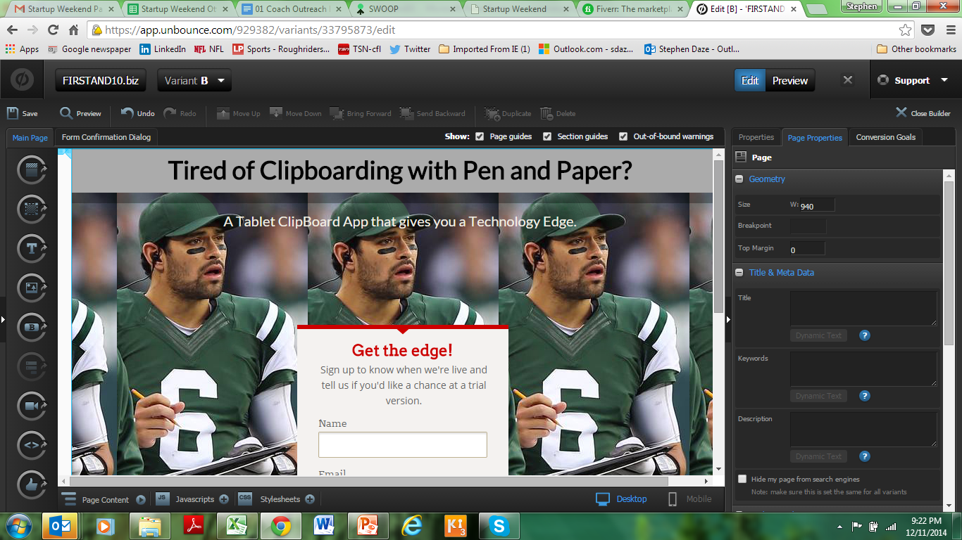
www.unbounce.com $54 (1 month free trial)

Slide 109
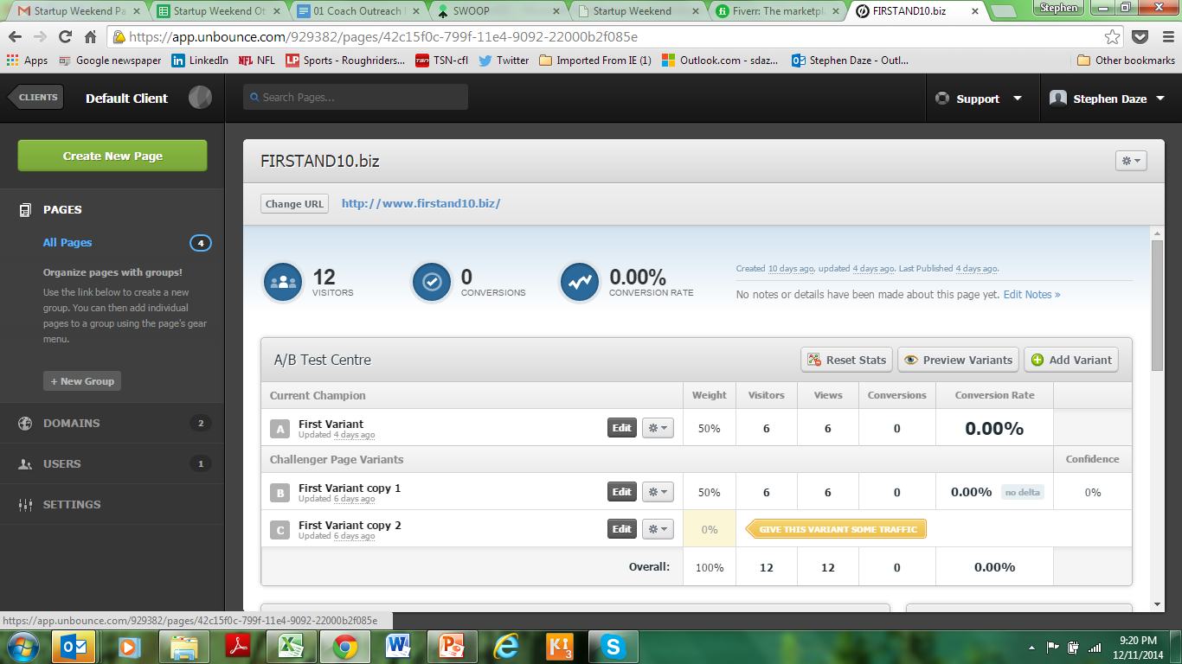

Slide 110
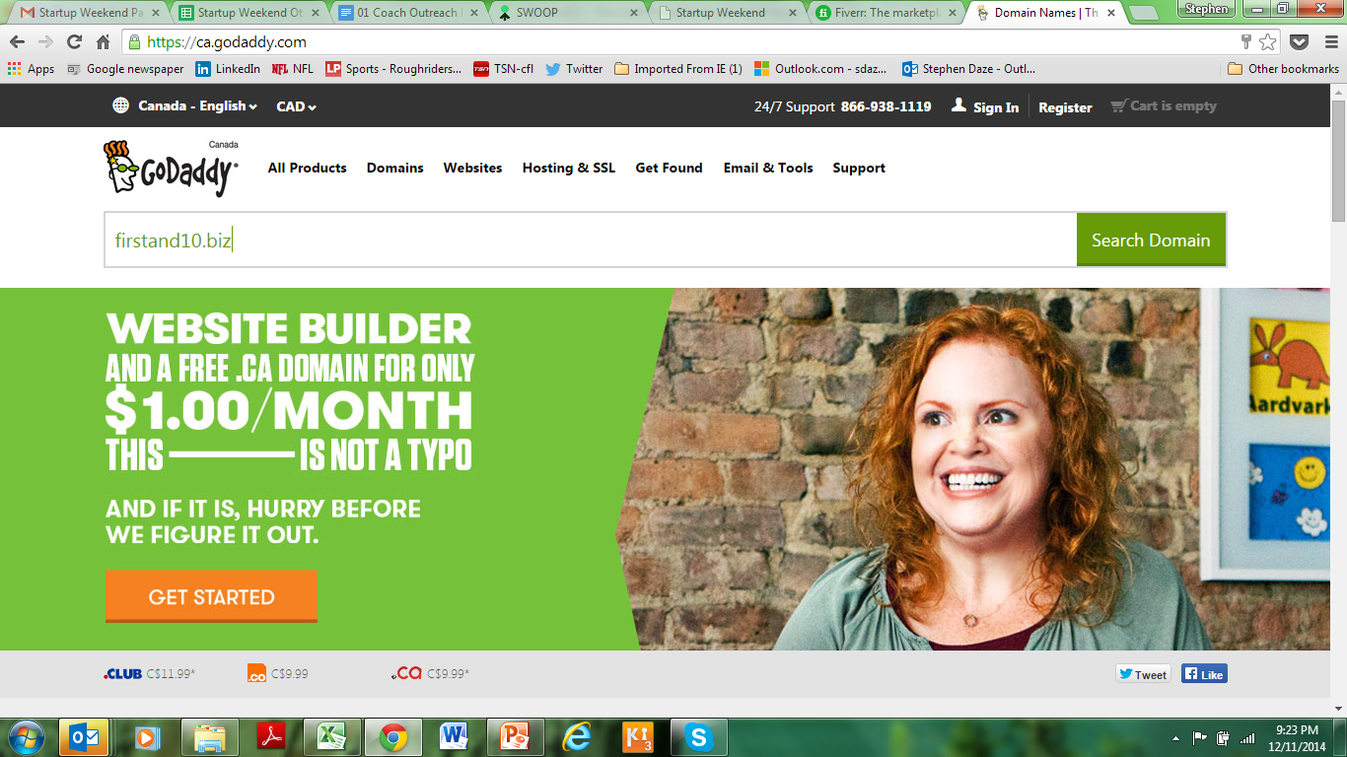
$16

Slide 111
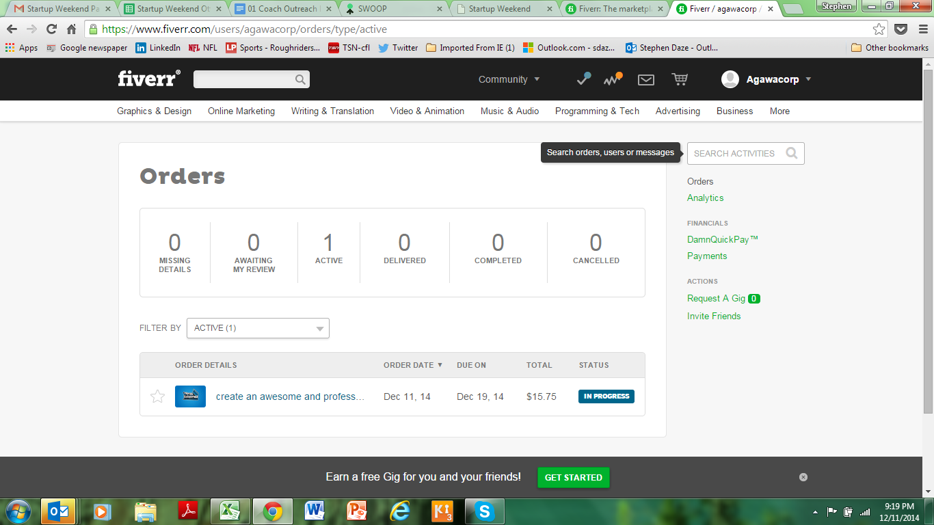
www.fiveer.com $15.75

Slide 112
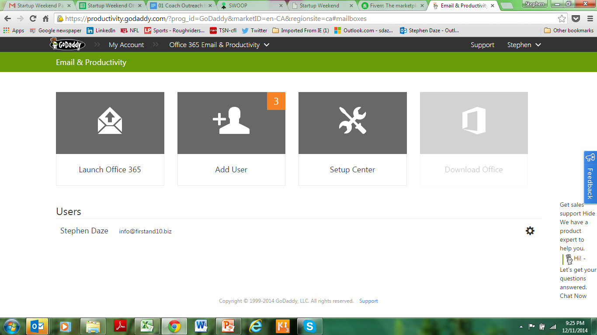
$5/month

Slide 113
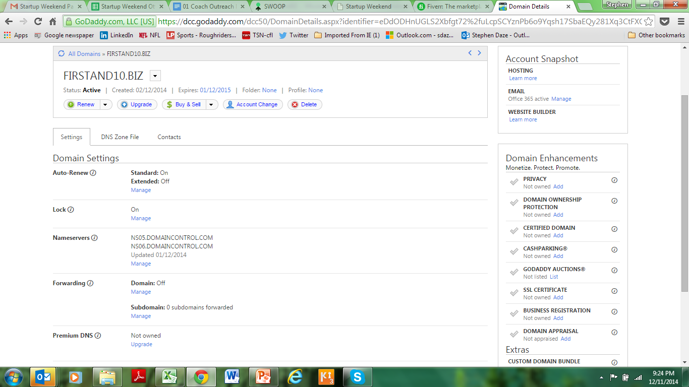

Slide 114
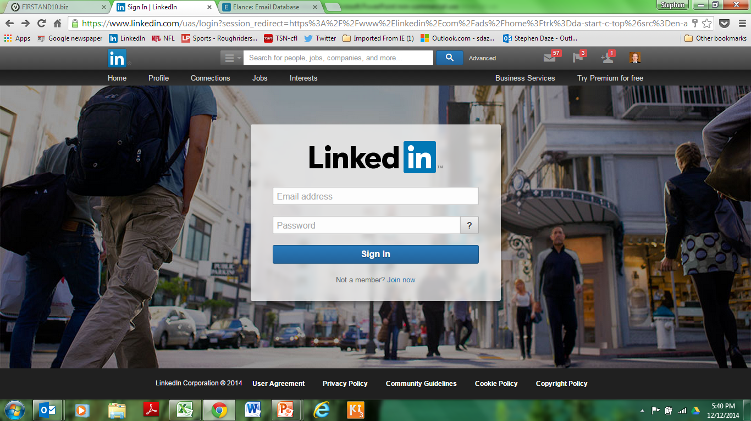

Slide 115
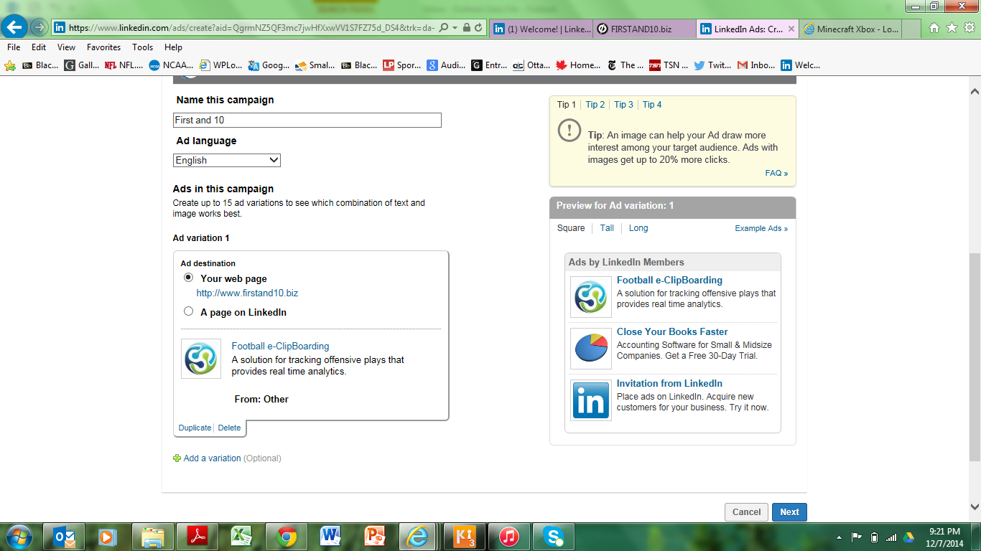

Slide 116
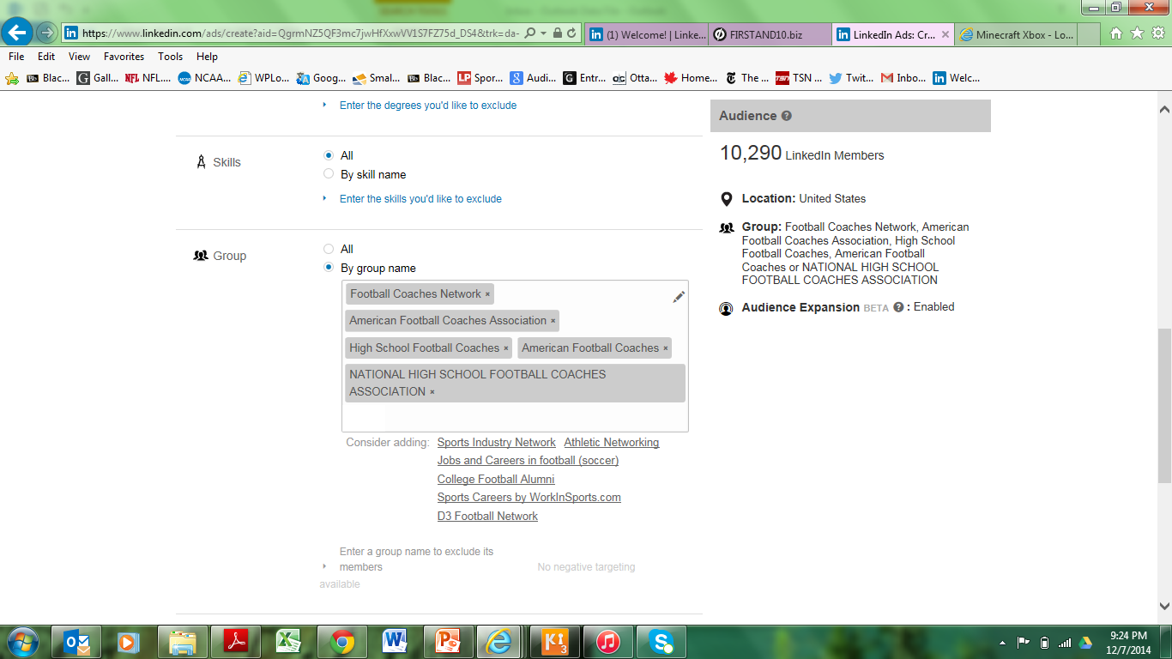

Slide 117
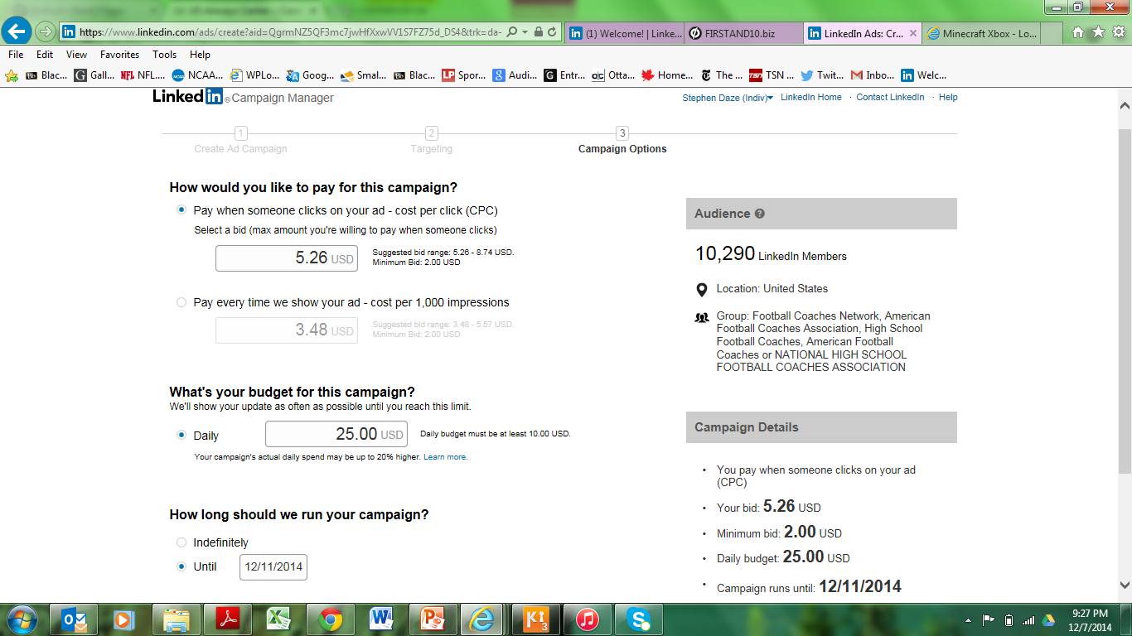
Google Adwords max. $25/day

Slide 118
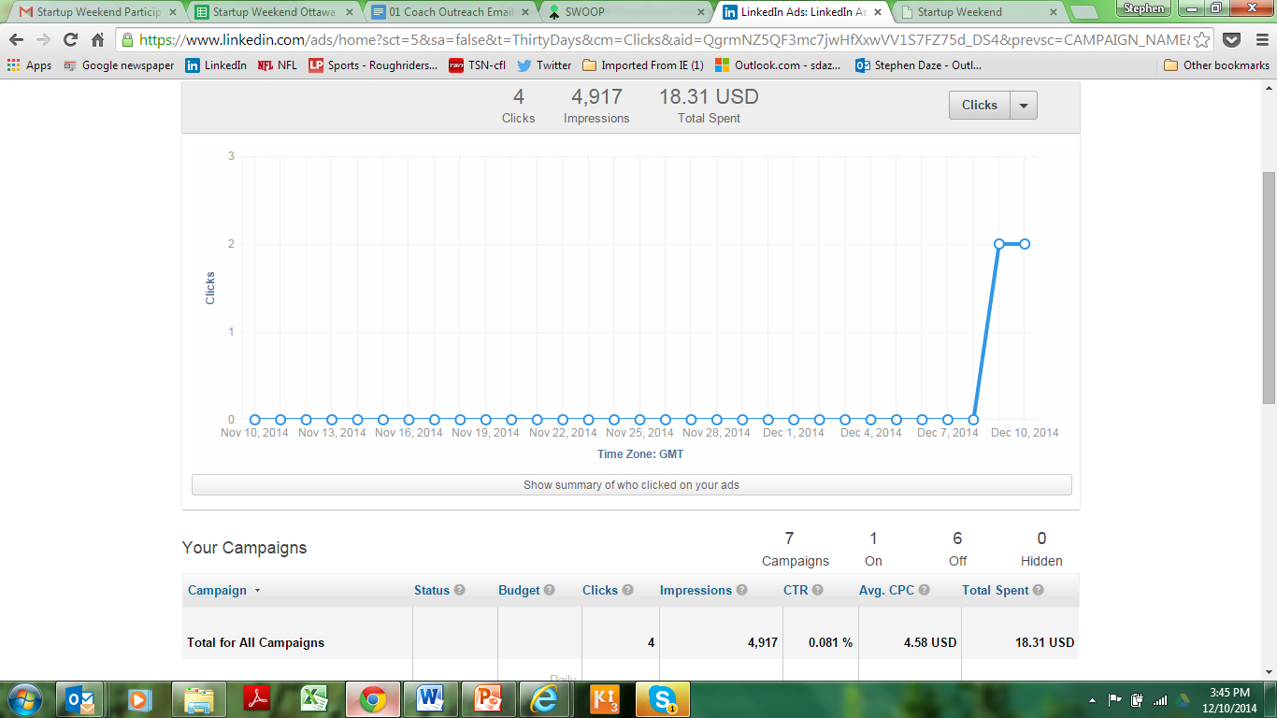

Slide 119
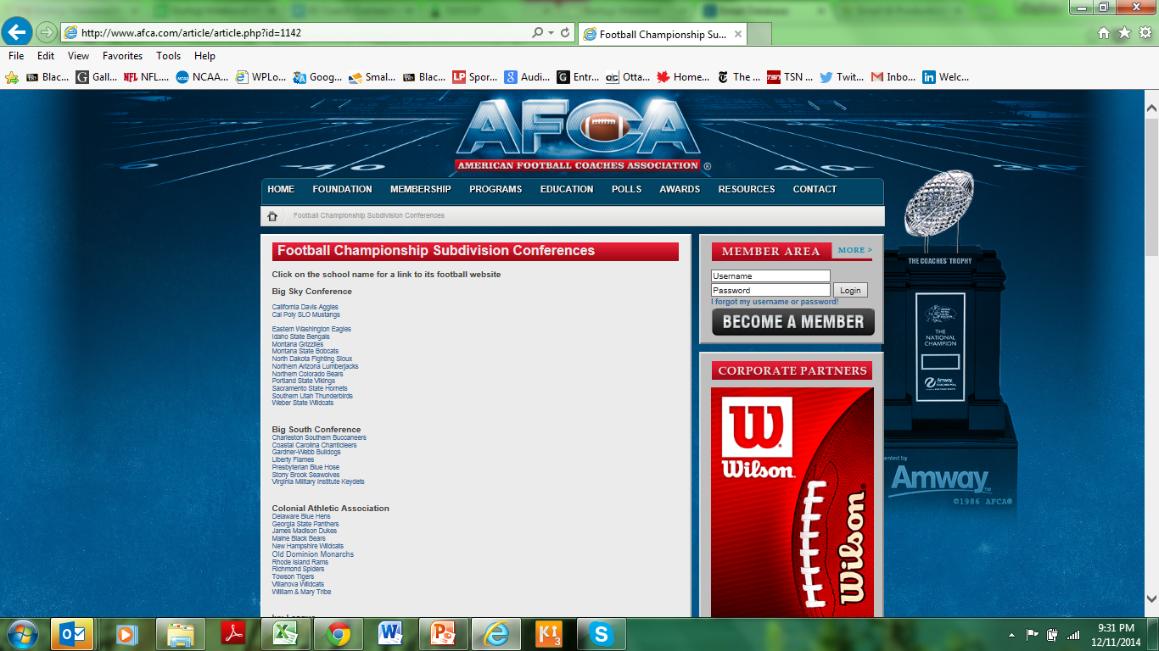

Slide 120
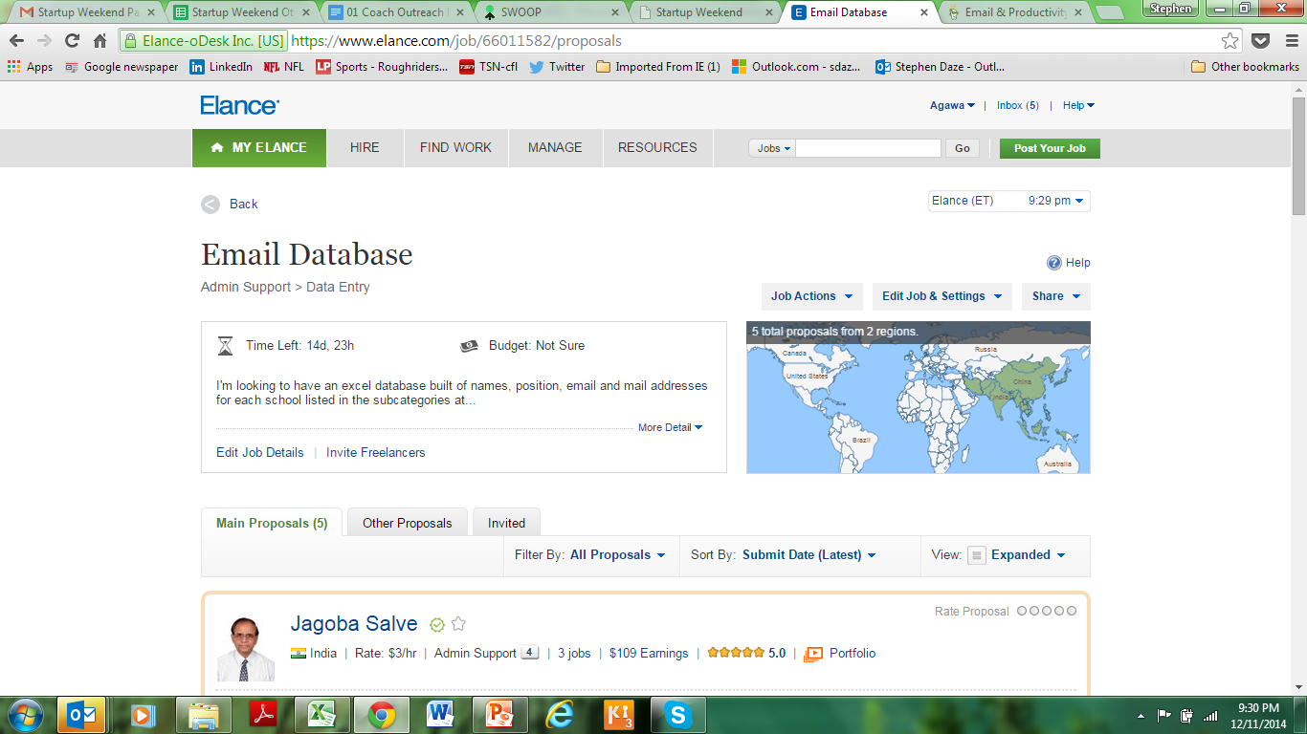
www.elance.com $54.79

Slide 121
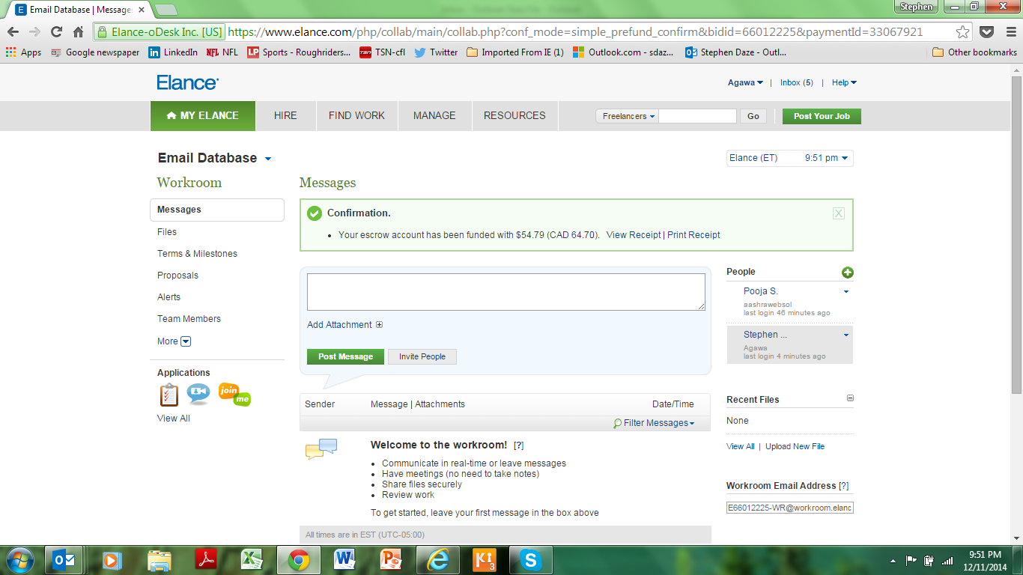

Slide 122
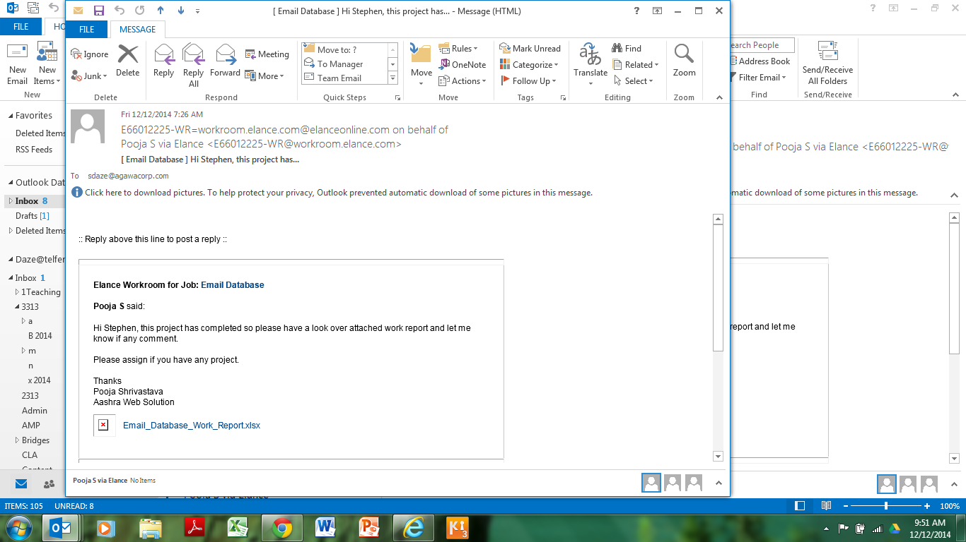

Slide 123
Next steps
Build out of a demo version.
Launch of actual website (more validation; sign ups; early sales?)
Participation in annual coaches show in January.

Slide 124
Tools and Resources
www.businessmodelgeneration.com/canvas and related https://canvanizer.com/ to organize your validation.
www.unbounce.com, www.quickmvp.com and www.launchrock.com – build landing pages to gauge clicks and interest/ collect email addresses/ combine with Google Adwords and other advertising mediums/ test variants of your message.
http://buzzsumo.com/ - look for key influencers in your industry.
www.indegogo.com and www.kickstarter.com – build awareness, raise funds and pre-sell your product online.
https://gomockingbird.com/, http://proto.io/ or others - create a mockup of your app or website in minutes.
http://startupstash.com/mockups-wireframing/- Mockup and Wireframes
http://startupstash.com/mvp/ - A curated directory of resources & tools to help you build your Startup
https://www.zoho.com/crm/?src=zoho - Customer Relationship Management to track your validation contacts and early leads
Other validation tools and resources:
Customer Discovery Tips and Templates - http://leanstartup.pbworks.com/w/page/54918676/Customer%20Interview%20Templates%20and%20Resources
Validation tools - http://leanstartup.pbworks.com/w/page/62585258/Validation%20Tools
Another similar list - http://www.squirrly.co/startup-tools-list-the-amazing-free-services-that-will-improve-your-work#.VNETZp3F_5G

Slide 125
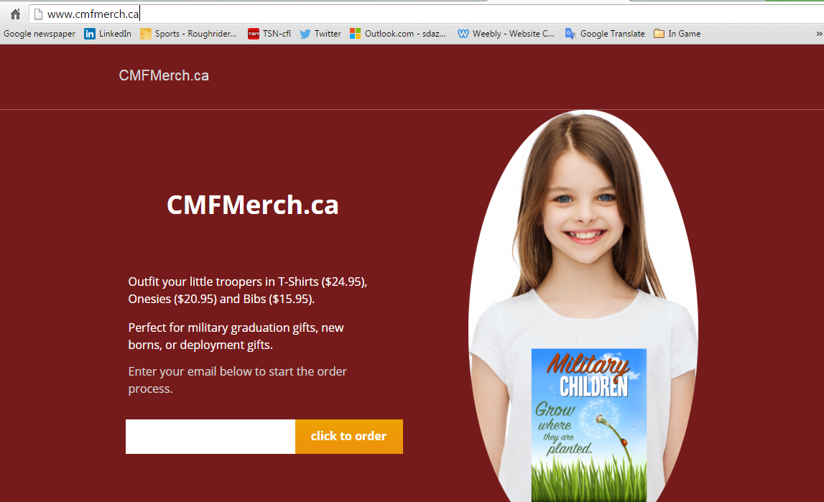
Overnight: Website; Facebook ads; Kijjijji Ads

Slide 126
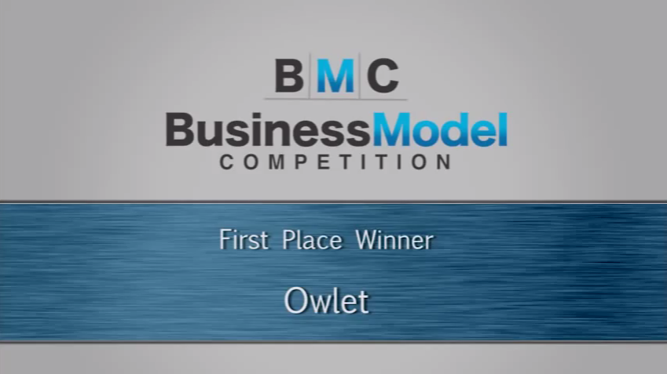
EXAMPLE

Slide 127
Who wants to try?
I’ll work with anyone who wants to practise the skills of validation.
I have pre-paid visa cards to help pay for things like: web domains; hosting; social media ads; facebook “boosts”, etc.

Slide 128
Concluding Thoughts?

Slide 129
Finalize idea – describe the problem first.
Sketch out a Business Model Canvas v1.
Determine validation action plan (What? How?)
Begin implementation of tests.
Presentation deck.

Slide 130
Pitches
Cash Flow and Financing
Next Steps
Day 2

Slide 131
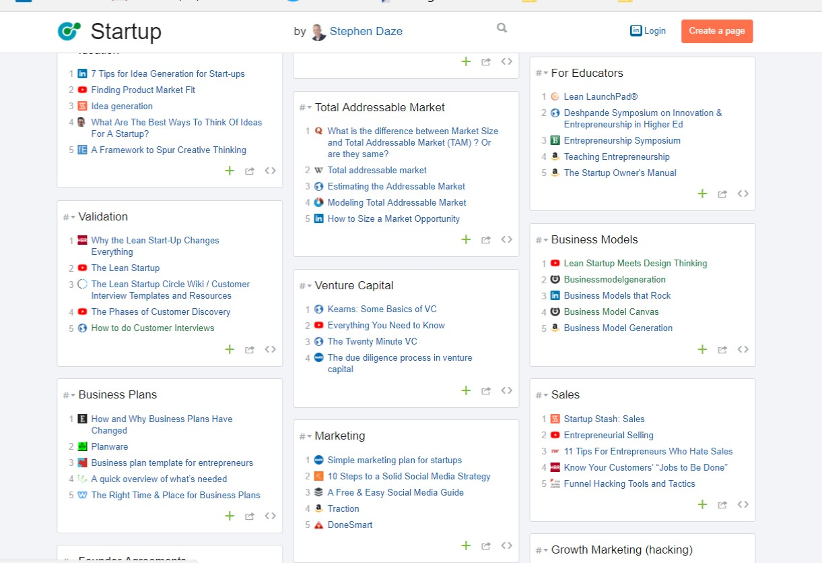
Resources
www.coachmystartup.com/mfs
https://startup.zeef.com/stephen.daze

Slide 132
Who wants to tell us what they accomplished last night?

Slide 133
Cash Flow

Slide 134
Objectives
Understanding the fundamentals of your cash flow statement.
Determine how your cash flow relates to the remainder of your Business Plan.
Complete a 12 month cash flow for a new business.

Slide 135
What is a Cash Flow Statement?
It’s not a “statement of cash flows.”
It is a projected financial statement.
Likely similar to an individual “budget.”

Slide 136
Your Cash Flow Helps You:
Determine when you can afford to take a draw out of the business.
Determine whether or not you can pay your bills each month.
Determine how much financing you need to run your business properly.
Determine when you can afford to grow your business through hiring staff, expanding your location or by purchasing capital equipment.
Determines how much money you have in the bank at the end of each month, it is not your profit.

Slide 137
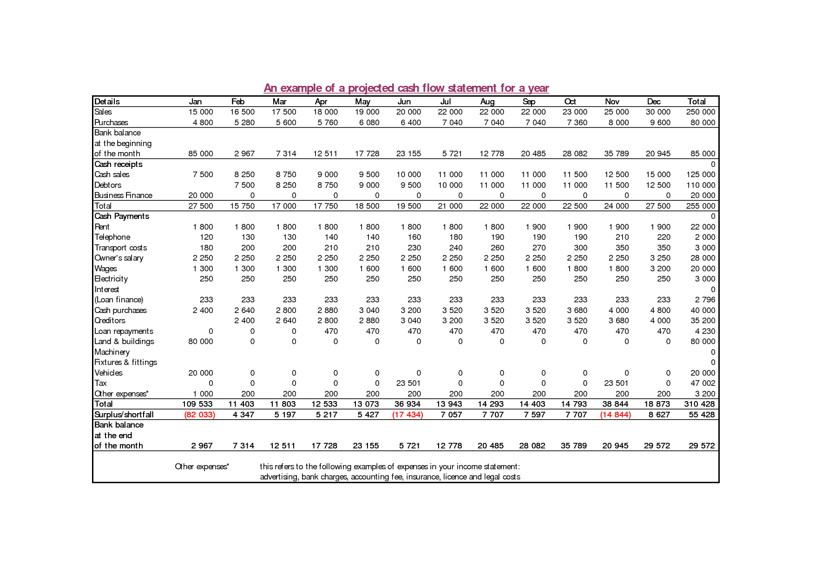

Slide 138
Cash Flow Forecasting:
… simply taking the words of the business plan
and translating them into numbers.
Actual money that is collected
from sales and actual money that is
paid out for expenses
on a monthly basis.

Slide 139
The Cash Flow Statement
There are three main sections in a cash flow statement:
Sources of Cash (Cash Receipts/Revenues)
  Cash revenues
  Loans
  Equity Investment (Personal or Outside Source)

Slide 140
2. Uses of Cash (Expenses or Disbursements)
  Actual Expenses that will be paid in that month
  Start-up Costs
Monthly Balance
  You can calculate how much cash you have left at the end of each month
  Revenue – Disbursements = Cash balance (monthly)
  Add your month end cash balances together to get a cumulative monthly total

Slide 141
Plus
Justification of your Revenue & Expenses Projections
How did you come up with the numbers?
Include a page of assumptions/footnotes.
Be able to explain each account line in your cash flow.

Slide 142
Projecting Disbursements
Consider the following factors when you are compiling your numbers:
Include all your start-up costs
Promotional Mix Activities– will cause changes in your monthly expenses and sales.
Straight line approach – Your busy or slow periods should be reflected in your increasing or decreasing costs for those periods: avoid straight line/flat line of your expenses. Most of your costs are rarely the same every month.

Slide 143
Projecting Revenue
Your revenue projections are probably the most critical, yet difficult, aspects of completing an accurate cash flow statement. Consider the following factors when putting your numbers together:

Slide 144
If you have a sales history, go back and use those figures to help guide your projections.
Your promotional mix activities can have a direct impact on your revenues.
Seasonality factors may influence the increase or decrease of revenues.
Your sales strategy, regarding volume/discount selling or penetration pricing can change your revenues.
Ensure that your projected growth rate is realistic for a new business entering the market place.
Monitor the competition- your revenues maybe influenced by their activity.
Continuously monitor current market conditions so you may react to changes in the industry.
Market Research (Trends, Gaps/Needs, Product/service, Target market, competition, Promotional mix)

Slide 145
Factors Influencing Your Revenue Collection
What percentage of your sales will be cash?
What percentage of your sales will be by credit? You must age your receivables to reflect when you actually get your money.
Will you take deposits on orders?
ü Customer Credit Rating
ü New customers must make a deposit
ü Amount ($) of the order
ü Customers payment history with my company

Slide 146
Calculating Your Revenues
Generally, revenue projections are calculated from sourcing information from many places. Consider the following methods:
Market Research
Maximum Sales
Industry Projections
Historical Plus Projections – Monthly basis

Slide 147
Useful Starting Point
Industry Canada’s Small Business Profiles
  https://www.ic.gc.ca/eic/site/pp-pp.nsf/eng/home

Slide 148
Cash Flow Exercise
Cash in bank - $3,790
Received loan - $5,000
Sales are already recorded
You must fill out expenses section and determine monthly and cumulative totals
Use Excel Spreadsheet; exercise details to be handed out in class
Highest, REALISTIC cash balance wins!

Slide 149
GROUP | (-) | (-) | ENDING TOTAL
1
2
3
4
5
6

Slide 150
Concluding Thoughts?

Slide 151
Financing Your
Business

Slide 152
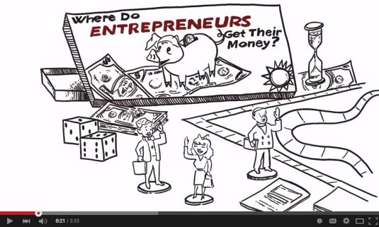

Where Do Entrepreneurs Get Their Money?
1. Their own money (owners equity or loans to the business.)
2. Debt: cash now for repayment (with interest) later.
3. Equity: cash from others for a piece of the business.
4. Bootstrapping: piecing it together on your own.

Slide 153
1. Personal Contribution
Either in the form of either:
  Owners equity – to be drawn out at a later time.
  As a loan to the business – to be repaid at a later time.

Slide 154
2. Debt
Debt: cash now for repayment (with interest) later
  Loans
  Lines of credit
  Mortgages
  Credit cards
  Etc.

Slide 155
Characteristics
Money lent to you with expectation of it being returned with interest.
Terms are determined in advance.
Different banks have different products – but they are all pretty similar.

Slide 156
Banks Consider the Following
1. Repayment Ability
  What evidence exists to convince me I'm going to get paid back? Personal financial situation.
2. Management
  What evidence exists that indicates that this person can manage his/her affairs well enough to allow the opportunity for payback? Credit history?
3. Personal Investment
  What evidence exists that this person has enough of a commitment to the business so that I'll be sure he/she wants to work hard to protect it? (If they protect theirs, they will be protecting mine!) Most lending institutions will require at least 25 percent cash/equity contributed to the total capital cost of the project.
4. Security
  If all else (above) fails, what protection do I have to get my money back? What will it be worth when the business fails?

Slide 157
Sources
Canada Small Business Financing: http://www.canadabusiness.ca/eng/
Business Development Bank: http://www.bdc.ca/en/Pages/home.aspx
Banks:
http://www.royalbank.ca/busindex.html
http://www.tdcanadatrust.com/products-services/banking/index-banking.jsp
https://www.cibc.com/ca/small-business.html
www.bmo.ca

Slide 158
3. Equity
Equity: cash for a piece of the business
  Investment
    Angel Investment
    Venture Capital
  Share purchase (IPO)
  Friends and Family (“love money”) – may also be considered a loan or charity!

Slide 159
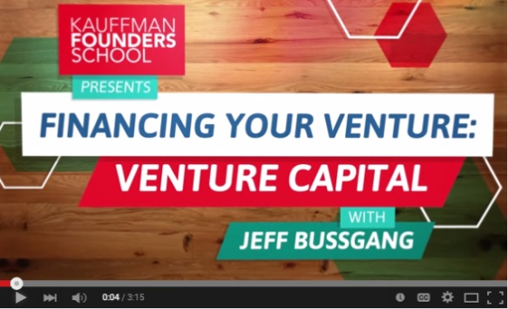
Venture Capital
Firms specifically designed to pool large sums of money and invest in risky asset class.
Money for the fund comes from “Limited Partners.”
Have to invest the money or return it.
Specific business model for the fund with specific criteria related to things such as:
  Industry
  Type and size of deal
  Stage

Slide 160
Venture Capital
Key Issues
Process
  Due Diligence
  Valuation
  Term Sheet
  Exit
Entrepreneur Considerations
  Ownership %
  Long term ownership (exit)
  Control

Slide 161



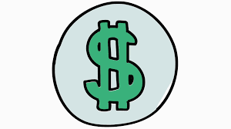








VC Explained
- Investment Thesis
- LP’s
- Term Sheet
- Valuation
- Due Diligence
- Economics of the Deal
- Exit

Slide 162

Angel Investors
Typically invest between $25,000 - $100,000.
Very hands-on and usually have a passion for their projects.
Deal requirements are not as cut and dry as Venture Capitalists.
Think of what they do as a hobby – they do not need to invest in a company, they choose to.
Investments are often limited to their geographic reach.
Tend to invest earlier but also looking for investment where business is close to launch or release.

Slide 163


Angel Investing Explained
- Investment Thesis
- LP’s
- Term Sheet
- Valuation
- Due Diligence
- Economics of the Deal
- Exit

Slide 164
Decision Criteria for Investors
 | Rank by Angels | Rank by VC
Enthusiasm of entrepreneur | 1 | 1
Trustworthiness of entrepreneur | 2 | 2
Sales potential of product | 3 | 6
Expertise of entrepreneur | 4 | 5
Liked entrepreneur upon meeting | 5 | 7
Growth potential of market | 6 | 3
Quality of product | 7 | 10
Perceived investor financial rewards | 8 | 4
Niche market | 9 | 16
Track record of entrepreneur | 10 | 11
* Angel Investing, Osnabrugge & Robinson

Slide 165
The Funding Food Chain
Financing
$
Types
Seed
Capital
Start Up
Financing
First
Stage
Second
Stage
Mezzanine
Bridge
Financing
IPO
Sources
Angels
Angels
Venture
Capital
Venture
Capital
Venture
Capital
Banks
Financial
Markets
Personal
Love Money
Angels

Slide 166


Slide 167
More Information
Canadian Venture Capital Association (www.cvca.ca)
National Venture Capital Association (www.nvca.org)
BDC Venture
http://www.angelinvestor.ca/
What I learned, pitch deck: http://www.techvibes.com/blog/investor-deck-transparency-and-lessons-learned-2014-01-16?goback=%2Egde_5037848_member_5829679035365490689#%21

Slide 168
4. Bootstrapping
  Piecing it together on your own!
  A means of financing a company through the creative acquisition and use of resources without raising cash from independent investors.

Slide 169
Q: What were some strategies you used during the Cash Flow exercise that helped you preserve your “cash” and bank account balance?

Slide 170
Advantages
It forces you to concentrate on selling to bring cash into the business.
Minimizes expenses, lessens the need for cash.
Founders retain greater authority, control and flexibility.
Equity is expensive especially at startup.
Better positions the company for external financing in the future if necessary.

Slide 171
Disadvantages
May not generate enough cash to grow at the desired rate.
Limits potential sales, market share and overall competitive position.
Provides insufficient support for high growth and capital intensive businesses.

Slide 172
Strategies for Success

Slide 173
Leverage Government Programs
IRAP (Industrial Research Assistance Program)
SR&ED Tax Credits (Scientific Research and Experimental Development)
Other Federal and Provincial Programs
http://www.nrc-cnrc.gc.ca/eng/irap/index.html
http://www.cra-arc.gc.ca/txcrdt/sred-rsde/menu-eng.html
http://www.novascotiabusiness.com/en/home/businesssupport/resourcesandfunding/default.aspx
http://www.acoa-apeca.gc.ca/eng/ImLookingFor/ProgramInformation/Pages/Home.aspx
http://www.feddevontario.gc.ca/eic/site/723.nsf/eng/h_00122.html
http://www.oce-ontario.org/
http://www.marsdd.com/funding/investment-accelerator-fund/

Slide 174
Get Operational Quickly
Get up and running rather than waiting for the home run.
Look for cash generating products or services, i.e. consulting by day.
Take on opportunities that might not be part of the strategic plan.
A business that is making money builds credibility.

Slide 175
Go Find a Customer
  Reach out to customers from day one.
  Get out and sell (perhaps before the product is ready.)
  Use personal passion and salesmanship to substitute for big marketing budgets.
  Offer products with tangible advantages over competitors.

Slide 176
Focus on Cash
  Cash is king – not profits, market share or other metrics.
  Create healthy margins from day one.
  Say “no” to loss making strategies to build market share or a customer base.
  Understand your cash flow – cash position, monthly burn, timelines.

Slide 177
Form Alliances For
  Market penetration
  Sales/marketing channels
  Product credibility
  Joint bidding on projects
  Accelerate time to market
  Geographic expansion
  Business experience
  Enhance company status

Slide 178
Work with Customers
  Ask customers to prepay fees or provide advances.
  Get customers to fund customization work (and let you own the IP).
  Deliver invoices with the goods, pay attention to collections.
  Don’t do business with dead beats and dreamers.
  Market with no money – website, biz cards, tradeshows, cold calls.

Slide 179
Work with Suppliers
  Ask for credit.
  Deal with service providers for low rates.
  Make use of below market rent space.
  Barter your products or services.
  Don’t abuse them.

Slide 180
Your Team
  Forgo, reduce or delay compensation (sweat equity).
  Employ relatives and friends at below market salaries.
  Look for volunteers, work term and co-op students.
  Pay with stock or stock options.
  Work from home.

Slide 181
You
  Use personal savings, credit cards and loans.
  Forgo, reduce or delay compensation (sweat equity).
  Work from home.
  Develop product at night and weekends while working elsewhere.
  Wear lots of hats.

Slide 182
Other
  Buy used equipment (auctions).
  Borrow equipment from other businesses.
  Share business premises with others.
  Know where to save and when to spend.
  Eliminate unnecessary expenditures.

Slide 183

Where Do Entrepreneurs Get Their Money?
1. Their own money.
2. Debt from banks: cash now for repayment (with interest) later.
3. Equity: cash from others for a piece of the business.
4. Bootstrapping: piecing it together on your own.

Slide 184
Concluding Thoughts?

Slide 185
Next Steps

Slide 186
Administrative Details
Banking
  Get a separate account (or two).
  Start your relationship with your bank now if you think you may need a loan.
  Banks will be mostly the same, but shop around.
Accounting
  Need to keep track of your expenses (excel).
  Talk with an accountant now to understand what they want at the end of the year.
  They can help you understand your financials (when you have $ in your financials!)

Slide 187
3. Rules and Regulations
Legal Structure
  Partnership/Shareholder Agreement
HST (GST/PST/RST)
Licences
Zoning & Bylaws
Provincial and Federal Regulations
Industry Regulations
*(http://www.entrepreneurshipmanitoba.ca/)

Slide 188
Sole Proprietorship
Named Sole Proprietorship ($80)
Corporation
($350 + lawyer)
You and the business are the same.
Earnings in your income tax.
Get to use “Inc.”
Legal separation.
Able to sell/give shares.
Income tax advantages.

Slide 189
4. Business Planning
- There are lots of examples online.
- Get help (local economic development offices.)
- Use your BMC as a starting point.
- Don’t over think it.

Slide 190
Business Plans
Exec. Summary
Marketing
Operations
Financial
- Appendices
Industry trends
Gap and Solution
Target market
Competitive analysis
Promotional strategy
Management team
Location/Distribution
Suppliers
Manufacturing plan
Operating requirements
Human resources
Financial requirements
Income statement
Cash flow

Slide 191
1. GENERATE AND ASSESS IDEA
2. CREATE V1 OF BUSINESS MODEL
3. RUN VALIDATION TESTS
4. GENERATE V1 OF CASH FLOW
5. CONSIDER RULES AND REGULATIONS
6. ADMINISTRATIVE DETAILS: BANK, ACCOUNTING
7. GO!
8. WRITE A BUSINESS PLAN
9. GROW!

Slide 192
Ideas
Business Models
Customer Validation
Cash Flow
Rules and Regulations
Tools
Common language
Network
Confidence: put on the skates
Just do it Attitude!

Slide 193
Concluding (and Parting!) Thoughts?
daze@telfer.uottawa.ca

Slide 194

VC Explained
- Investment Thesis
- Limited Partner’s
- Term Sheet
- Valuation
- Due Diligence
- Syndicate
- Economics of the Deal
- Exit (5-10x return??)

